Slide 1
Module 9
Evaluating Family
Progress
Notes:
11.0.1

Slide 2


Agenda
9.1: Ongoing Assessment
9.2: Purposeful Contacts
9.3: Progress Update
9.4: Achieving Permanency and Safe Case Closure
Pre-Service CM Specialty Module 9.0.2

Slide 3
Unit 9.1
Ongoing Assessment
Notes:
11.1.4

Slide 4

Learning Objectives
Identify the purpose of ongoing assessment.
Identify and describe assessment activities and skills.
Pre-Service CM Specialty Module 9.1.2

Slide 5
Florida Child Welfare Practice Model
Assessment Progression
FFA-Investigation
Safety
Protective Capacities
Child Functioning
FFA-Ongoing
Safety
Protective Capacities
Child Functioning
Progress-Update
Safety
Protective Capacities
Child Functioning
Pre-Service CM Specialty Module 9.1.3

Slide 6
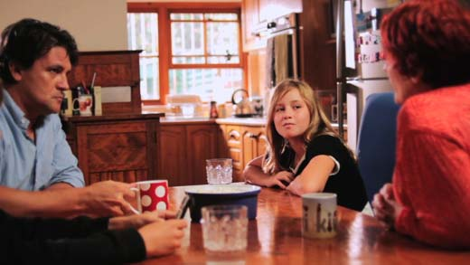

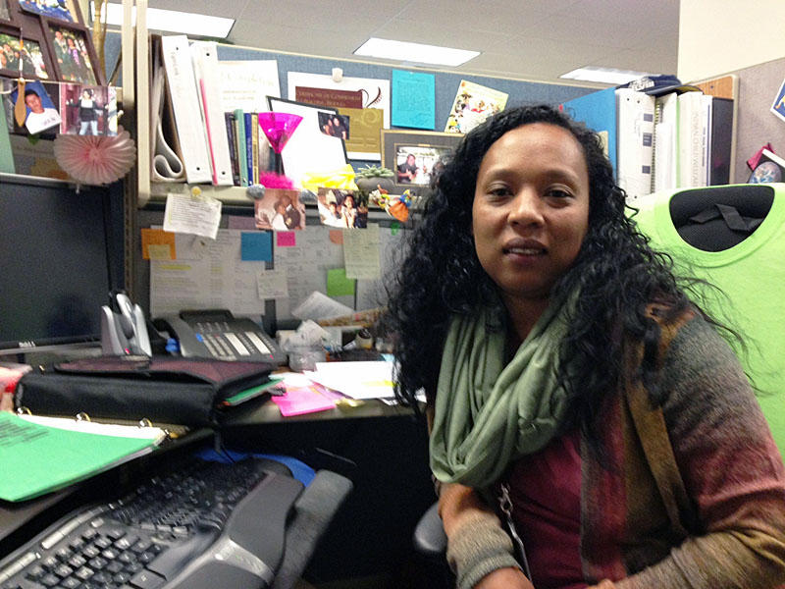
What is the ongoing assessment process?
Information is collected to assess and monitor and support a family’s progress in almost every ongoing activity of the Case Manager.
Pre-Service CM Specialty Module 9.1.4

Slide 7
Ongoing Assessment Documentation
CASE NOTES
MEETINGS
Pre-Service CM Specialty Module 9.1.5

Slide 8
Purpose of Ongoing Assessment
Are we keeping the child safe?
Are parent(s) making progress towards strengthened protective capacities?
Is the child experiencing improved well-being and stability?
Is the case plan working effectively to achieve permanency?
Pre-Service CM Specialty Module 9.1.6

Slide 9


Activity A:
Finding Information
Instructions:
In small groups, for the topic you were assigned, identify what information you would be looking for and how you would obtain that information.
Be prepared to discuss.
Pre-Service CM Specialty Module 9.1.7

Slide 10
Unit 9.2
Progress Update
Notes:
11.1.4

Slide 11
Learning Objectives
Describe the purpose of and sufficient information needed to complete a Progress Update.
Describe the sufficient information needed to complete a Judicial Review.
Explain the assessment of family time.
Practice the evaluation of case plan outcomes.
Pre-Service CM Specialty Module 9.2.2

Slide 12

What is the Progress-Update?
A formalized assessment that occurs on a regular basis after the development and implementation of the case plan.
Pre-Service CM Specialty Module 9.2.3

Slide 13
Progress Update
Insert screen shot of Progress Update
Pre-Service CM Specialty Module 9.2.4

Slide 14
When Progress-Updates Occur
Every three months OR Critical Junctures including:
  Birth or death of a sibling
  The addition of a new family member, including intimate partners
  Before changing the case plan to include unsupervised visits
  Before reunification and establishment of an in-home safety plan
  Before recommending case closure
  When a case is dismissed by court
  As needed based on professional judgment
Pre-Service CM Specialty Module 9.2.5

Slide 15
Case Manager Role During
Progress Update
Explain to parent(s) the purpose of regular, formal progress evaluation
Listen and learn parent(s) motivations, values, and concerns
Facilitate sharing of feedback among team members
Attempt to build team agreement on progress being made and next steps
Complete documentation of formal Progress Update
Pre-Service CM Specialty Module 9.2.6

Slide 16

Worksheet: Progress Update Facilitative Objectives
Pre-Service CM Specialty Module 9.2.7

Slide 17
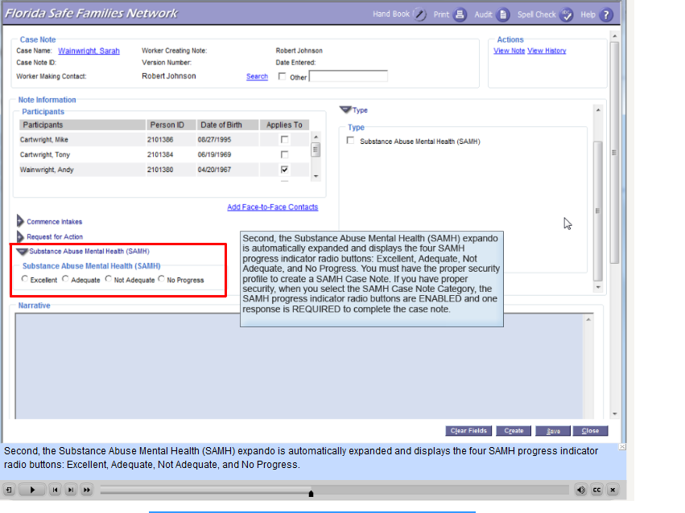
FSFN: Substance Abuse Provider Case Notes
Pre-Service CM Specialty Module 9.2.8

Slide 18

FSFN: Substance Abuse Provider Progress Reports
Pre-Service CM Specialty Module 9.2.9

Slide 19
Areas of Assessment on
Progress Update
Reason for Ongoing Involvement
Child Needs
Protective Capacities & Family Change Strategies
Outcomes Evaluation
Family Assessment Areas
Safety Summary and Planning
Pre-Service CM Specialty Module 9.2.10

Slide 20
Additional Assessment Areas in Judicial Reviews
Visitation/Family Time
Placement
Additional Child Information
Family Change Strategies/Resources
Review Summary
Pre-Service CM Specialty Module 9.2.11
Notes:
10

Slide 21
Judicial Review Worksheet
Pre-Service CM Specialty Module 9.2.12

Slide 22

Visitation/Family Time
Assess quality
Assess frequency
Find ways to improve visitation
Pre-Service CM Specialty Module 9.2.13

Slide 23
Child Placement Information
Strengths of placement
Problems with placement?
Is child placed with siblings?
Is placement conducive to parent visitation?
Is placement least restrictive?
Did child change schools?
Efforts to place with siblings; closer proximity to parent(s); in child’s school district?
Pre-Service CM Specialty Module 9.2.14

Slide 24
Additional Child Information
Prefills with information from Medical/Mental Health and Education records in FSFN
Summary of current medical, mental health, information is created
Information about child’s Master Trust Account (if any)
Independent Living Skills information for children 13 years and older
Pre-Service CM Specialty Module 9.2.15

Slide 25
Summary of Child Needs and Protective Capacities
Information that automatically pre-fills the Judicial Review from the completed Progress Update:
Child functioning description and Child Strengths and Needs ratings.
Adult and Parenting functioning descriptions and Caregiver Protective Capacity ratings.
Pre-Service CM Specialty Module 9.2.16

Slide 26

Assessing Outcomes
Excellent Progress
Acceptable Progress
Not Adequate Progress
No Progress
Pre-Service CM Specialty Module 9.2.17

Slide 27
Examples of Progress Achievement
Outcome:
Ms. Dalhart takes action appropriate to situations involving her parenting and protective responsibilities.
Excellent Progress:
The judgment is that Ms. Dalhart is becoming action oriented in general and as a caregiver. The behavioral evidence is:
  Ms. Dalhart performs her duties and responsibilities when necessary.
  Ms. Dalhart proceeds with a course of action.
  Ms. Dalhart takes necessary steps.
  Ms. Dalhart does think expediently and timely.
  Ms. Dalhart discharges her duties in a timely and appropriate manner.
Pre-Service CM Specialty Module 9.2.18

Slide 28
Outcomes for Sandler/Braun Case: Mr. Braun
Outcome:
Bruce will recognize how his alcohol use and aggressiveness negatively impact his family. Bruce will control these urges and seek healthy means to cope with his frustrations.
Outcome will be achieved when:
He will recognize how his alcohol use and aggressiveness negatively impact his family.
He is able to refrain from excessive alcohol consumption and develops a lapse/relapse plan to protect his family.
He develops positive coping mechanisms for his frustrations.
Pre-Service CM Specialty Module 9.2.19

Slide 29
Outcomes for Sandler/Braun Case: Ms. Braun
Outcome:
Melanie will demonstrate recognition of when Bruce’s alcohol use and aggressive behavior negatively impacts their children she will take immediate action to protect the children when needed.
Outcome will be achieved when:
She understands the impact of Mr. Braun’s drinking on her family.
She will understand and recognize Mr. Braun’s triggers
She has developed and implemented a plan keep the children safe in the event of a relapse.
Pre-Service CM Specialty Module 9.2.20

Slide 30
Outcomes for Sandler/Braun Case: Both Parents
Outcome:
Both parents will be in agreement with, and consistently use, acceptable parenting methods to manage James’ behavior.
Outcome will be achieved when:
The parents are able to follow through with acceptable discipline and behavior management methods with James
The parents are able to communicate and remain consistent with consequences.
Pre-Service CM Specialty Module 9.2.21

Slide 31
Activity B:
Progress Ratings and the Sandler/Braun Case
Instructions:
In small groups, using your assigned topic:
  Determine which outcome rating you would apply for each of the three outcomes.
  Justify your ratings by identifying the information from the notes that support your choice.
  Identify one or more criteria for the outcome rating above the one selected that supports your decision not to select a higher rating.
Be prepared to discuss.
Pre-Service CM Specialty Module 9.2.22

Slide 32
Unit 9.3
Modifications to the
Case Plan and Family Time
Notes:
11.1.4

Slide 33
Learning Objectives
Review the actions that should result from a Progress Update.
Describe the reasons for parents not participating in family time or negative child behaviors and possible solutions.
Describe the process for case plan modifications.
Pre-Service CM Specialty Module 9.3.2

Slide 34

Now what?
Pre-Service CM Specialty Module 9.3.3

Slide 35

Results of Progress Evaluation
No Change
Change in Safety Plan
Change in Family Time Plan (if removal)
Change in Case Plan
Pre-Service CM Specialty Module 9.3.4

Slide 36
Changes in Safety Plan
Increase or decrease level of restrictiveness of any type of plan
Change in-home plan to out-of-home
Conditions for Return are met- Reunify
Pre-Service CM Specialty Module 9.3.5

Slide 37
Conditions for Return Met =
Reunification Planning
How will I know when:
Parents are now willing to accept in-home plan and cooperate…
Home environment is now calm and consistent enough…
Safety services are available at a sufficient level…
No further professional evaluations are needed at this time…
The parent(s) have an adequate physical location….
Pre-Service CM Specialty Module 9.3.6

Slide 38
Activity C:
Caregiver Behaviors
Instructions:
In your small group, develop a report on the criteria you were assigned. Make sure to answer the following questions:
  What are we seeking to learn about the parent at this point to know that their situation is different?
  What information would be an indicator that the parent is not yet where they need to be (meaning that they do not yet meet the specific criteria)?
Be prepared to discuss.
Pre-Service CM Specialty Module 9.3.7

Slide 39

Visitation/Family Time
The Case Manager has many opportunities to promote better quality family time.
Pre-Service CM Specialty Module 9.3.8

Slide 40

“Improving Parent –
Child Visits”
Pre-Service CM Specialty Module 9.3.9

Slide 41

Modifications to Case Plans
Identifying and implementing solutions related to services/treatment access.
Enlisting the provider’s assistance.
Changing providers.
Other strategic changes.
Identifying outcomes achieved.
Pre-Service CM Specialty Module 9.3.10

Slide 42
Unit 9.4
Achieving Safe Case Closure
Notes:
11.1.4

Slide 43
Learning Objectives
Review the steps on how to safely close a case.
Pre-Service CM Specialty Module 9.4.2

Slide 44
Reasons for Case Closure
The caregiver has substantially achieved all of the outcomes in the case plan pertaining to improved caregiver protective capacities and a safety plan is no longer needed.
The caregiver has not achieved outcomes in a case plan and:
  A relative or non-relative has obtained legal custody of the child.
  Parental rights have been terminated and child has achieved a permanency goal.
Pre-Service CM Specialty Module 9.4.3
Notes:
11.1.6

Slide 45

Planning Case Closure:
Who to Contact
The Parent
Safety Plan Providers
GAL
Service Providers
Supervisor
Pre-Service CM Specialty Module 9.4.4

Slide 46

Closure:
Cases Involving Court Supervision
There must be a termination summary or court report made explaining the basis for requesting termination.
Pre-Service CM Specialty Module 9.4.5

