Slide 1

DCF
Child Welfare and Child In Care Eligibility Webinar
Notes:
RJR

Slide 2
Why change, … why now?
  Feedback from FSFN and FLORIDA users
  New Laws impacting eligibility
  Recommendations from audits and reviews
  Requirement to achieve Statewide Automated Child Welfare Information System (SACWIS) compliance
Why change?
  FLORIDA has a new rules engine
Why now?

Slide 3
FLORIDA - FSFN Enhancement – The Big Picture
Phase I – FLORIDA system enhancements - July 14, 2014
Fully Automate Medicaid Eligibility Process
Phase II – FSFN system enhancements - December 2014
Phase III – FSFN and FLORIDA interface enhancements - Spring 2015
Fully Automated FSFN Submission to FLORIDA
Automates Foster Care and Adoption Eligibility in FSFN
Project Complete!

Slide 4

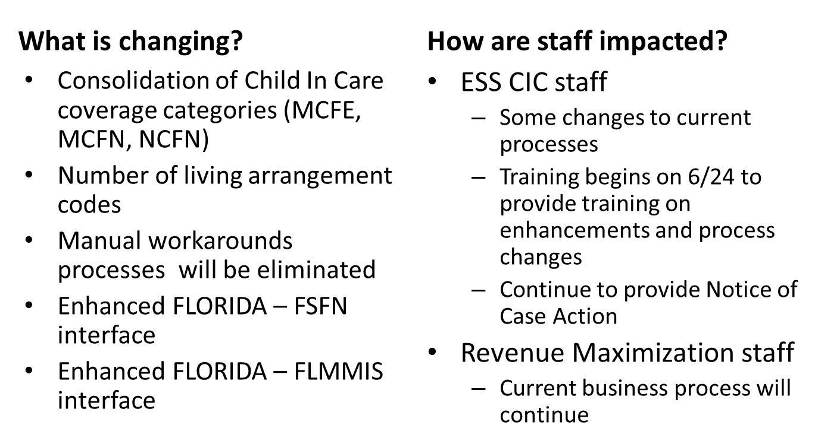

Slide 5
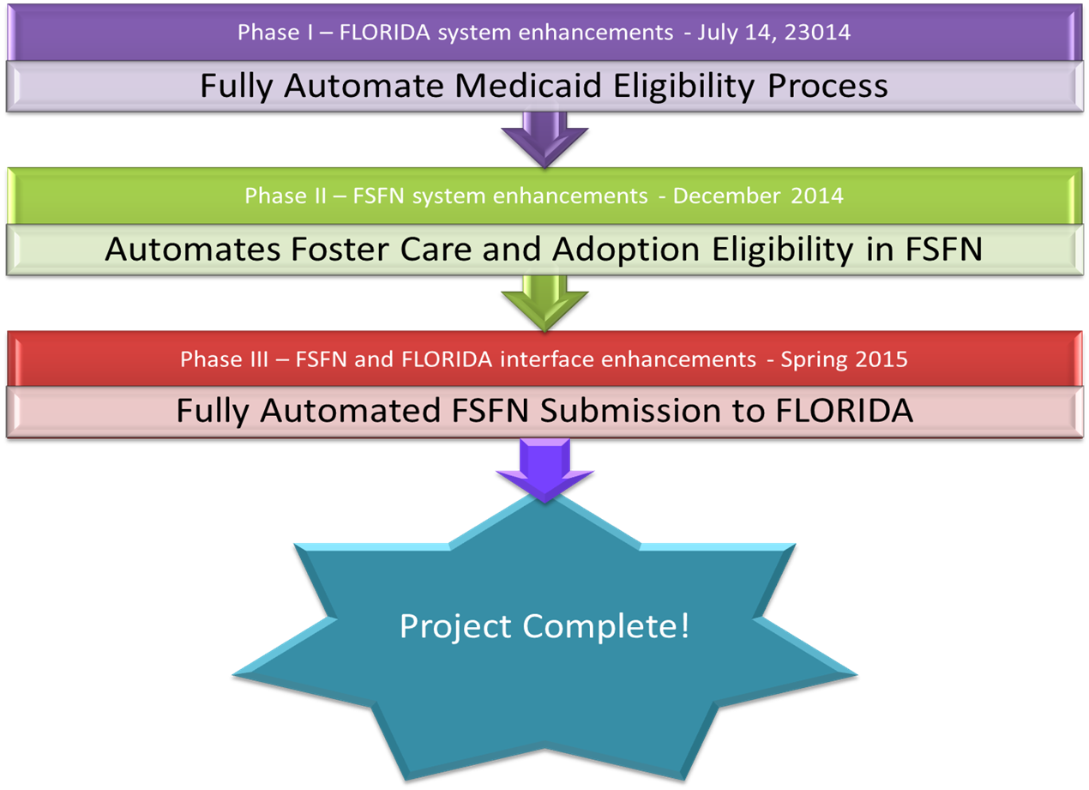
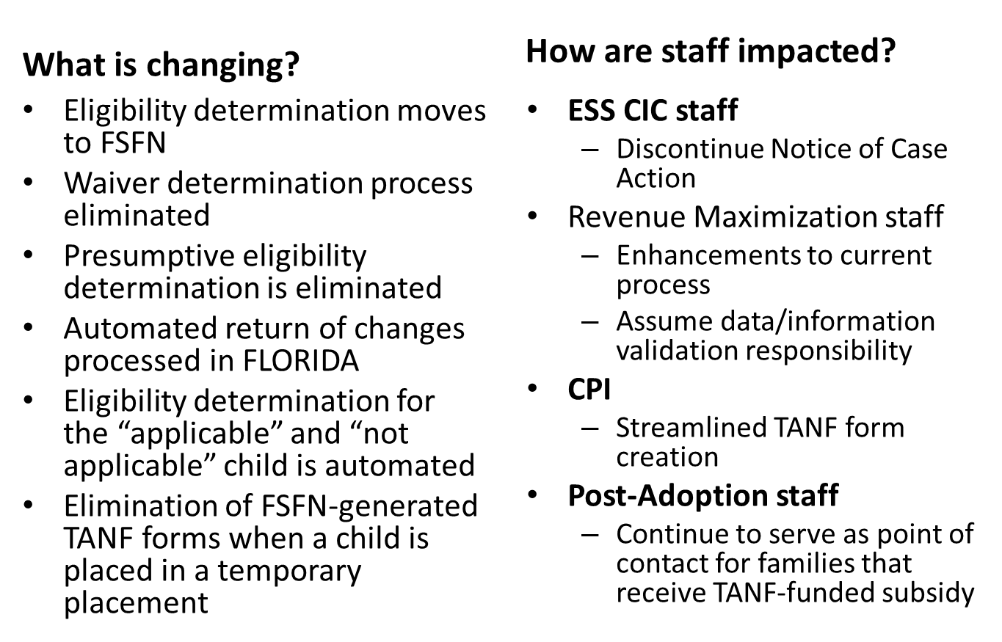

Slide 6
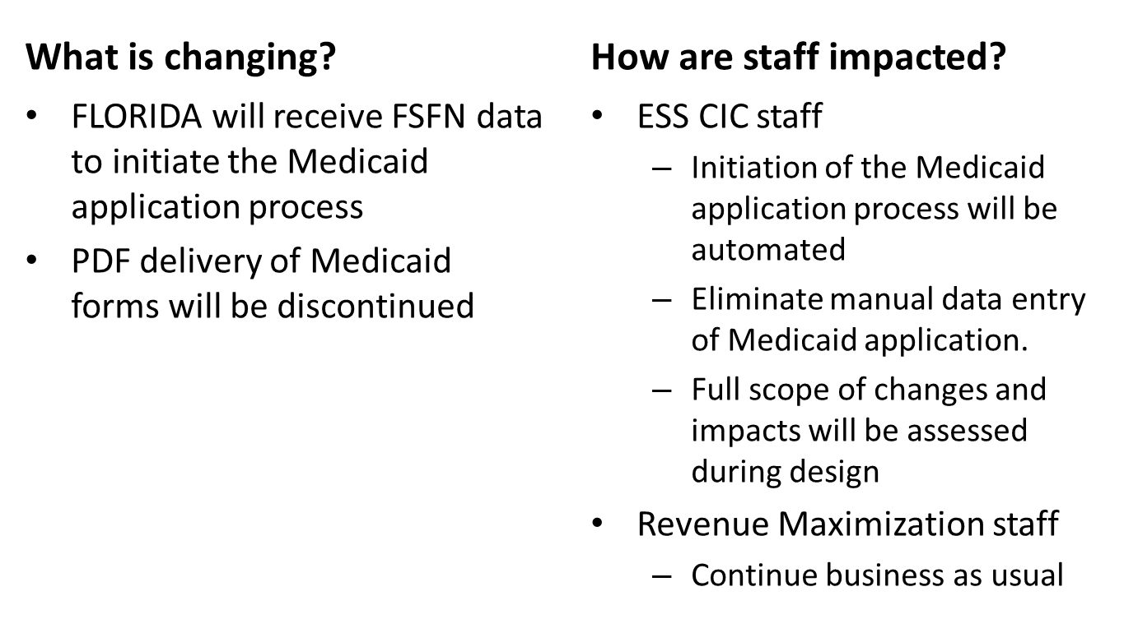

Slide 7
Child in Care System Enhancement Overview
System Enhancements to the Economic Self-Sufficiency (ESS) Child In Care (CIC)
eligibility Medicaid coverage process:
  Consolidation of Medicaid Coverage groups
  Addition of 4 New Living Arrangement Codes
    CINS/FINS, Independent Living, Private Adoption, Interstate Compact
  Updated Title IV- E and Non-Title IV-E Driver Flow Process
MCFE
  Will contain all Title IV-E cases
MCFN/NCFN
  Will contain all Non-Title IV-E cases

Slide 8
Child In Care Work Flow Process
Child Welfare staff will notate child’s preliminary Title IV-E eligibility in comments section of the Medicaid application
The process and driver flow used to determine and/or authorize Medicaid eligibility will depend on if the case is identified as Title IV-E or non Title IV-E
Continue suppressing notices in the FLORIDA system
Continue completing a manual Notice of Case Action (NOCA)
Child Welfare continue to notify ESS staff of any changes that will modify coverage
Note : Once FSFN is modified in 2015, manual notices no longer required
Notes:
Business will continue as usual.

Slide 9
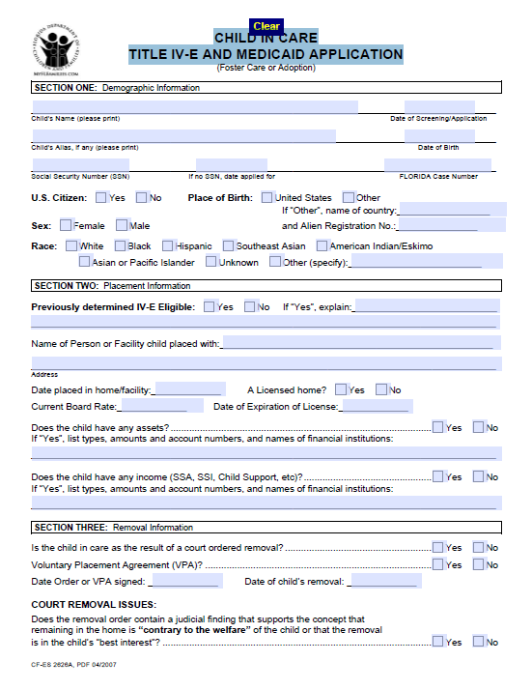
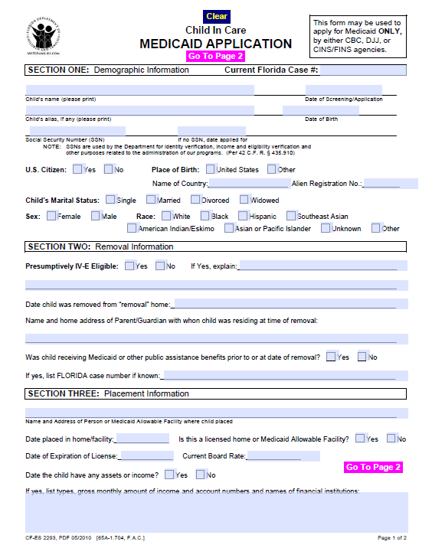
Application
The following application should be used when requesting CIC Medicaid:
CF-ES 2626-A Child In Care Title IV-E and Medicaid Application (Page 1)
CF-ES 2293 Child In Care Medicaid Application (Page 1)
Notes:
One of the two following applications will be submitted for Medicaid for a child in care: 2293 or the 2626A.
They all can be found in DCF forms.

Slide 10
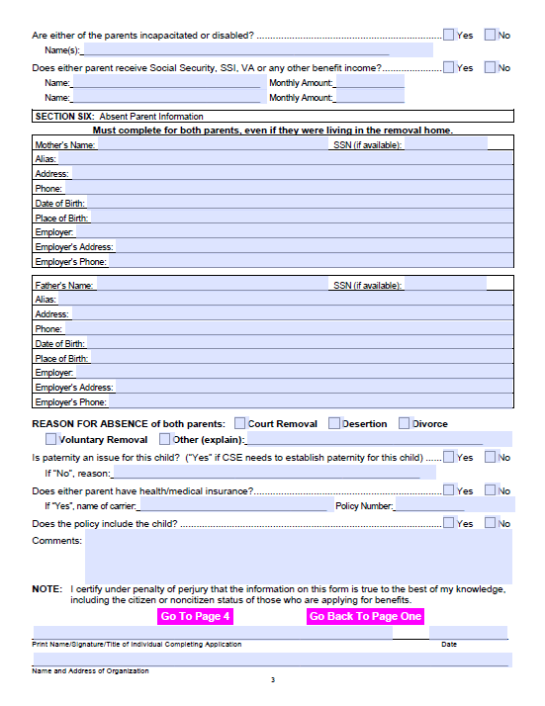
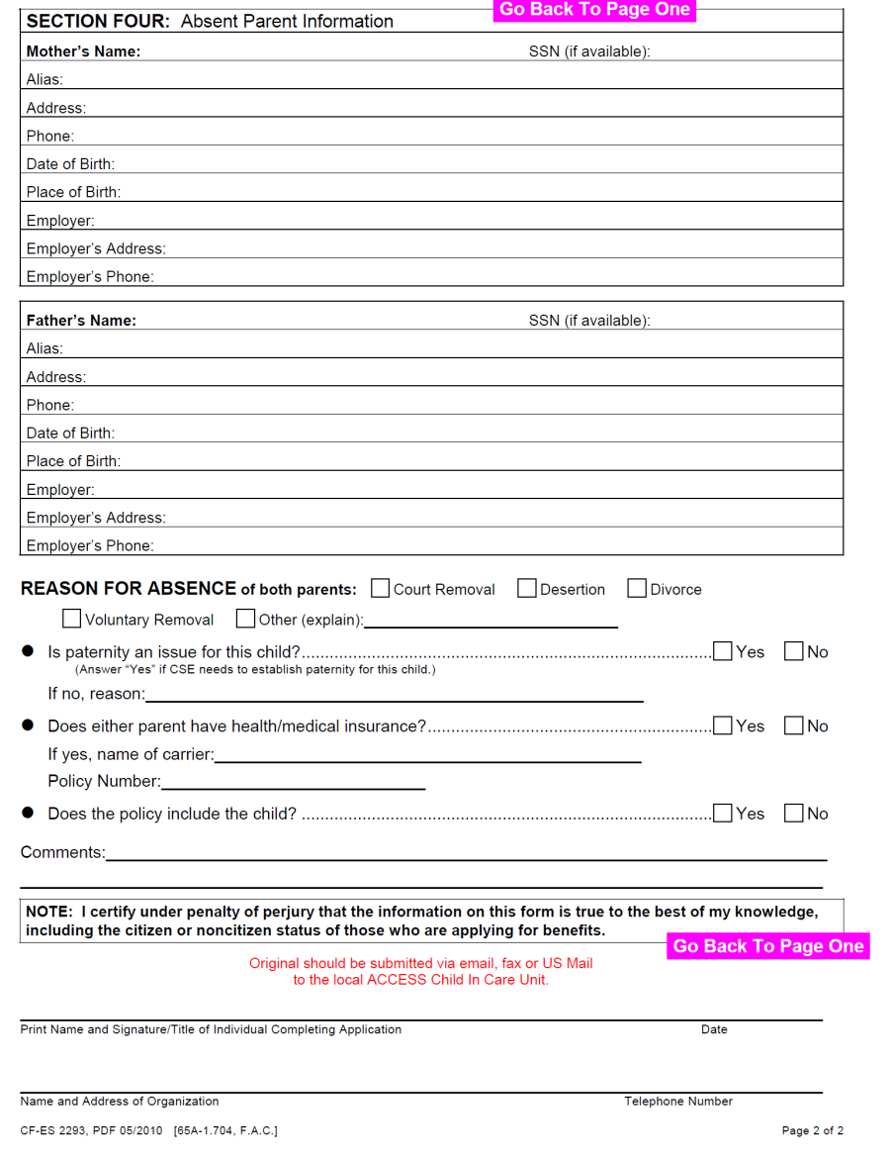
Application
The following application should be used when requesting CIC Medicaid:
Review the comments section for results of preliminary assessment
CF-ES 2626-A Child In Care Title IV-E and Medicaid Application (Page 3)
CF-ES 2293 Child In Care Medicaid Application (Page 2)
Notes:
Make sure you review the comments sections of both forms, because Rev Max and the CBC will entering comments as to whether or not the child has been preliminarily assessed as IV-E eligible or not.
If there are no comments, the case should be processed as a Non-Title IV-E case.

Slide 11
Medicaid Work Flow Process
At Removal
  Revenue Maximization staff checks FLORIDA Screen IQEL: Does the child have Medicaid?
  If yes
    Determine Title IV-E Eligibility
    Request Medicaid change to CIC
  If no
    Apply for emergency Medicaid
    Determine Title IV-E Eligibility
    Request Medicaid change to CIC
Medicaid
At discharge or when the child turns 18
  No change; young adult maintains Medicaid eligibility and enrollment

Slide 12
FSFN System Enhancement Overview
What is Changing?
  Elimination of FSFN-generated TANF forms when a child is placed in a temporary placement.
  Logic and calculations
TANF
Foster
Care
  Revenue Maximization staff
  Child Protective Investigators
Who is impacted?

Slide 13
FSFN System Enhancement Overview
What is Changing?
  Eligibility redetermination questions
  Logic and calculations
  Reports
TANF
Maintenance Adoption Subsidy
  Revenue Maximization staff
  Post-adoption Case managers
Who is impacted?

Slide 14
FLORIDA and FSFN Systems Enhancement Overview
What is Changing?
  Eligibility determination moves to FSFN
  Presumptive eligibility determination is eliminated - - continue to process eligibility screening
  Dynamic display of questions
  Reports
Title IV-E Foster Care
  Revenue Maximization staff
  ESS CIC staff
Who is impacted?

Slide 15
FLORIDA and FSFN Systems Enhancement Overview
What is Changing?
  Eligibility determination moves to FSFN
  Eligibility determination for the “applicable” and “not applicable” child is automated
  Dynamic display of questions
  Reports
Title IV-E Maintenance Adoption Subsidy
  Revenue Maximization staff
  ESS CIC staff
Who is impacted?

Slide 16
FSFN System Enhancement Overview
What is Changing?
  New information added
  Links to eligibility screens
FSFN Person Management Page
  Revenue Maximization staff
Who is impacted?

Slide 17
FLORIDA - FSFN Enhancement – The Big Picture
Phase I – FLORIDA system enhancements - July 14, 2014
Fully Automate Medicaid Eligibility Process
Phase II – FSFN system enhancements - December 2014
Phase III – FSFN and FLORIDA interface enhancements - Spring 2015
Fully Automated FSFN Submission to FLORIDA
Automates Foster Care and Adoption Eligibility in FSFN
Project Complete!

Slide 18
DCF Central Office Contacts
  Questions?
  Contact Dianna Laffey at Dianna_Laffey@dcf.state.fl.us or
  Mukweso Mwenene at Mukweso_Mwenene@dcf.state.fl.us

