Slide 1
Pre-service
Orientation
Notes:
1.0.1

Slide 2
Agenda
Introduction Activity – Ice Breaker
Secretary’s Message
Introduction to the Department
Introduction to Child Welfare
Team Building Exercise
Program Agenda for CORE and Specialty Tracks
Labs / Fieldwork Requirements
Florida Certification Board Requirements
Question and Answer Session
Notes:
1.0.2

Slide 3
Secretary’s Welcome
Notes:
1.1.2

Slide 4
DCF Programs
Office of Self Sufficiency
Adult Protective Services
Child Care
Domestic Violence
Child Welfare (Family Safety)
Homelessness
Substance Abuse and Mental Health
Refugee Services

Slide 5
Office of Child Welfare
Florida Abuse Hotline
Child Protective Investigations
Community Based Care
Case Management
Foster Care
Adoptions
Children’s Legal Services
Interstate Compact on the Placement of Children

Slide 6
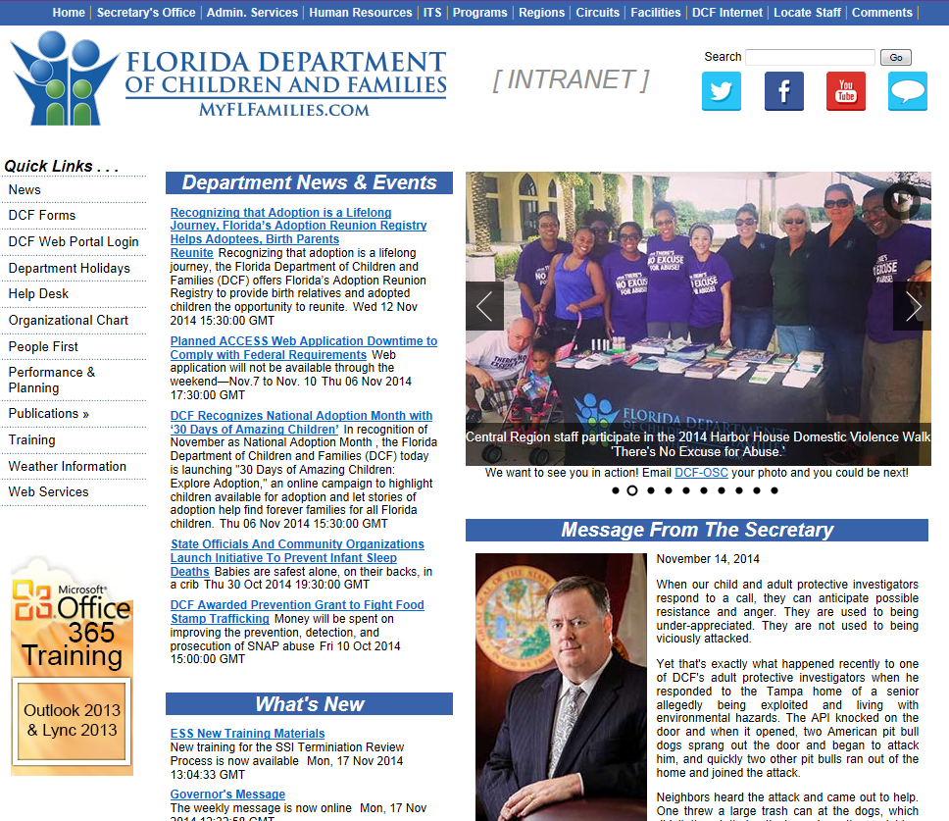
http://eww.dcf.state.fl.us/
Notes:
1.5.3

Slide 8
Introduction to
Child Welfare
Notes:
1.1.4

Slide 9
Activity The Value of Team Work
Notes:
1.1.3

Slide 10
CORE Pre-Service Curriculum
Orientation
M1: The Child Welfare System (3)
M2: Florida’s Child Welfare Practice Model (2)
M3: Child Development (6)
M4: Trauma and the Child (6)
Lab 1: Foundations for Interviewing (6)
Lab 2: Exploring Skills (6)
Lab 1 & 2: Structured Field Day -observing exploring skills
M5: Family Conditions (6)
M5: Family Conditions (3)
Lab 3: Focusing Skills (6)
Labs 1-3: Structured Field Days - Shadowing / exploring and focusing skills
M6: Understanding Child Maltreatment (6)
M6: Understanding Child Maltreatment (6)
M6: Understanding Child Maltreatment (6)
M6: Understanding Child Maltreatment (6)
Lab 4: Child Interviewing (6)
Lab 4: Child Interviewing (6)
Lab 4: Structured Field Day - Shadowing / observation and practice child interviewing
M7: Assessment and Analyzing Family Functioning (6)
Lab 5: Interviews to learn about Maltreatment Surrounding Circumstances and family functioning (6)
Structured Field Day: Shadowing/observing & practice adult functioning, parenting, child discipline (6)
M8: Safety & Risk (6)
M8: Safety & Risk (6)
M9: Safety Planning (6)
M10: Readiness Assessment (6)

Slide 11
Pre-Service Curriculum
Protective Investigator
Case Management
CORE
Licensing
Adoptions
Hotline

Slide 12
CORE Modules
Module 1: The Child Welfare System
Module 2: Florida’s Child Welfare Practice Model
Module 3: Child Development
Module 4: Trauma and the Child
Module 5: Family Conditions
Module 6: Understanding Maltreatment
Module 7: Assessing and Analyzing Family Functioning
Module 8: Safety and Risk
Module 9: Safety Planning
Module 10: Readiness Assessment

Slide 13
Labs/Fieldwork Requirements
Lab 1: Foundations for Interviewing
Lab 2: Exploring Skills
Lab 3: Focusing Skills
Lab 4: Child Interviewing Skills
Lab 5: Interviews to Learn about Adult Functioning, Maltreatment and Circumstances Surrounding

Slide 14
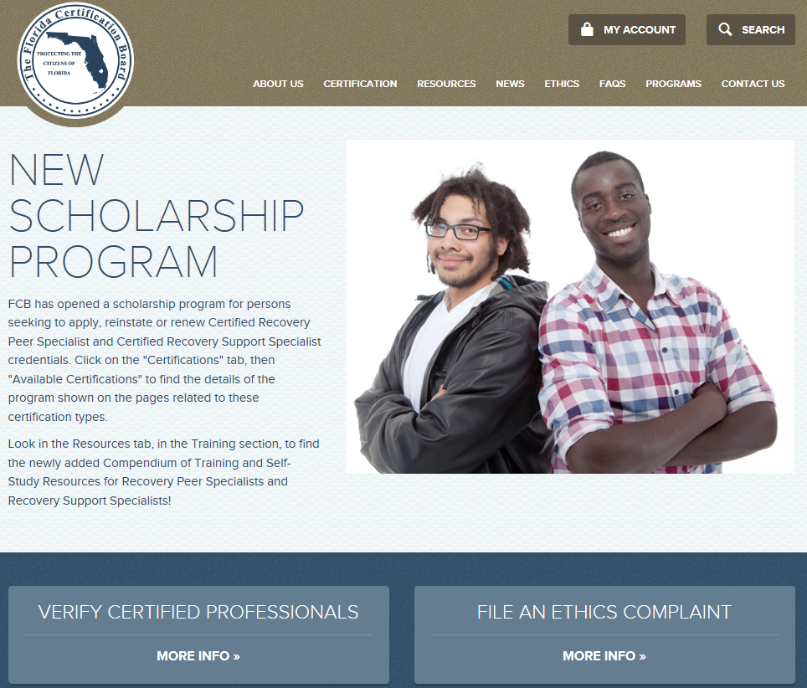
Florida Certification Board

