Slide 1

Module 9
Safety Planning
Notes:
8.0.1

Slide 2

Workshop Agenda
Pre-Service Curriculum Module 9.0.2
Notes:
This slide is not in the participant guide.

Slide 3
Unit 9.1
What are Safety Plans?
Pre-Service Curriculum Module 9.1.1

Slide 4

Learning Objectives
Pre-Service Curriculum Module 9.1.2
Notes:
12.1.5

Slide 5

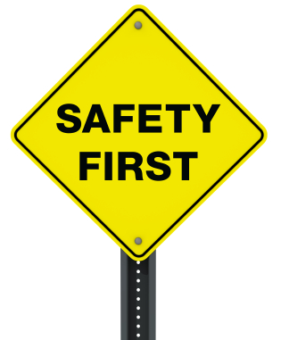
What is a Safety Plan?
A written arrangement between caregivers and the agency that establishes how danger threats to child safety will be managed
Must be implemented, active, and vigorously managed as long as threats to child safety exist and caregiver protective capacities are insufficient to assure a child is protected in the home
Chapter 39.301(9)(a)6, F.S.
Pre-Service Curriculum Module 9.1.3

Slide 6
Two Types of Danger
PRESENT DANGER
Immediate
Significant
Clearly Observable
Family condition that is occurring in the present tense
IMPENDING DANGER
State of Danger in which family behaviors, attitudes, motives, emotions, and/or situations pose a threat to a child which may not be currently active, but can be anticipated to have severe effects on a child
Chapter 39.301(9)(a)6, F.S.
Pre-Service Curriculum Module 9.1.4

Slide 7
Controlling for Danger
What and | Present Danger Safety Plan | Impending Danger Safety Plan
When | Initial Contact | Conclusion of Family Functioning Assessment
Why | Control safety | Control safety
What | Present Danger | Impending Danger
Purpose | Manage present danger while completing information collection and Family Functioning Assessment | Manage Impending Danger while allowing treatment and intervention services to occur
Pre-Service Curriculum Module 9.1.5

Slide 8
Safety Plans
Focused on stabilizing activities, observation and supervising.
Manages or controls the condition that results in a child being unsafe
Effective by using both formal and informal providers.
Effect must be immediate.
Pre-Service Curriculum Module 9.1.6

Slide 9
Case Plans
Case plans are concerned with making differences—with outcomes with self-sustainable change.
Help create fundamental change in functioning and behavior that is associated with the reason that the child is unsafe.
By that very established premise, a case plan and the service found on a case plan cannot and do not control safety threats and should not be used on a Safety Plan.
Pre-Service Curriculum Module 9.1.7

Slide 10

Scope of Safety Plans
Use of in-home, out-of-home, combination of actions
Clarification of the role of parents (caregivers) in the plan
Protective role of others
Specification of the safety services from a limited to extensive perspective
Use and responsibility of the family network and professionals
Parent (caregiver) access to child
Identification and rationale for different kinds of separation
Anticipated time limits that govern separation
Pre-Service Curriculum Module 9.1.8

Slide 11

Criteria for Safety Plans
Must control or manage Impending Danger
Must have an immediate effect
Must be immediately accessible and available
Must contain safety actions only
No promissory commitments
Pre-Service Curriculum Module 9.1.9

Slide 12
Unit 9.2
Safety Planning Analysis and Conditions for Return: Purpose
Pre-Service Curriculum Module 9.2.1

Slide 13
Learning Objectives
Pre-Service Curriculum Module 9.2.2
Notes:
12.1.5

Slide 14
Safety Planning: True or False
Reunifying a child with his family is based on caregivers meeting case plan outcomes.
A central thought on caregivers’ minds when CPS is involved is what is necessary to get their children returned to them and get the agency out of their lives.
Conditions for return are criteria for reunification and for the purpose of keeping kids safe at home with an in-home safety plan.
Pre-Service Curriculum Module 9.2.3

Slide 15
Safety Planning: True or False
Child placement is the option agencies use when a safety plan will not work.
Child placement should be viewed as a temporary safety management response that is most intrusive.
Child placement is necessary until threats to a child’s safety are gone.
Caregivers deserve to know exactly what is required in order to get their children returned home.
Pre-Service Curriculum Module 9.2.4

Slide 16
Safety Planning Analysis and Conditions for Return
Impending Danger must be understood to determine sufficient safety management
Safety Planning Analysis and Conditions for Return logically correspond with how impending danger is occurring
  Frequency
  Intensity
  Influences
Specific to caregiver willingness, acceptance, and capacity for in-home safety management
Understandable
Necessary and Allow for an in-home safety plan
Pre-Service Curriculum Module 9.2.5

Slide 17

Safety Plan Analysis: In-Home or Out-of-Home?
Analyze the relationship between specific pieces of information for determining the degree of intrusiveness and the level of effort necessary for assuring that the safety plan will be reasonably effective in protecting a child in his/her home.
Pre-Service Curriculum Module 9.2.6

Slide 18

Safety Planning Analysis Criteria #1
The parents/legal guardians are willing for an in-home safety plan to be developed and implemented and have demonstrated that they will cooperate with all identified safety service actions and safety resources/providers.
Pre-Service Curriculum Module 9.2.7

Slide 19
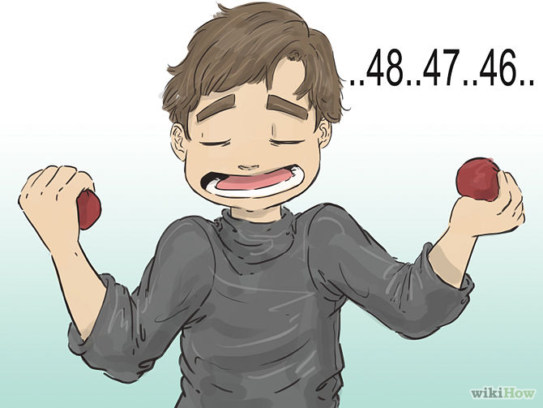
Safety Planning Analysis Criteria #2
The home environment is calm and consistent enough for an in-home safety plan to be implemented and for safety actions and safety resources/service providers to be in the home safely.
Pre-Service Curriculum Module 9.2.8

Slide 20

Safety Planning Analysis Criteria #3
Safety resources/services are available at a sufficient level and to the degree necessary in order to gauge the way in which impending danger is manifested in the home.
Pre-Service Curriculum Module 9.2.9

Slide 21

Safety Planning Analysis Criteria #4
An in-home safety plan and the use of in-home safety resources and services can sufficiently manage impending danger without the need for results of a professional evaluation.
Pre-Service Curriculum Module 9.2.10

Slide 22

Safety Planning Analysis Criteria #5
The parents/legal guardians have a physical location in which to implement an in-home safety plan. (shelter, tent, house, etc.)
Pre-Service Curriculum Module 9.2.11

Slide 23
Safety Planning Analysis:
In-Home or Out-of-Home?
IN HOME:
Safety planning analysis supports the development of an in-home safety plan;
Safety Analysis Criteria are supported and identified as being present;
No conditions for return needed-as child would be on an in-home plan.
OUT-OF-HOME:
Safety planning analysis does not support the development of an in-home safety plan;
Safety Analysis Criteria that were not supported and/or identified as not being present are the FOUNDATION for Conditions for Return.
Pre-Service Curriculum Module 9.2.12

Slide 24
The Concept of Conditions for Return
A written statement identifies specific circumstances that must exist within a child’s home to implement an in-home safety plan so that a child who is placed can be returned to his or her parents/caregivers.
What is necessary for children to be reunified with their family are circumstances which support “Yes” conclusions on the safety planning analysis questions required for an in home safety plan:
  Acceptable home environment residence/environment
  Cooperative, willing and able caregivers
  Sufficient in-home safety service resources
Pre-Service Curriculum Module 9.2.13

Slide 25

Applying Concepts to Practice
In small groups of 4:
  Review written case information: FFA
  Review the safety planning analysis and conditions for return
  Identify areas for questions regarding case practice
Pre-Service Curriculum Module 9.2.14
Notes:
Exercise will take approximately 90 minutes.

Slide 26
Activity: Applying Concepts
In small groups of 4:
  Review written case information: FFA
  Complete the worksheets based upon the FFA
Pre-Service Curriculum Module 9.2.15

Slide 27
Practice: Conditions for Return
Safety Planning Analysis for Morgan Family:
  Criteria #1: No
  Criteria #2: Yes
  Criteria #3: Yes
  Criteria #4: Yes
  Criteria #5: No
Pre-Service Curriculum Module 9.2.16

Slide 28
Unit 9.3
Creating Sufficient Safety Plans
Pre-Service Curriculum Module 9.3.1

Slide 29
Learning Objectives
Pre-Service Curriculum Module 9.3.2
Notes:
12.1.5

Slide 30

Creating a Sufficient Safety Plan
A safety plan is sufficient when it is a well thought-out approach containing the most suitable people taking the necessary actions, frequently enough to control danger threats and/or substitute for diminished caregiver protective capacities.
Pre-Service Curriculum Module 9.3.3

Slide 31

Definition of In-Home Safety Services/Actions
Active and intentional efforts made by the Agency (CPI or Case Manager), the family, informal and formal resources that will assume the responsibility for assuring that a child’s basic needs and safety needs are met.
Pre-Service Curriculum Module 9.3.4

Slide 32

Safety Services
Managing Threatening Behavior
Managing Crisis
Providing for Social Support
Providing Resources
Providing for temporary separation between a child and adult
Pre-Service Curriculum Module 9.3.5

Slide 33
Who is Appropriate to Participate as Safety Service Providers?
Are safety service providers (formal or informal) suitable to participate on safety plans?
How do we know?
  Demonstration of awareness;
  Free from any of their own “concerns”;
  Aligned with the child and identifies threats;
  Aligned with priority for child safety;
  Has the resources needed to engage in safety services.
Pre-Service Curriculum Module 9.3.6

Slide 34

Developing the Safety Plan
Family centered
Willingness
Created in collaboration with family, service providers, and CPI/CM (Team Meeting/Safety Planning Meeting/TDM)
Supervisor Consultation to ensure sufficiency
Pre-Service Curriculum Module 9.3.7

Slide 35
Activity: Applying Concepts to Practice
Using the Safety Plan Sufficiency Criteria, determine if plan is or is not sufficient.
Pre-Service Curriculum Module 9.3.8

