Slide 1

Module 7
Assessment and Analyzing Family Functioning
Notes:
12.0.1

Slide 2

Agenda
Pre-Service Curriculum Module 7.0.2
Notes:
12.0.3

Slide 3
Unit 7.1
Information Collection Protocol
Pre-Service Curriculum Module 7.1.1
Notes:
12.1.4

Slide 4

Learning Objectives
Pre-Service Curriculum Module 7.1.2
Notes:
12.1.5

Slide 5
Information Collection
KNOW THE FAMILY
Extent of Maltreatment
Surrounding Circumstances
Child Functioning
Adult Functioning
Disciplinary Practices/Behavior Management
General Parenting Practices
Pre-Service Curriculum Module 7.1.3

Slide 6
Information Collection Domains
Maltreatment
Nature of, or Circumstances Surrounding the Maltreatment
Child Functioning
Adult Functioning
General Parenting
Parental Discipline
Pre-Service Curriculum Module 7.1.4

Slide 7

Activity
Information Collection
Pre-Service Curriculum Module 7.1.5
Notes:
11.8.165

Slide 8
Information Collection as a Competency
I know what information I must learn about a family. I know what information I must collect on each case I am assigned.
I understand the purposes or reasons for needing to know this information.
I demonstrate awareness that everything I do to reconcile and validate information influences the overall quality of the information.
I can discuss and write about the information I collected logically, succinctly, and in a way that justifies my conclusions.
Pre-Service Curriculum Module 7.1.6

Slide 9
Activity
Competencies
Pre-Service Curriculum Module 7.1.7
Notes:
11.8.165

Slide 10
Information Collection is Sufficient When:
Fully describes what has or is happening in each domain, providing a clear picture and accurate understanding without having to refer to additional material.
Is essential to gaining a full understanding or complete picture of the domain.
Adequately describes the role of other persons in the home or the family resource network.
Provides clear rationale for decision making and supports the identification of impending danger and diminished caregiver protective capacities.
Pre-Service Curriculum Module 7.1.8

Slide 11
Unit 7.2
Assessing the Extent of Maltreatment and Circumstances Surrounding Maltreatment
Pre-Service Curriculum Module 7.2.1
Notes:
12.1.4

Slide 12
Learning Objectives
Pre-Service Curriculum Module 7.2.2
Notes:
12.1.5

Slide 13
Extent of Maltreatment
What is occurring?
What has occurred?
What are the results of what has occurred?
Pre-Service Curriculum Module 7.2.3
Notes:
7.1.4

Slide 14

Surrounding Circumstances of Maltreatment
Pre-Service Curriculum Module 7.2.4
Notes:
11.8.164

Slide 15
Activity
Extent of Maltreatment
Pre-Service Curriculum Module 7.2.5
Notes:
11.8.165

Slide 16
Unit 7.3
Assessing Child Functioning
Pre-Service Curriculum Module 7.3.1
Notes:
3.8.1

Slide 17
Learning Objectives
Pre-Service Curriculum Module 7.3.2
Notes:
3.8.2

Slide 18
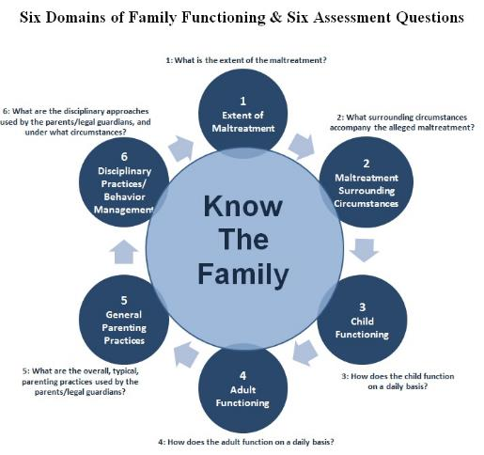
Child Functioning
Pre-Service Curriculum Module 7.3.3
Notes:
3.8.4

Slide 19
Child Functioning
Looks at how a child functions from day-to-day, including their current status and current needs, rather than what the child could do at a specific point in time. This information is qualified by age of the child or any special needs or developmental delays.
General behavior patterns
  Child’s ability to trust adults
  Sociability
  Sexual behavior
Emotions
  Self-awareness and acceptance
  Mood changes
Temperament
  Independence
  Assertiveness
Development
  Verbal skills / communication
  Motor skills
  Self-control
Academic Status
  Poor academic performance
  Intellect and mental performance
Physical capacity
  Vulnerability
  Ability to make needs known
  Play and work
  Eating and sleeping habits
Health status
  Medical condition that must be managed
  Symptoms of depression or trauma
Pre-Service Curriculum Module 7.3.4
Notes:
3.8.5

Slide 20
Activity
Analyzing Child Functioning
Pre-Service Curriculum Module 7.3.5
Notes:
3.1.15

Slide 21
Unit 7.4
The Parent/Caregiver as a Functioning Adult
Pre-Service Curriculum Module 7.4.1
Notes:
3.1.3

Slide 22
Learning Objectives
Pre-Service Curriculum Module 7.4.2
Notes:
3.1.4

Slide 23
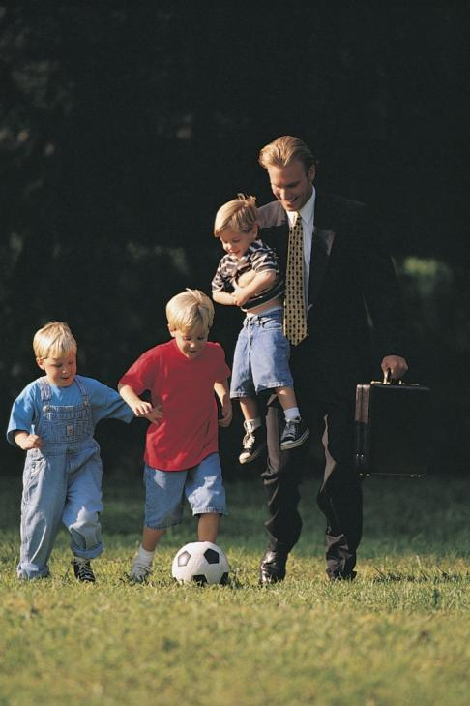

Who Cares For and Nurtures the Child?
Pre-Service Curriculum Module 7.4.3
Notes:
3.1.6

Slide 24
Behavioral
Emotional
Cognitive
Problem Solving
Decision Making and Judgment
Coping and Stress Management
Physical Health and Capacity
Home and Financial Management
Communication and Social Skills
Citizenship and Community Involvement
Functioning within Cultural Norms
Income and Employment
Family or Domestic Violence
Rationality
Substance Abuse
Mental Health
Self Control
Independence
Self Care and Preservation
Pre-Service Curriculum Module 7.4.4

Slide 25

Cognitive Functioning
Pre-Service Curriculum Module 7.4.5
Notes:
3.1.9

Slide 26

Emotional Functioning
Pre-Service Curriculum Module 7.4.6
Notes:
3.1.10

Slide 27

Behavioral Functioning
Pre-Service Curriculum Module 7.4.7
Notes:
3.1.12

Slide 28
Activity
Assessing Adult Functioning
Pre-Service Curriculum Module 7.4.8
Notes:
3.1.15

Slide 29
Activity
Analyzing Adult Functioning
Pre-Service Curriculum Module 7.4.9
Notes:
3.1.16

Slide 30
Unit 7.5
Parenting General
Pre-Service Curriculum Module 7.5.1
Notes:
3.1.3

Slide 31
Learning Objectives
Pre-Service Curriculum Module 7.5.2
Notes:
3.1.4

Slide 32
Cognitive
Reasons for Being a Caregiver
Knowledge and Skill
Emotional
Satisfaction in being a Caregiver
Expectations and Empathy
Behavioral
Parenting Style
History of Parenting Behavior
Decision Making
Protectiveness
Cultural Practices
Pre-Service Curriculum Module 7.5.3

Slide 33
Activity
Assessing General Parenting
Pre-Service Curriculum Module 7.5.4
Notes:
3.2.27

Slide 34
Activity
Analyzing Parenting General
Pre-Service Curriculum Module 7.5.5
Notes:
3.2.27

Slide 35
Unit 7.6
Parenting Discipline
Pre-Service Curriculum Module 7.6.2
Notes:
3.1.3

Slide 36
Learning Objectives
Pre-Service Curriculum Module 7.5.1
Notes:
3.1.4

Slide 37
Parenting Discipline Domain
Discipline is considered in a broader context than socialization; teaching and guiding the child. Usually, staff focuses on discipline only within a punishment context, so emphasis on the importance of viewing discipline as providing direction, managing behavior, teaching, and directing a child are considered in answering this question. Study here would include the parent's methods, the source of those methods, purpose or reasons for, attitudes about, context of, expectations of discipline, understanding, relationship to child and child behavior, meaning of discipline. Information that answers this question includes:
  a. Disciplinary methods
  b. Approaches to managing child behavior
  c. Perception of effectiveness of utilized approaches
  d. Concepts and purpose of discipline
  e. Context in which discipline occurs
  f. Cultural practice
Pre-Service Curriculum Module 7.6.3

Slide 38
Cognitive
Approaches to Managing Child Behavior
Perception of Effectiveness of Utilized Approaches
Emotional
Attitude about Discipline
Relationship to Child
Behavioral
Disciplinary Methods
Context in which Discipline Occurs
Concepts and Purpose of Discipline
Meaning of Discipline
Understanding
Expectations of Discipline
Child Behavior
Pre-Service Curriculum Module 7.6.4

Slide 39
Activity
Parenting Discipline
Pre-Service Curriculum Module 7.6.5
Notes:
3.2.27

Slide 40
Activity
Amy’s Parenting General
Pre-Service Curriculum Module 7.6.6
Notes:
3.2.27

