Slide 1

Module 4
Trauma and the Child
Notes:
4.0.1

Slide 2
Agenda
Unit 4.1: Trauma and its Impact on the Child
Unit 4.2: Approaching Children and Families in a Trauma Informed Manner
Unit 4.3: Referring and Advocating for the Child and Family in a Trauma-Informed Manner
Pre-Service Curriculum Module 4.0.2
Notes:
2.0.2

Slide 3
Unit 4.1
Trauma and Its Impact on the Child
Pre-Service Curriculum Module 4.1.1
Notes:
4.1.1

Slide 4

Learning Objectives
Pre-Service Curriculum Module 4.1.2
Notes:
4.1.2

Slide 5

What is Trauma?
Trauma is an emotional response to an event. The emotional response is intense, distressing and/or painful and can overwhelm your ability to cope. There can be direct involvement in the event or indirect through witnessing the event.
Pre-Service Curriculum Module 4.1.3
Notes:
3.4.5

Slide 6
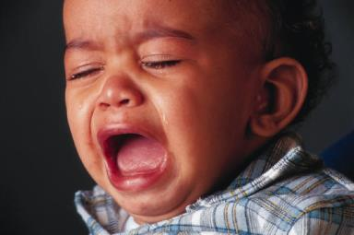
Stress and Trauma
Pre-Service Curriculum Module 4.1.4

Slide 7
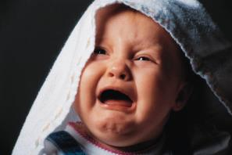
Types of Trauma
Early Childhood Trauma
Domestic Violence
Physical Abuse
Neglect
Sexual Abuse
Traumatic Grief
Persistent Absence of Responsive Care
Complex Trauma or Toxic Shock
Pre-Service Curriculum Module 4.1.5

Slide 8
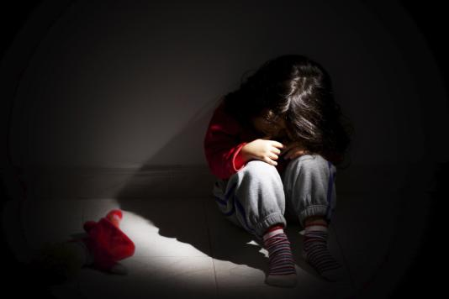
Childhood Trauma
Early childhood trauma: Children ages 0-6
Intentional violence – child physical or sexual abuse and/or domestic violence
Child neglect
Child traumatic grief
Complex trauma
Pre-Service Curriculum Module 4.1.6
Notes:
3.4.6

Slide 9

What is Child Traumatic Stress (CTS)?
Pre-Service Curriculum Module 4.1.7
Notes:
3.4.7

Slide 10

How Trauma Impacts the Child
Early Experiences and Development
Attachment
Pre-Service Curriculum Module 4.1.8
Notes:
3.4.8

Slide 11

Impact of Trauma on the Child’s Brain
Pre-Service Curriculum Module 4.1.9
Notes:
3.4.10

Slide 12
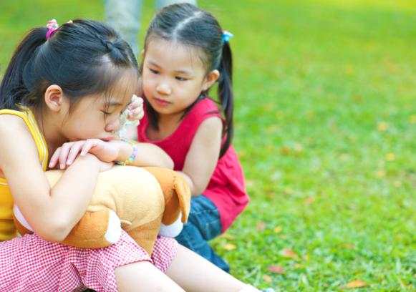
The Impact of Trauma on Very Young Children
Development is sequential
Maltreatment and trauma lead to infant and toddler vulnerability
Pre-Service Curriculum Module 4.1.10
Notes:
3.4.11

Slide 13
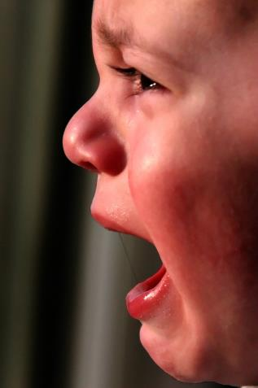
Impact of Traumatic Stress on Visible Behavior
Pre-Service Curriculum Module 4.1.11

Slide 14

Activity
What Did You See?
Pre-Service Curriculum Module 4.1.12
Notes:
3.4.9

Slide 15

Factors that Influence a Child’s Response to Trauma
Pre-Service Curriculum Module 4.1.13
Notes:
3.4.12

Slide 16
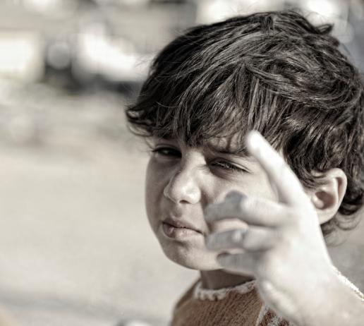
Behaviors Associated with Complex Trauma
Attachment
Biology
Affect/Emotions
Dissociation
Behavioral Control
Cognition Issues
Self-concept
Pre-Service Curriculum Module 4.1.14
Notes:
6.1.16

Slide 17
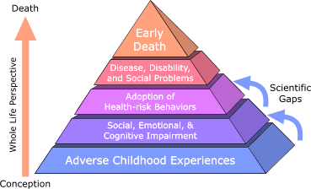
Adverse Childhood Experiences (ACE)
Pre-Service Curriculum Module 4.1.15
Notes:
3.4.16

Slide 18

Long-term Impact of Trauma
Toxic Stress
Generational Trauma
Pre-Service Curriculum Module 4.1.16
Notes:
3.4.17

Slide 19

Culture and Trauma
Influence of Cultural Factors
Identification of Trauma
Interpreting Trauma
Responding to Trauma
It is important to not underestimate the trauma experienced by the child due to this kind of disruption.
Pre-Service Curriculum Module 4.1.17
Notes:
3.4.19

Slide 20
Historical Trauma
Cumulative exposure
Affects subsequent generations
Exacerbates present-day trauma
A psychological injury
Pre-Service Curriculum Module 4.1.18
Notes:
3.4.20

Slide 21
Unit 4.2
Approaching Children and Families in a Trauma-Informed Manner
Pre-Service Curriculum Module 4.2.1
Notes:
3.6.1

Slide 22
Learning Objectives
Pre-Service Curriculum Module 4.2.2
Notes:
3.6.2

Slide 23
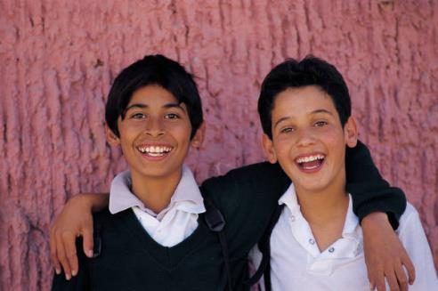
Keeping the Child Psychologically Safe
Pre-Service Curriculum Module 4.2.3
Notes:
3.6.4

Slide 24
National Child Traumatic Stress Network (NCTSN)
According to the NCTSN, psychological safety is a sense of safety, or the ability to feel safe, within oneself and safe from external harm.
Pre-Service Curriculum Module 4.2.4

Slide 25
Activity
Henry
Pre-Service Curriculum Module 4.2.5
Notes:
3.6.5

Slide 26
Activity
Rewriting Henry’s Experience With Us
Pre-Service Curriculum Module 4.2.6
Notes:
3.6.6

Slide 27

Ways to Behave in a
Trauma-Informed Manner
Pre-Service Curriculum Module 4.2.7
Notes:
3.6.7

Slide 28
Activity
Using a Trauma-Informed Approach in Child Welfare Practice: Creating Your Rules of Thumb
Pre-Service Curriculum Module 4.2.8
Notes:
3.6.8

Slide 29

Parents Must Truly Address The Roots of Their Trauma
Pre-Service Curriculum Module 4.2.9
Notes:
3.3.10

Slide 30

How People Exposed to Trauma React to Authority
Pre-Service Curriculum Module 4.2.10
Notes:
3.6.11

Slide 31
Unit 4.3
Referring and Advocating for the Child and Family in a Trauma-Informed Manner
Pre-Service Curriculum Module 4.3.1
Notes:
3.7.1

Slide 32
Learning Objectives
Pre-Service Curriculum Module 4.3.2
Notes:
3.7.2

Slide 33
Screening, Assessments and Evaluations
Pre-Service Curriculum Module 4.3.3
Notes:
3.7.4

Slide 34
Other Referrals and Advocacy
Pre-Service Curriculum Module 4.3.4
Notes:
3.7.5

Slide 35

Pharmacology and the
Child or Adult
Pre-Service Curriculum Module 4.3.5
Notes:
3.7.8

Slide 36

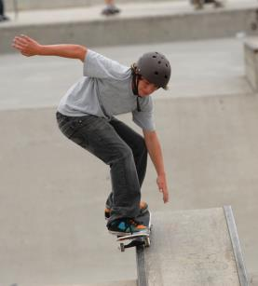
What Medication Does NOT Help
Pre-Service Curriculum Module 4.3.6
Notes:
3.7.7

Slide 37

Evidence-Based, Trauma-Informed Interventions
Pre-Service Curriculum Module 4.3.7
Notes:
3.7.8

Slide 38

Culture and Historical Trauma
Pre-Service Curriculum Module 4.3.8
Notes:
3.7.9

Slide 39
Activity
How should I address
Culture or Historical Trauma?
Pre-Service Curriculum Module 4.3.9
Notes:
3.7.10

