Slide 1
Module 3
Child Development
Notes:
2.0.1

Slide 2
Agenda
Unit 3.1: How Children Develop
Unit 3.2: Child Attachment, Permanency
and Well-Being
Pre-Service Curriculum Module 3.0.2
Notes:
2.0.2

Slide 3
Unit 3.1
How Children Develop
Pre-Service Curriculum Module 3.1.1
Notes:
3.1.1

Slide 4

Learning Objectives
Pre-Service Curriculum Module 3.1.2
Notes:
2.1.4

Slide 5


What is NORMAL in Your World?
Age Group | Age Group
Newborn 1 Year Old 3 Year Old 5 Year Old 7 Year Old | 10 Year Old 12 Year Old 14 Year Old 16 Year Old 18 Year Old
Pre-Service Curriculum Module 3.1.3
Notes:
2.1.5

Slide 6

What is a ‘Child’?
Definition
Roles
Lifespan
Pre-Service Curriculum Module 3.1.4
Notes:
2.1.6

Slide 7
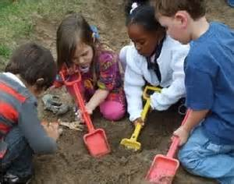
Science of Early Childhood Development
http://developingchild.harvard.edu/index.php/resources/multimedia/videos/inbrief_series/inbrief_science_of_ecd/
InBrief: The Science of Early Childhood Development
Center on the Developing Child, Harvard University
Pre-Service Curriculum Module 3.1.5

Slide 8

Why Should Child Welfare Professionals
Know About Child Development?
To understand why young children are the most vulnerable to maltreatment
To assess child functioning including the impact of maltreatment
To identify problems early and make appropriate referrals
To dispel myths about young children
To do no further harm
To make better informed decisions
Pre-Service Curriculum Module 3.1.6

Slide 9

Maturation Process
Critical Windows
Brain Development
Pre-Service Curriculum Module 3.1.7
Notes:
2.1.8

Slide 10
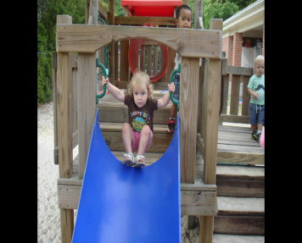
Encourage family use of…
Early Head Start
  Prenatal to 3 years
Head Start
  3-5 years
Florida Healthy Families
  Birth-5 years
Florida Early Steps
  Birth to 3 years
Find quality child care
  Florida Office of Early Learning
Pre-Service Curriculum Module 3.1.8

Slide 11

Prenatal Development
Genetics
Teratogens
Environment
Pre-Service Curriculum Module 3.1.9
Notes:
2.1.9

Slide 12

Post Partum Depression
The baby blues don’t
go away after 2 weeks.
Symptoms of
depression get more
and more intense.
Symptoms of
depression begin any
time after delivery, even
many months later.
Mom has thoughts of harming herself or baby.
Pre-Service Curriculum Module 3.1.10

Slide 13

Neglect
…the most common maltreatment among infants, at a rate of
79.7
per 1,000 maltreated children.
  U.S. Dept. of Health and Human Services, ACYF. (2009).
  Child maltreatment 2009.
  ChildStats.gov. (2011). America's children: Key national indicators of well-being, 2011.
Pre-Service Curriculum Module 3.1.11
Notes:
Source: U.S. Dept. of Health and Human Services, ACYF, 2008; CDC, “Nonfatal Maltreatment of Infants”, MMWR, 57(13): 336-339, April 4, 2008. Available at http://www.cdc.gov/mmwr/preview/mmwrhtml/mm5713a2.htm

Slide 14
1. The Majority of Children Entering Child Welfare are Ages 0-5
Why?
Pre-Service Curriculum Module 3.1.12

Slide 15
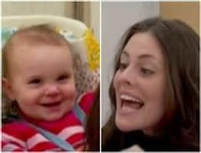

Impact of Neglect on Child Development
http://developingchild.harvard.edu/resources/multimedia/videos/inbrief_series/inbrief_neglect/
InBrief: The Science of Early Childhood Development
Center on the Developing Child, Harvard University
Pre-Service Curriculum Module 3.1.13

Slide 16
Developmental Domains
Cognitive
Social
Emotional
Physical
Pre-Service Curriculum Module 3.1.14
Notes:
2.1.11

Slide 17

Physical Development
Newborn: 5% to 10% weight
At 2 weeks: rapid weight gain
4 -6 months: double weight
Ages 1 and 2: + 5 pounds.
Ages 2-5: +5 pounds per year
Pre-Service Curriculum Module 3.1.15
Notes:
2.1.12

Slide 18




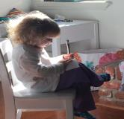
Cognitive Development
Pre-Service Curriculum Module 3.1.16

Slide 19


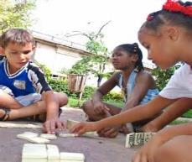
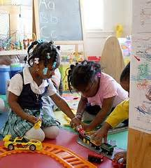
Social and Emotional Development
Pre-Service Curriculum Module 3.1.17

Slide 20
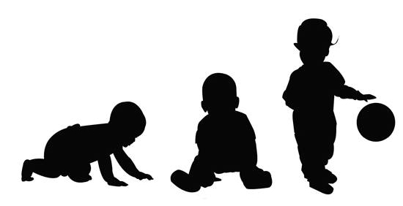
Developmental Stages –
0-12 Months 12-36 Months
Pre-Service Curriculum Module 3.1.18
Notes:
3.1.13

Slide 21

Activity
0-36 Months
Pre-Service Curriculum Module 3.1.19
Notes:
2.1.25

Slide 22

Developmental Stages – Preschool Period
3-6 years
Pre-Service Curriculum Module 3.1.20
Notes:
2.1.16

Slide 23
Activity
3-6 Year Olds
Pre-Service Curriculum Module 3.1.21
Notes:
2.1.25

Slide 24

Developmental Stages –
Latency Age
6-11 Years
Pre-Service Curriculum Module 3.1.22
Notes:
2.1.20

Slide 25
Activity
6-12 Year Olds
Pre-Service Curriculum Module 3.1.23
Notes:
2.1.25

Slide 26

Developmental Stages:
Adolescence
13-18 Years
Pre-Service Curriculum Module 3.1.24
Notes:
2.1.23

Slide 27
Activity
13-18 Year Olds
Pre-Service Curriculum Module 3.1.25
Notes:
2.1.25

Slide 28
Unit 3.2
Child Safety, Permanency and Well-Being
Pre-Service Curriculum Module 3.2.1
Notes:
3.3.1

Slide 29
Learning Objectives
Pre-Service Curriculum Module 3.2.2
Notes:
3.3.2

Slide 30

Nurturing, Attachment and Permanency
Need for Safety
Definitions
Connection to
Development
Pre-Service Curriculum Module 3.2.3
Notes:
2.2.29

Slide 31
Stability and Permanency
“Although young children certainly can establish healthy relationships with more than one or two adults, prolonged separations from familiar caregivers and repeated “detaching” and “re-attaching” to people who matter are emotionally distressing and can lead to enduring problems.”
Young Children Develop in an Environment of Relationships,
The National Scientific Council on the Developing Child
Center on the Developing Child at Harvard University
Pre-Service Curriculum Module 3.2.4

Slide 32

Being Safe – Feeling Safe
Pre-Service Curriculum Module 3.2.5
Notes:
3.3.4

Slide 33

Three-Tiered Hierarchy of Safety
Level 1: Physical Safety
Level 2: Social Safety
Level 3: Emotional Safety
Pre-Service Curriculum Module 3.2.6
Notes:
3.3.5

Slide 34

Factors Impacting Protectiveness
  Parenting Model
  Special Needs of Child
  Caregiver Capacities
  Family Conditions
    Substance abuse
    Domestic violence
    Unmanaged mental illness
Pre-Service Curriculum Module 3.2.7
Notes:
3.3.9

Slide 35
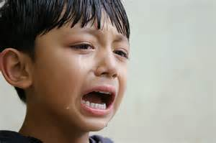

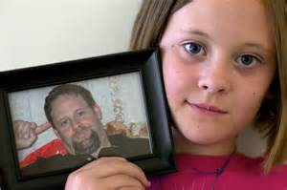
Do no further harm..
Pre-Service Curriculum Module 3.2.8

Slide 36

Important Child Relationships
Beyond Parents
Siblings
Relatives
Neighborhoods
Community
Pets
Pre-Service Curriculum Module 3.2.9
Notes:
3.3.12

Slide 37

Child Well-Being and Permanency
Definition
Role of Child Welfare Professional
Pre-Service Curriculum Module 3.2.10
Notes:
3.3.13

