Slide 1
Module 2
Florida’s Child Welfare Practice Model
Notes:
2.0.1

Slide 2
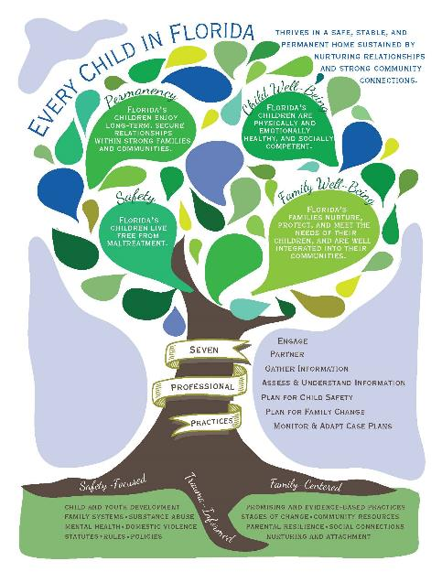
Agenda
Unit 2.1:
Florida’s Child Welfare Practice Model and Related Values
Pre-Service Curriculum Module 2.0.2
Notes:
2.0.2

Slide 3
Unit 2.1
Florida’s Child Welfare Practice Model
Pre-Service Curriculum Module 2.1.1
Notes:
2.1.1

Slide 4
Learning Objectives
Pre-Service Curriculum Module 2.1.2
Notes:
2.1.2

Slide 5
Pre-Service Curriculum Module 2.1.3
Notes:
2.1.3

Slide 6
Pre-Service Curriculum Module 2.1.4
Notes:
2.1.4

Slide 7
Pre-Service Curriculum Module 2.1.5
Notes:
2.1.5

Slide 8
Pre-Service Curriculum Module 2.1.6
Notes:
2.1.6

Slide 9
Pre-Service Curriculum Module 2.1.7
Notes:
2.1.7

Slide 10
Pre-Service Curriculum Module 2.1.8
Notes:
2.1.8

Slide 11
Pre-Service Curriculum Module 2.1.9
Notes:
2.1.3

Slide 12
Knowledge and Skills to Achieve Results
Safety
Well-Being Permanency
Notes:
2.1.10

Slide 13
Foundations for Child Welfare Practice Model
Demonstrate:
Respect
Courtesy
Empathy
Encouragement
Professionalism
Respond:
Promptly
By following through with commitments
By continually seeking to engage
Enable:
Participation and involvement
Family expertise
Feedback (Ask what is needed)
Family Education/
Knowledge (Provide necessary information)
Pre-Service Curriculum Module 2.1.11
Notes:
2.1.11

Slide 14
Child Welfare Practice Model
CPI or CM Lead Responsibility
Engage Child & Family
Partner with Child & Family & Assemble Family Team
Gather Information
(Current Situation, Strengths, Needs, Family Wishes, Underlying Factors)
Assess & Understand
(Reconcile, Validate, Build Big Picture)
Adapt Safety & Case Plans & Achieve
Safe Case Closure
Plan for Child Safety
(In-Home or Out-of-Home; Conditions for Return & Visitation)
Plan for Family Change (Interventions, Services & Long-term View)
Implement & Monitor
(Evaluate Family Progress & Result;, What is working or not working in case plan?)
Pre-Service Curriculum Module 2.1.12
Notes:
2.1.12

Slide 15
Engagement & Teamwork
CPI or CM Lead Responsibility
Engage Child & Family
Partner with Child & Family & Assemble Family Team
Gather Information
Assess & Understand
Adapt Safety & Case Plans & Achieve
Safe Case Closure
Plan for Child Safety
Plan for Family Change
Implement & Monitor
Pre-Service Curriculum Module 2.1.13
Notes:
2.1.13

Slide 16
Activity Engagement and Teamwork
Pre-Service Curriculum Module 2.1.14
Notes:
2.1.14

Slide 17
Gather, Assess and Understand Information
CPI or CM Lead Responsibility
Engage Child & Family
Partner with Child & Family & Assemble Family Team
Gather Information
Assess & Understand
(Reconcile, Validate, Build Big Picture)
Adapt Safety & Case Plans & Achieve
Safe Case Closure
Plan for Child Safety
Plan for Family Change
Implement & Monitor
Pre-Service Curriculum Module 2.1.15
Notes:
2.1.15

Slide 18
Activity Information Sufficiency
Pre-Service Curriculum Module 2.1.16
Notes:
2.1.16

Slide 19
Safety Planning & Case Planning
CPI or CM Lead Responsibility
Engage Child & Family
Partner with Child & Family & Assemble Family Team
Gather Information
Assess & Understand
Adapt Safety & Case Plans & Achieve
Safe Case Closure
Plan for Child Safety
(In-Home or Out-of-Home; Conditions for Return & Visitation)
Plan for Family Change (Interventions, Services & Long-term View)
Implement & Monitor
Pre-Service Curriculum Module 2.1.17
Notes:
2.1.17

Slide 20
Implement, Monitor and Adapt Plans
CPI or CM Lead Responsibility
Engage Child & Family
Partner with Child & Family & Assemble Family Team
Gather Information
Assess & Understand
Adapt Safety & Case Plans & Achieve
Safe Case Closure
Plan for Child Safety
Plan for Family Change
Implement & Monitor
(Evaluate Family Progress & Results; What is working or not working in case plan?)
Pre-Service Curriculum Module 2.1.18
Notes:
2.1.18

Slide 21
Activity Core Practices
Pre-Service Curriculum Module 2.1.19
Notes:
2.1.19

Slide 22
Safe Case Closure
CPI or CM Lead Responsibility
Engage Child & Family
Partner with Child & Family & Assemble Family Team
Gather Information
Assess & Understand
Achieve
Safe Case Closure
Plan for Child Safety
Plan for Family Change
Implement & Monitor
Pre-Service Curriculum Module 2.1.20
Notes:
2.1.20

