Slide 1
SYSTEM OF CARE SUBCOMMITTEE
Commission on Mental Health and Substance Use Disorder
Commissioner Harris
Secretary, Florida Department of Children and Families
AUGUST 15, 2023

Slide 2
System of care SUBCOMMITTEE CHARGE
Review and evaluate the management and functioning of the existing publicly supported mental health and substance use systems and services in the Department of Children and Families and the Agency for Health Care Administration, and other departments which administer mental health and substance use disorder services.

Slide 3
Key Themes
Need for better coordination of care
Need for enhanced real-time data sharing
Need to address workforce challenges
Enhance opportunities for data driven decision-making
Need to conduct a true service gap analysis

Slide 4
Patient centered behavioral health homes
Certified Community Behavioral Health Clinics are organizations that provide integrated health care for individuals with behavioral health conditions, both insured or uninsured. The CCBHC model provides the following:
24/7 Access to care
Coordinated Care
Comprehensive Service Array – coverage of nine core categories of services
Metrics and Reporting
Data sharing

Slide 5
Gap analysis
Identify any gaps in the provision of mental health and substance use disorder services.
Provide recommendations on how behavioral health managing entities may fulfill their purpose of promoting service continuity and work with community stakeholders throughout this state in furtherance of supporting crisis response services.

Slide 6
Statewide Gap analysis findings
Teaming Models
A Thriving System of Care
Data Sharing
Provider Shortages
Peer and Recovery-Support Services
Waitlists
Central Receiving Facilities
In-County Mobile Response Team
Supports for Individuals with dual diagnoses
Rural vs Urban
Housing
Notes:
Throughout our convenings

Slide 7
Mobile response teams and central receiving facilities
Analyze the current capacity of crisis response services available throughout this state, including services provided by mobile response teams and centralized receiving facilities. The analysis must include information on the geographic area and the total population served by each mobile response team along with the average response time to each call made to a mobile response team; the number of calls that a mobile response team was unable to respond to due to staff limitations, travel distance, or other factors; and the veteran status and age groups of individuals served by mobile response teams.

Slide 8
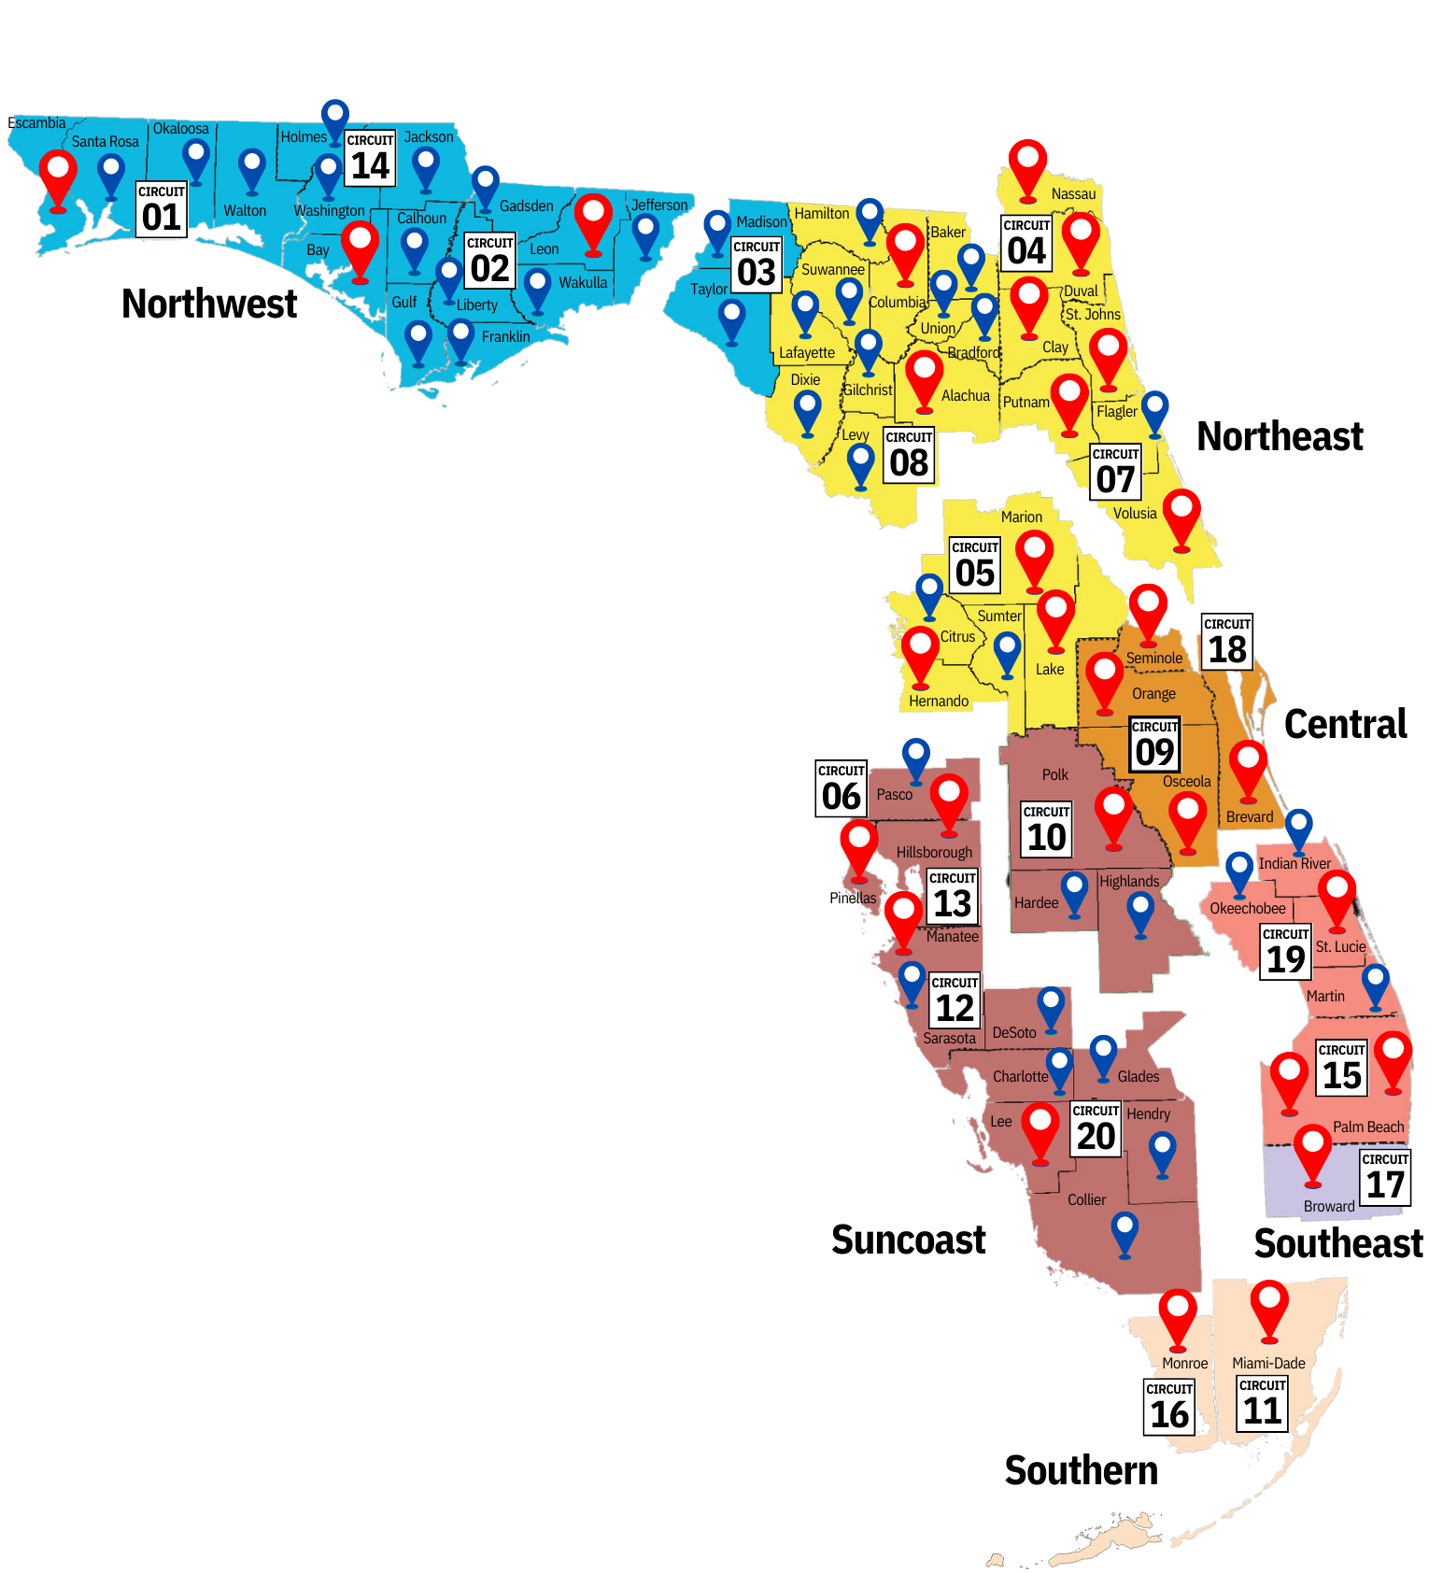
Expansion of MRT services
2018 MRT MAP
After the Marjory Stoneman Douglas High School Public Safety Act of 2018, there were 29 MRTs established across the state.

Slide 9
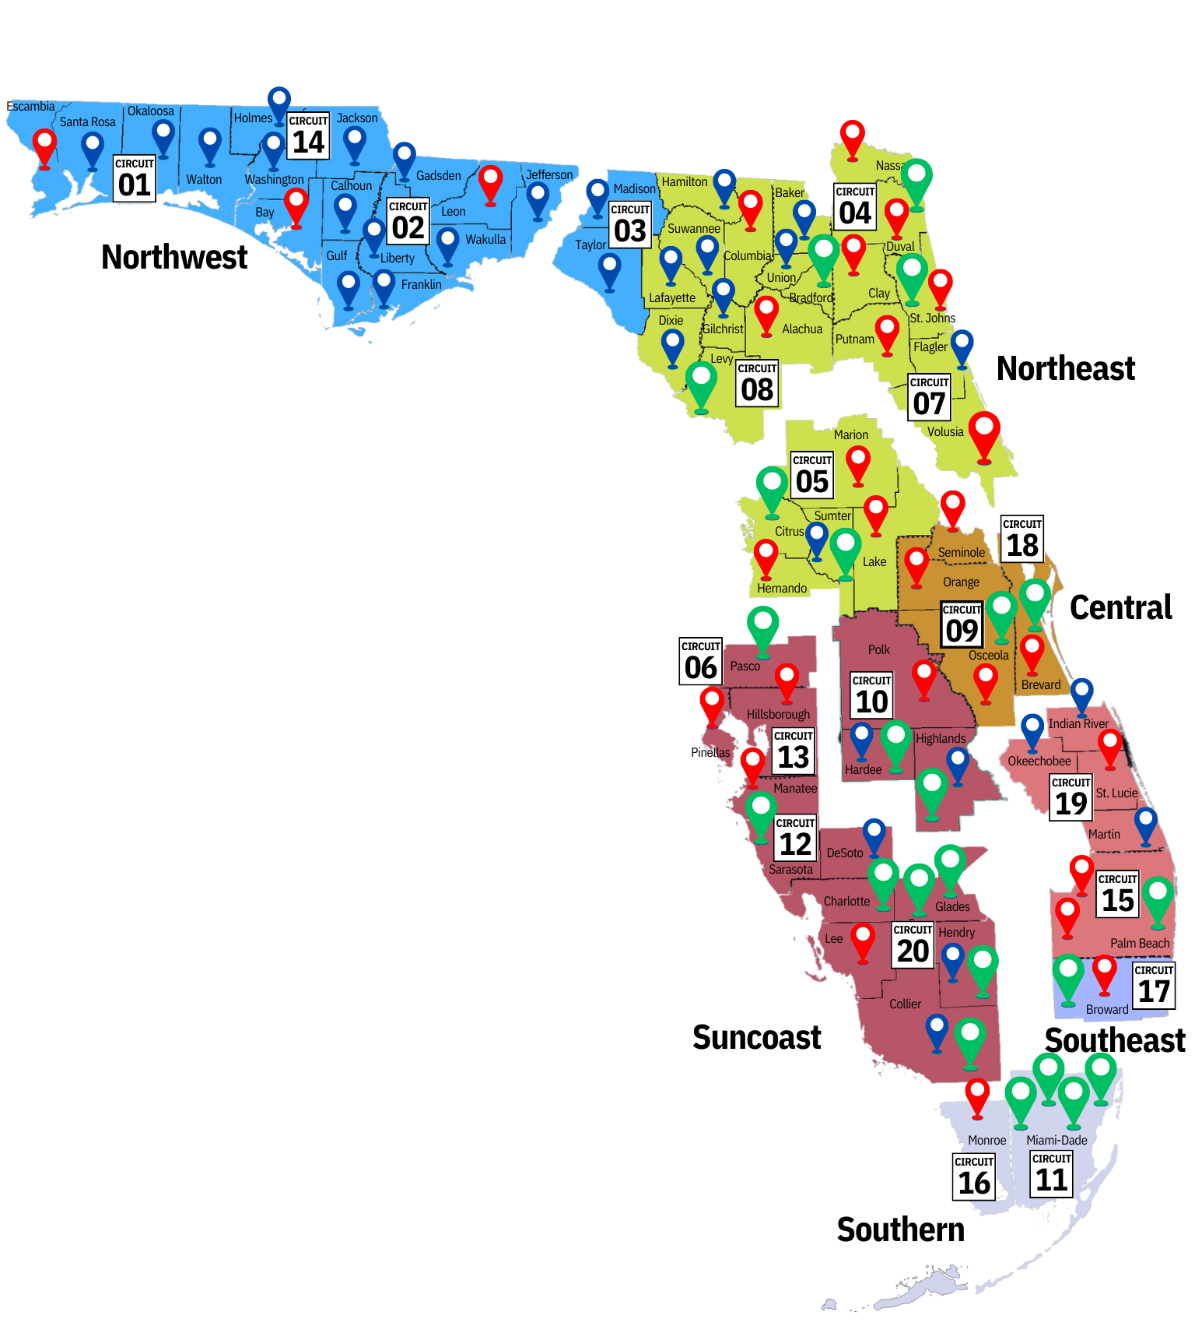
Expansion of MRT services
2023 MRT MAP
Since 2018, the annual budget for MRTs has increased from $18.3 million to $36.3 million in 2022.

Slide 10
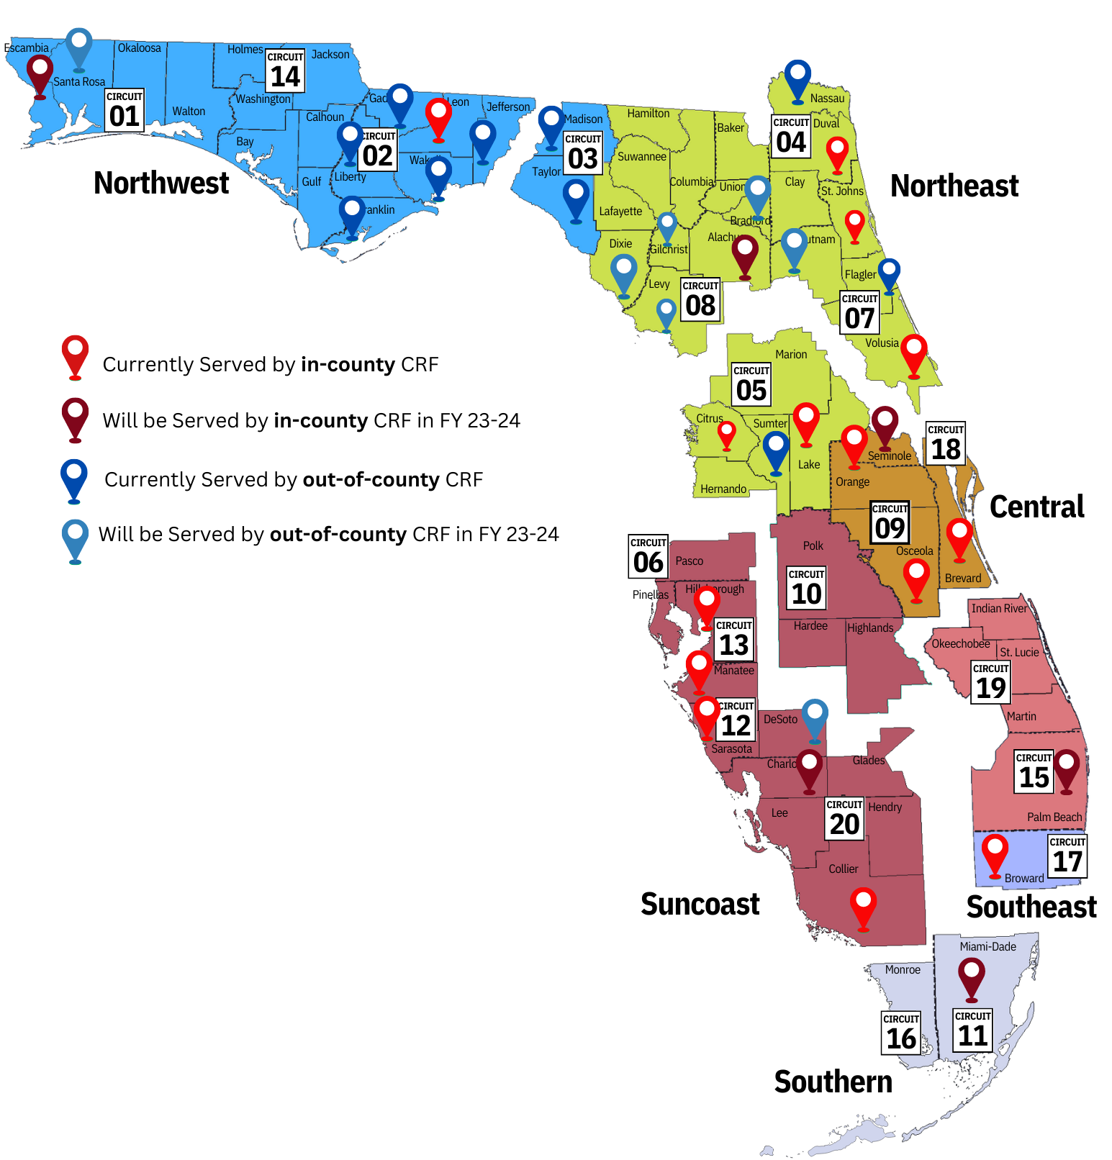
Central receiving facilities

Slide 11
ANTICIPATED subcommittee recommendations
Expand Patient Centered Behavioral Health Homes
Establish a standardized framework for the Florida specific CCBHC model that addresses behavioral health challenges and barriers.
2. Complete GAP analysis
Produce recommendations around the need for expansion of key services that address challenges and reduce the need or use of deeper end/more costly services
3. Explore opportunities/funding that support regionalized expansion of regional health information exchanges
4. Regional Collaboratives
Establishing regional collaboratives that address ongoing challenges at the local level maintain open lines of communication.

Slide 12
Questions?

