Slide 1
The 988 Suicide and Crisis Lifeline In Florida
Florida Department of Children and Families
Office of Substance Abuse and Mental Health
Presenter: Nikki Wotherspoon

Slide 2
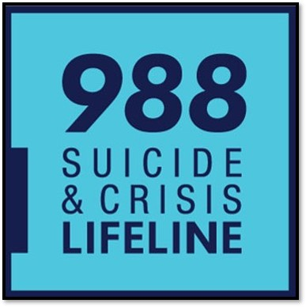
What is the 988 suicide and crisis lifeline?
The 988 Suicide & Crisis Lifeline is an easy-to-remember, three-digit number that offers 24/7 access to trained crisis counselors to assist individuals experiencing emotional distress, suicidal thoughts and feelings, or substance use crises.
Created by the Federal Communications Commission (FCC) in July 2020 and formally passed by Congress in October 2020.

Slide 3
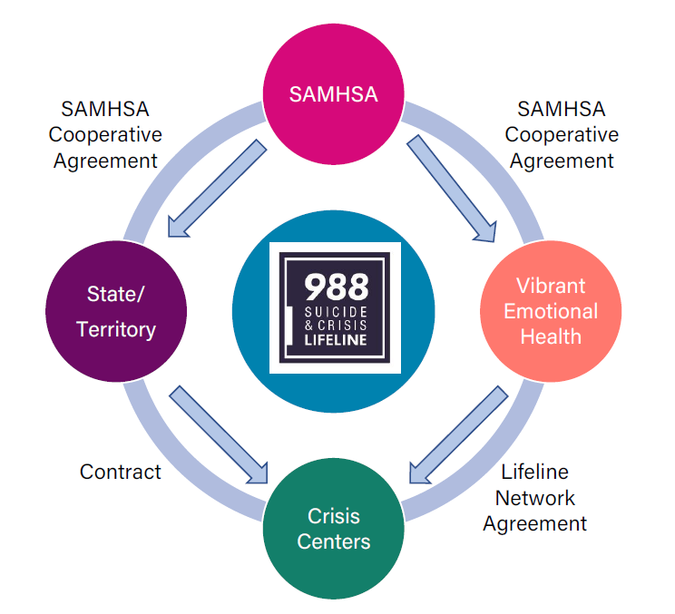
988 Partnership and Collaboration
The Substance Abuse and Mental Health Services Administration within the US Department of Health and Human Services is the federal agency charged with national implementation of 988.
Vibrant Emotional Health is the Lifeline Administrator.
The Department of Children and Families is the statutory single state authority on substance abuse and mental health in Florida.

Slide 4
Roles and Responsibilities
SAMHSA | DCF | Vibrant
Fund states, territories, and tribal nations for 988 via cooperative agreements. | Fund 988 Centers via contracts. | Fund and oversee the national phone, text, and chat backup network, Spanish Language and LGBTQ+ subnetworks.
Fund Vibrant as the Lifeline Administrator via cooperative agreements. | Collaborate and build partnerships with key stakeholders to coordinate a robust crisis continuum of care. | Provide technological infrastructure, standards, training, and quality improvement of the network as the Lifeline Administrator.
Work with Vibrant, states, territories, and tribal nations to carry out the requirements of cooperative agreements. | Oversee the state’s 988 Suicide and Crisis Lifeline, including developing policies and protocols. | Work with 988 Crisis Centers through Center Engagement Managers.

Slide 5
Planning Grant
February 2021 – March 2022
$325,000 through Vibrant Emotional Health
Landscape Analysis
Established 988 Coalition
8 Core Competencies
1. Ensuring statewide coverage for 988 calls, chats, and texts.
2. Funding structure for Lifeline Contact Centers.
3. Capacity building for current and projected 988 volume/follow-up.
4. State support of the 988 centers operational, clinical, and performance standards.
5. Identification of key stakeholders.
6. State support of 988 centers having systems in place to maintain local resource and referral listings.
7. Ensuring all 988 centers can provide follow-up services according to best practices.
8. Alignment with national initiatives around public messaging for 988.

Slide 6
988 Year One Goals (SFY 2022-23)
Goal 1: Recruit and retain qualified behavioral health staff to handle high acuity calls, support increases in call volume, improve in-state answer rates, and statewide coverage without compromising quality of service to constituents.
Goal 2: Closely monitor each of Florida’s 13 988 Suicide and Crisis Lifeline centers to improve statewide implementation in both range and depth.
Goal 3: Identify quality assurance strategies to assure training on intervening with high-risk populations continues at routine intervals throughout center staff employment.
Goal 4: Propose a glide path for callers into 988 to dispatch the Mobile Response Team for assessment to determine if CSU level of care is needed or care coordination for individuals who need assistance accessing routine behavioral health services.

Slide 7
What are the differences between 211, 911, and 988?
211
Provides information and referrals on local social services resources.
911
Dispatches Emergency Medical Services, Fire, and Police
988
Provides crisis counseling for suicide prevention, and mental health or substance use crisis.

Slide 8
Call Routing Process

Slide 9
988 Initiates the Crisis Continuum of Care
988 Suicide and Crisis Lifeline
“Someone to Talk To”
Mobile Response Teams
“Someone to Respond”
Crisis Stabilization Programs
“Somewhere to Go”

Slide 10
Monthly Call Metrics
Chats have more than doubled and texts are 5.6 times the number received for the same period in the prior year.
September and October were affected by both a change in Vibrant’s routing provider and Hurricane Ian.
*Note – To allow centers to build capacity, Florida has not yet begun aggressive marketing of 988. Call volume is expected to increase as the public learns more about the 988 Suicide and Crisis Lifeline.

Slide 11
Data for October 2022 – March 2023
409
# of contacts that included a suicide attempt in progress
293
# of contacts that resulted in Voluntary Emergency Rescue
264
# of contacts that resulted in Involuntary Emergency Rescue
9,138
# of individuals referred to Mental Health or Related Services
1,181
# of contacts referred to a Mobile Response Team
207
# of formal MOUs executed with crisis services partners
168
# of call center staff hired
267
# of call center staff trained

Slide 12
Funding
988 Allocations FY 23-24
State Fiscal Year | 988 Implementation Grant | 988 Supplemental Block Grant | Total 988 Funding
FY 22-23 | $ 3,605,776 | $ 8,461,833 | $ 12,067,609
FY 23-24 | $ 3,678,612 | $ 8,461,833 | $ 12,140,445
Total | $ 7,284,388 | $ 16,923,666 | $ 24,208,054

Slide 13
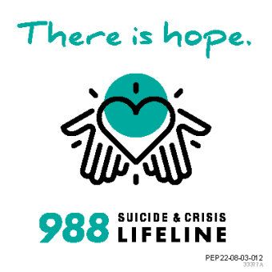
Florida’s 988 Suicide and Crisis Lifelines:
211 Northwest Florida United Way
211 Big Bend
211 Northeast Florida
Alachua County Crisis Center
211 Brevard
211 Heart of Florida United Way
Personal Enrichment for Mental Health Services
211 Tampa Bay Cares
Crisis Center of Tampa Bay/211
David Lawrence Center
211 Palm Beach/Treasure Coast
211 Broward United Way
Jewish Community Services of South Florida

Slide 14
Questions about 988?
Nikki Wotherspoon
Supervisor of Special Projects & Research
Office of Substance Abuse & Mental Health
Nikki.Wotherspoon@MyFLFamilies.com
Jorge “Javy” Passalacqua
988 Evaluator
Office of Substance Abuse & Mental Health
Jorge. Passalacqua@MyFLFamilies.com

