Slide 1
Module 7
Family Engagement Standard - Exploration

Slide 2
Agenda
7.1: Overview of Exploration
7.2: Scaling Caregiver Protective Capacities
7.3: Assessing and Ensuring Child Well-being
7:4: Danger Statement, Family Goal and Motivation for Change
7.5: Information Collection/Domains
Pre-Service CM Specialty Module 7.0.2

Slide 3
Unit 7.1
Overview of Exploration
Notes:
9.1.4

Slide 4
Learning Objectives
Explain the purpose of the Exploration Stage and why it is important in the FFA-Ongoing process.
Pre-Service CM Specialty Module 7.1.2

Slide 5
Family Engagement Standards
Safety Management and Enhancing Caregivers Protective Capacities
Preparation
Introduction
Exploration
Case Planning
Developing Strategy for Engagement
Engagement
Determine What Must Change Through Information Collection
Develop Strategies for Change Case Plan Outcomes
Caregiver Protective Capacity Assessment
Child Needs
Danger Statement
Family Goal
Motivation for Change
Complete FFA Ongoing
Case Plan
Pre-Service CM Specialty Module 7.1.3

Slide 6
Exploration
Exploration is the act of exploring with the family:
How they are functioning in relation to child needs and protective capacities,
Identifying family strengths, including positive protective capacities;
How danger threats or negative family conditions have manifested.
What must change.
Motivation for change, resistance, or ambivalence.
Pre-Service CM Specialty Module 7.1.4

Slide 7
Exploration Seeks to….
Achieve agreement with parent(s) as to:
What must change for children to be safe.
How to achieve change.
Parent’s role in achieving change.
Role of others in helping parent(s) achieve change.
Pre-Service CM Specialty Module 7.1.5

Slide 8
Unit 7.2
Scaling Caregiver Protective Capacities

Slide 9
Learning Objectives
Define the concept of scaling caregiver capacities.
Demonstrate the ability to scale caregiver protective capacities using a case example.
Pre-Service CM Specialty Module 7.2.2

Slide 10
Caregiver Protective Capacities
Pre-Service CM Specialty Module 7.2.3
Notes:
10.2.13

Slide 11
Definition: Caregiver Protective Capacities
Caregiver protective capacities are personal and caregiving behavioral, cognitive and emotional characteristics that can be specifically and directly associated with being protective of one’s young.
Caregiver protective capacities are personal qualities or characteristics that contribute to vigilant child protection.
Pre-Service CM Specialty Module 7.2.4

Slide 12
Behavioral Protective Capacity
Specific action, activity, or performance that is consistent with, and results in, protective parenting and protective vigilance.
Controls impulses
Takes action
Sets aside own needs for child
Demonstrates adequate skills
Adaptive as a parent/legal guardian
History of protecting
Pre-Service CM Specialty Module 7.2.5

Slide 13
Cognitive Protective Capacity
Specific intellect, knowledge, understanding and perception that results in protective parenting and protective vigilance.
Is self-aware
Is intellectually able
Recognizes threats
Recognizes child’s needs
Understands protective role
Plans and articulates plans for protection
Pre-Service CM Specialty Module 7.2.6

Slide 14
Emotional Protective Capacity
Specific feelings, attitudes, identification with child and motivation that results in protective parenting and protective vigilance.
Meets own emotional needs
Is resilient
Is tolerant
Expresses love, empathy, sensitivity to the child
Is stable
Is positively attached with the child
Is aligned and supports the child
Pre-Service CM Specialty Module 7.2.7

Slide 15
Scaling: Caregiver Protective Capacities
CPI-Family Functioning Assessment
Based on six domains of information;
Limited information known at the time in relation to what can be known;
Determination of Yes or No;
Indicators of being “enhanced” or “diminished”.
CM-Ongoing Family Functioning Assessment and Evaluation
Based on four domains of information;
Extensive information to be known;
Determination of degree of functioning from a limited to extensive perspective.
Pre-Service CM Specialty Module 7.2.8

Slide 16
Scaling Caregiver Protective Capacities
A: CPC is functioning and not affecting child safety;
B: CPC is functioning and at times may have effect on conditions in the home, but not child safety;
C: CPC is diminished and at times has affected child safety;
D: CPC is diminished and at a level that it is pervasively affecting child safety.
Pre-Service CM Specialty Module 7.2.9

Slide 17
Activity A: Scaling Caregiver Protective Capacities
Instructions:
Working individually, read the scenarios and using your Caregiver Protective Capacity Definition, scale the capacity as an A, B, C, or D.
Pre-Service CM Specialty Module 7.2.10

Slide 18
Identifying Diminished CPCs
Pre-Service CM Specialty Module 7.2.11
Notes:
10.2.14

Slide 19
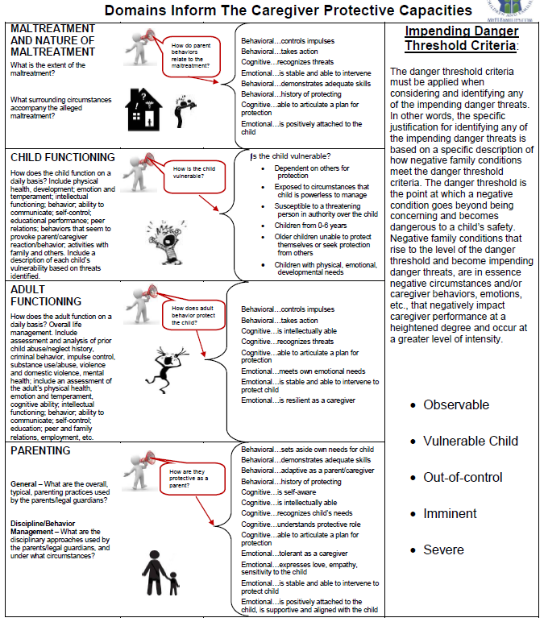
Pre-Service CM Specialty Module 7.2.12

Slide 20
Exploration
Overview of Exploration.
Existing Caregiver. Protective Capacities.
Diminished Caregiver Protective Capacities.
Determining what must change.
Pre-Service CM Specialty Module 7.2.13

Slide 21
Activity B: Observation of Exploration Stage Interviews
Instructions:
Watch the two videos of Angela Russell and her interaction with Brandy, the Case Manager.
Read the overview of the Russell family.
Answer the questions on the worksheet.
Be prepared to discuss.
Pre-Service CM Specialty Module 7.2.14

Slide 22
Unit 7.3
Assessing and Ensuring Child Well-Being
Notes:
9.1.4

Slide 23
Learning Objectives
Define the different child strengths and needs indicators.
Scale the child strengths and needs.
Pre-Service CM Specialty Module 7.3.2

Slide 24
Child Strengths and Needs
Set of indicators directly related to a child’s well-being and success.
Each indicator is rated based upon information that is provided in the narrative description of child functioning.
The ratings provide a way for the case manager to identify areas that need attention in the case plan and to measure changes over time.
Pre-Service CM Specialty Module 7.3.3

Slide 25
Pre-Service CM Specialty Module 7.3.4

Slide 26
Developmental Domains
Physical
Cognitive
Social
Emotional
Pre-Service CM Specialty Module 7.3.5

Slide 27
Normal?
Statistical concept
Typical or expected for the majority of members of a group
Identified traits and processes displayed by most children within timeframes
Pre-Service CM Specialty Module 7.3.6

Slide 28
Child: Ages and Stages
Birth to 3
School Age (6-12)
Adolescence (13-21)
Pre-School (3-5)
Pre-Service CM Specialty Module 7.3.7

Slide 29
Factors Influencing Child Strengths and Needs
Biological
Factors
Interpersonal
Relationships
Environmental Factors
Abuse and
Neglect
Child
Pre-Service CM Specialty Module 7.3.8

Slide 30
Child Strengths and Needs Assessment
Part of the FFA-Ongoing and Progress Updates
Measure extent certain desired conditions are present in a child’s life
Includes scaling of 10 defined child strengths and needs
Pre-Service CM Specialty Module 7.3.9

Slide 31
Scaling of Child Needs: Purpose
Permanency
Well-Being
Safety
Child
Needs
Pre-Service CM Specialty Module 7.3.10

Slide 32
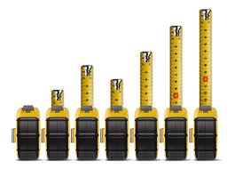
Scaling Child Needs: Child Needs Met
A: Demonstration of the exceptional ability in this area OR that the need is being addressed by the parent.
B: Demonstration of average ability in this area OR that the parent is attempting, or has made attempts to meet the need.
Pre-Service CM Specialty Module 7.3.11

Slide 33
Scaling Child Needs: Child Needs Not Met
C: Demonstration of need for increased support or attention in this area: could be for both child and parent response.
D: Demonstration of need for intensive support in this area; could be for both child and parent response.
Pre-Service CM Specialty Module 7.3.12

Slide 34
Activity C: Identifying Indicators of Child Strengths and Needs
Instructions:
Working within your groups, review child needs and scaling in your CFOP as you complete the worksheet.
For each child need, identify behavioral examples of how the child need may manifest with children they are working with.
Remember, assessments are to observe both the strengths and needs of children, so please consider both the strengths and needs for children when identifying your examples.
Pre-Service CM Specialty Module 7.3.13

Slide 35
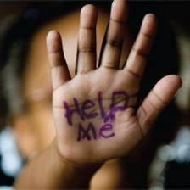
Emotion/Trauma
Management of emotions
Self-regulation
Response to stress
Coping skills and techniques
Physical symptoms of trauma
Pre-Service CM Specialty Module 7.3.14

Slide 36
Behavioral
Empathy
Right from wrong
Impact of behavior on self and others
Actions towards others
Societal expectations/norms
Pre-Service CM Specialty Module 7.3.15

Slide 37
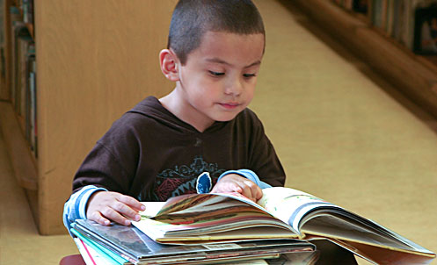
Development and Early Learning (0-6)
Cognitive abilities:
Language development
Physical skills:
Riding a bike
Dressing
http://developingchild.harvard.edu/resources/brain-hero/#
Pre-Service CM Specialty Module 7.3.16

Slide 38
Early Development Resources Opportunities
Children’s Medical Services
Florida Early Steps Program
County Health Departments
Healthy Families Florida
Head Start
Voluntary Prekindergarten (VPK)
Florida Quality Child Care Programs
Pre-Service CM Specialty Module 7.3.17

Slide 39
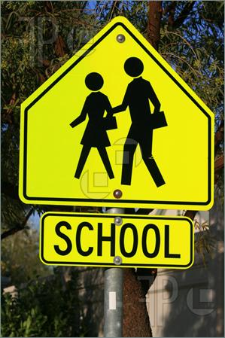
Academic Status (6-17)
Academic advancement:
Reading
Math
Language
Advancement to next grade level
Pre-Service CM Specialty Module 7.3.18

Slide 40
Skills to Access Educational Resources & Advocate
Pre-Service CM Specialty Module 7.3.19

Slide 41
Skills to Access Educational Resources & Advocate
When a student in foster care changes schools, an average of four to six months of educational progress is lost.
Youth who had even one fewer change in living arrangement per year were almost twice as likely to graduate from high school before leaving foster care.
Pre-Service CM Specialty Module 7.3.20

Slide 42
Case Managers and a Child’s Academic Success
Case Managers need to:
Have a basic understanding of how to work within the school system
Advocate for placement and school stability, needed educational services, and participation in school activities
Provide the child with a feeling of normalcy and well being
Pre-Service CM Specialty Module 7.3.21

Slide 43
Potential Educational Partners
Child’s parent(s)/caregivers
Child’s teacher
School counselor
School nurse
Before and after care staff
Special education professionals
School secretary
Guardian ad Litem
Education parent surrogate
Pre-Service CM Specialty Module 7.3.22

Slide 44
Educational Questions
Is child:
Performing on grade level?
Passing all subjects?
Displaying any behavioral issues?
Does child:
Have friends at school?
Have needs that require a 504 plan or IEP?
Have parental involvement in school success?
Pre-Service CM Specialty Module 7.3.23

Slide 45
Family Relationships
Parent/child relationship
Sibling relationships
Dynamic family relationships
Support and guidance from family
Sense of family identity
Pre-Service CM Specialty Module 7.3.24

Slide 46
Positive Peer/Adult Relationships
Interactions with others
Demonstrated social skills
Peer pressure: life choices
Pre-Service CM Specialty Module 7.3.25

Slide 47
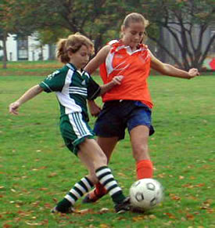
Physical Health
Provision of basic and appropriate health care
Physical symptoms of health concerns
Dental and visual needs
Medical and dental established providers/provision for care
Pre-Service CM Specialty Module 7.3.26

Slide 48
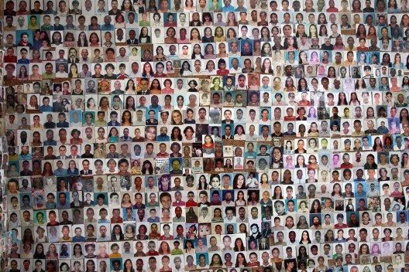
Cultural Identity
Race
Class
Ethnicity
Religion
LGBTQ
Identified cultural identity
Sense of cultural identity
Desire for cultural identity
Pre-Service CM Specialty Module 7.3.27

Slide 49
Substance Awareness
Self
Others
Treatment
Awareness of effects
Recovery
Pre-Service CM Specialty Module 7.3.28

Slide 50
Preparation for Adult Living (13-17)
Life skill development:
Housing
Employment
Financial
Educational
Support
Planning
Pre-Service CM Specialty Module 7.3.29

Slide 51
Activity D: Scaling Child Strengths and Needs
Instructions:
Working alone, read the scenarios and identify the appropriate category the scenario belongs to and what rating you would give each child.
Be prepared to discuss as a class.
Pre-Service CM Specialty Module 7.3.30

Slide 52
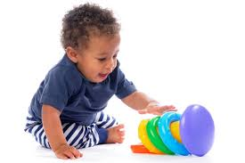
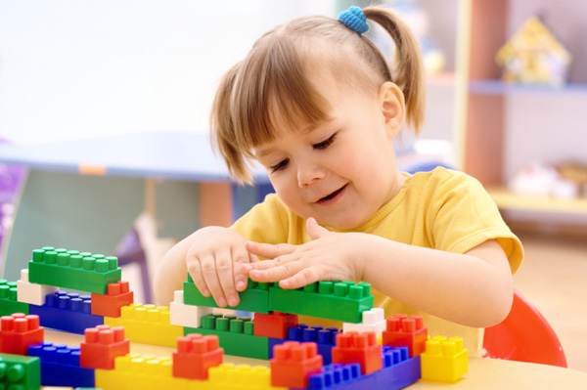
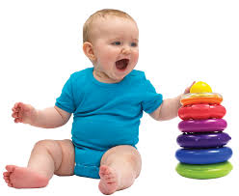
Becoming Allies to Address Child Needs
Pre-Service CM Specialty Module 7.3.31

Slide 53
Unit 7.4
Danger Statement, Family Goal and Motivation for Change

Slide 54
Learning Objectives
Describe what a danger statement is and how to develop one.
Describe what a family goal is and how to develop one.
Identify how to develop a family change strategy using the danger statement, family goal and motivation for change.
Pre-Service CM Specialty Module 7.4.2

Slide 55
Purpose: Danger Statement and Family Goal
Danger Statement: To understand what must be different for parents in order for intervention to cease.
Family Goal: To identify and verbalize how the family will be functioning when all the children are safe, including consideration of barriers, support, and ideas for intervention.
Pre-Service CM Specialty Module 7.4.3

Slide 56
Activity E: The “WHAT” Questions That Formulate The Danger Statement
Instructions:
Watch the two video segments.
Once the videos are completed, write a danger statement for the Russell family.
Pre-Service CM Specialty Module 7.4.4

Slide 57
The “WHAT” Questions That Formulate The Family Goal
What must be different?
What can the parents do?
What are the parents willing to do?
What will the family “look” like for the agency to not be involved?
Pre-Service CM Specialty Module 7.4.5

Slide 58
Unit 7.5
Information Collection/Domains
Notes:
9.1.4

Slide 59
Learning Objectives
1. Explain how the five worker competencies affect information collection.
2. Demonstrate documentation of the FFA-Ongoing domains.
Pre-Service CM Specialty Module 7.5.2

Slide 60
Information Collection
Pre-Service CM Specialty Module 7.5.3

Slide 61
Information Collection as a Competency
I know what information I must learn about a family. I know what information I must collect on each case I am assigned.
I understand the purposes or reasons for needing to know this information.
I demonstrate the ability to gather the information.
Pre-Service CM Specialty Module 7.5.4

Slide 62
Information Collection as a Competency
I demonstrate awareness that everything I do to reconcile and validate information influences the overall quality of the information.
I can discuss and write about the information I collected logically, succinctly, and in a way that justifies my conclusions.
Pre-Service CM Specialty Module 7.5.5

Slide 63
Documenting the Six Information Collection Domains
Professional Judgment:
Accurate Reflection – Positive and Negative
Objective and Neutral
On the “record” of information and decision making
Reconciled to provide clarity
Pre-Service CM Specialty Module 7.5.6

Slide 64
Activity F: Domain Information for the Sandler/Braun Family
Instructions:
Read exploration notes for Sandler-Braun Family
Based on this information and information you already know about the family complete domain information on the Sandler-Braun FFA- Ongoing. This includes the following sections:
Section II: Additional Ongoing Information
Section III: Child Functioning
Section IV: Adult Functioning
Section V: Parenting
Pre-Service CM Specialty Module 7.5.7

Slide 65
Activity G: Scaling Caregiver Protective Capacities for the Sandler/Braun Case
Instructions:
Review the domain information on the FFA-Ongoing.
Rate each protective capacity for Melanie and Bruce, using Sander/Braun FFA-Ongoing.
Pre-Service CM Specialty Module 7.5.8

Slide 66
Activity H: Child Strengths and Needs: Sandler/Braun Children
Instructions:
Scale each of the Child Strengths and Needs for the Sandler/Braun children using Sandler/Braun FFA-Ongoing.
If there are any Child Strengths and Needs you need more information on in order to scale them please indicate the additional information you need and where you can obtain this information.
Pre-Service CM Specialty Module 7.5.9

Slide 67
Activity I: Formulating the Danger Statement, Family Change Strategy, and Determining Motivation for Change
Instructions:
Complete the following sections of your Sandler/Braun FFA-Ongoing:
VI. Reasons for Ongoing Involvement Danger Statement
VII. Family Change Strategy
XII. Motivation for Change
XIV. Current Safety Plan Assessment for Sufficiency
Be prepared to discuss.
Pre-Service CM Specialty Module 7.5.10

