Slide 1
Module 5
Out-of-Home Care
Notes:
3.0.1

Slide 2
Agenda
5.1: Placement Considerations (Out-of-Home Care)
5.2: Meeting Children’s Needs in Out-of-Home Care
5.3: Family Visitation and Maintaining Connections
5.4: Transitions and Achieving Permanency
Pre-Service CM Specialty Module 5.0.2

Slide 3
Unit 5.1
Placement Considerations
(Out-of-Home Care)
Notes:
3.1.4

Slide 4
Learning Objectives
Explain case management’s role in removals and explain the difference between “emergency” and “planned” placement of children.
Discuss the principles to follow and the complex issues that may exist when considering placement.
Explain the requirements for a unified home study.
Identify the basic requirements of federal laws affecting placement and the Case Manager’s responsibility for ensuring compliance.
Pre-Service CM Specialty Module 5.1.2

Slide 5
When is Case Management Involved in Removal?
Case management- ongoing monitoring of the safety plan
Review 5 safety analysis questions
Any changes from “yes” to “no”
Consultation with Supervisor, CLS, CPI
Questions
Pre-Service CM Specialty Module 5.1.3

Slide 6
Choosing the Best Placement
Pre-Service CM Specialty Module 5.1.4

Slide 7
Principles to Follow
Meets child’s individual needs
Minimize Moves
Least Restrictive Most Homelike setting
Pre-Service CM Specialty Module 5.1.5

Slide 8
Least to Most Restrictive Placements
Relatives
Non-relatives
Foster family home
Residential treatment facility
Non-custodial parents
Medical/
Therapeutic Foster care
Residential group care (group home)
You must document all efforts to comply with “levels” of placement in FSFN.
Pre-Service CM Specialty Module 5.1.6

Slide 9
Complex Placement Issues
Victims of Human Trafficking
Sibling groups
APD placements
Placing victims or perpetrators of sexual abuse
Complex mental health/behavioral issues
Complex medical problems
Pre-Service CM Specialty Module 5.1.7

Slide 10
Activity A: Assessing for an Appropriate Placement
Instructions:
In small groups, read your assigned scenario.
Identify the significant information that you would utilize to find the most appropriate placement.
Write your list on flip chart paper.
Be prepared to share with the class.
Pre-Service CM Specialty Module 5.1.8

Slide 11
Key Requirements for Relative/Non-Relative Placement
Home Study
65C-28.012
Background Checks
Fingerprints
39.0138
65C-28.011
Pre-Service CM Specialty Module 5.1.9

Slide 12
Background Checks
An abuse/neglect records check for all household members/frequent visitors
For everyone 12 and over: local, state and juvenile delinquency checks
NCIC (national) criminal background checks for household members 18 and older (must be done within 10 days of emergency placement)
Information from other states
Pre-Service CM Specialty Module 5.1.10

Slide 13
Felony Disqualifications 39.0138
Criminal history records checks for all persons being considered for approval for placement of a child; includes all household members and frequent visitors.
Disqualifications for person other than parent:
Conviction of one or more listed felonies
Child abuse, abandonment, or neglect
Domestic Violence
Child pornography
Homicide, sexual battery, or other felony involving violence
Conviction of listed felonies within previous 5 years
Assault
Battery
Drug related offense
Pre-Service CM Specialty Module 5.1.11

Slide 14
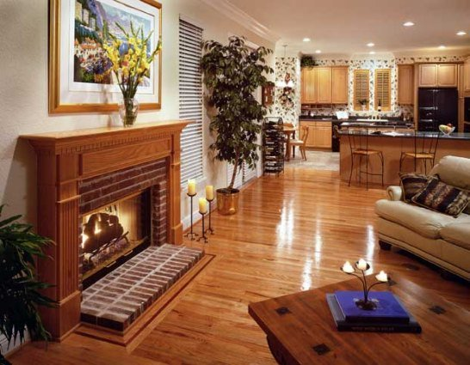
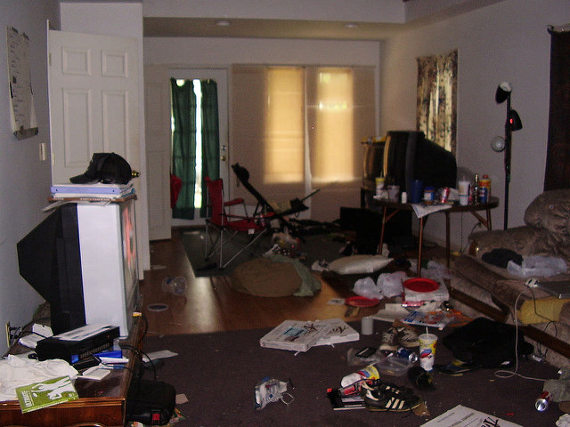
Examining the Physical Condition of the Home
Appropriate sleeping arrangement.
Physical hazards in the home.
Physical hazards outside the home.
Appropriate baby proofing.
Fire alarms, security measures.
Pre-Service CM Specialty Module 5.1.12

Slide 15
Assessing the Caregiver’s Appropriateness and Protective Capacities
Financially able to care for the child.
Aligned with the child.
Understand the child’s specific needs.
Willing to work cooperatively with the family and providers.
Willing to attend court, school meetings, and other appointments.
Pre-Service CM Specialty Module 5.1.13

Slide 16
Attachments for the Home Study
Acknowledgement of Firearm Safety
Water Safety Addendum
Safe Sleeping
Photos of the Home
Sex Offender Neighborhood Search
Financial Documentation
Pre-Service CM Specialty Module 5.1.14

Slide 17
Activity B: Assessing During the Unified Home Study
Instructions:
Review the blank Unified Home Study
Identify ways to collect the information needed for each item.
Be prepared to share with the class.
Pre-Service CM Specialty Module 5.1.15

Slide 18
Other Parent Home Assessment (CFOP 170-7)
Child abuse history check
Interview of parent
Walk through of the home
Criminal history checks
Pre-Service CM Specialty Module 5.1.16

Slide 19
Relatives Who Qualify for Relative Caregiver Program
Relatives who are within the fifth degree by blood or marriage to the parent or stepparent.
Brothers and sisters (including those of half blood)
Aunts, uncles, nieces, nephews
Grandparents, great-grandparents
First cousins (first cousins once removed)
Pre-Service CM Specialty Module 5.1.17

Slide 20
Program Eligibility for RCP
Parent cannot reside in the home
Child is a U.S. citizen or qualified non-citizen
Placed in Florida, by Florida
Approved home study
Children must be adjudicated dependent
Approved by the court in a Court Order
Children cannot be included in any other temporary cash assistance case
Pre-Service CM Specialty Module 5.1.18

Slide 21
Your Responsibilities for RCP
Informing the Caregiver at the time of the child’s placement about financial assistance
Completing a home study
Completing the Relative Caregiver Communication Form
Pre-Service CM Specialty Module 5.1.19

Slide 22
Relative Responsibilities in RCP
Cooperate with Child Support Enforcement
Provide immunization documentation and other paperwork
Participate in re-determinations of process every 6 months or as required
Notify the Case Manager and Economic Self Sufficiency if there are any changes in household composition or address
Pre-Service CM Specialty Module 5.1.20

Slide 23
Non-Relative Caregiver Program
Requires: Approved Home Study, Court Order Placing the Child and Adjudicating the Child Dependent.
Non-relative must provide signed statement by the caregiver that they would require financial assistance to care for the child.
Participate in re-determinations of process every 6 months or as required.
Eligibility is assessed annually.
Pre-Service CM Specialty Module 5.1.21

Slide 24
Federal Laws Affecting Placement Decisions
Multi-Ethnic Placement Act
Indian Child Welfare Act
Interstate Compact for the Placement of Children
Pre-Service CM Specialty Module 5.1.22

Slide 25
Multiethnic Placement Act
Specific Intentions:
Prohibits the denial of anyone the opportunity to become a foster parent on the basis of race, color or national origin.
Prohibits the denial or delay in placement of a child due to race, color, or national origin.
Requires states to diligently recruit foster/adoptive parents who reflect the racial and ethnic diversity of the state.
Pre-Service CM Specialty Module 5.1.23

Slide 26
Activity C: MEPA and Identity within Transracial Adoptions
Instructions:
Watch the video, “Struggle for Identity”.
Consider the following questions:
How do you think children are affected being place outside their race/religion/ethnicity, etc.?
What can you do to help as a Case Manager?
Be prepared to discuss.
Pre-Service CM Specialty Module 5.1.24

Slide 27
Why do we need ICPC?
Protects the child:
Legal and financial protections
Ensures safety of the placement prior to move
Ensures continued supervision after placement
Benefits to the Sending Agency:
Ensure safety of the proposed placement through evaluation and home study.
Sets out responsibilities of receiving state and sending agency.
Retain jurisdiction
Ensures supervision and reports after placement.

Slide 28
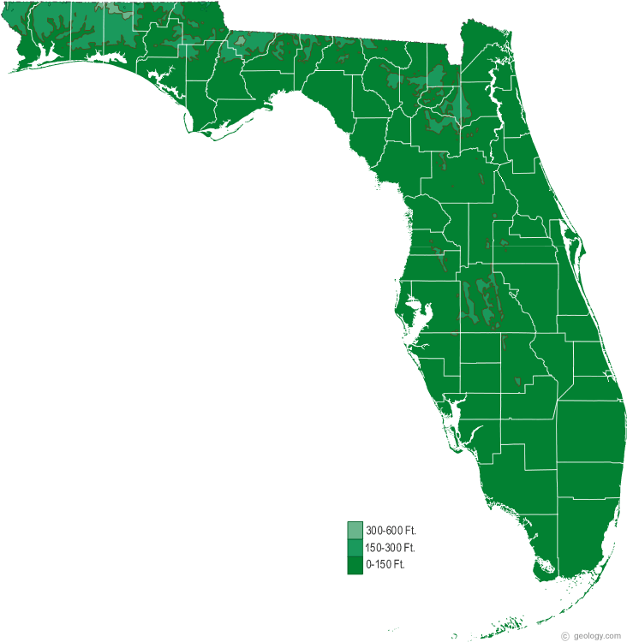
Introduction to Florida ICPC
The most common types of ICPC that Case Managers will use are Regulation 2: General Placement, and Regulation 7: Priority Placement.
States must conduct, complete, and report the results of a home study within 60 days of the request (except Reg 7 Priority- 30 days).
The 60 days time limit begins when the receiving state’s ICPC Office receives a request.
Pre-Service CM Specialty Module 5.1.26

Slide 29
Definition of a Native American Child
As defined by ICWA…an Indian child is any unmarried person who is under age 18 and is either a member of an Indian tribe or is eligible for membership in an Indian tribe and is the biological child of a member of an Indian tribe.
Pre-Service CM Specialty Module 5.1.27

Slide 30
Activity D: The Indian Child Welfare Act
Instructions:
Watch the video, “Struggle for Identity”.
Consider the following questions:
How did ICWA affect this case?
Why is it important to determine a child’s Indian heritage as quickly as possible?
What responsibilities do you think you have when determining if a child is of Indian heritage?
Be prepared to discuss.
Pre-Service CM Specialty Module 5.1.28

Slide 31
Unit 5.2
Meeting Children’s Needs in
Out-of-Home Care
Pre-Service CM Specialty Module 5.2.1
Notes:
3.1.4

Slide 32
Learning Objectives
Explain what a Child Resource Record is and case management responsibilities associated with it.
Explain what a CBHA is and how it is utilized.
List the steps to follow when a child enters care on medication or needs medication while in care.
Explain informed consent and what reasonable efforts are to obtain it.
Evaluate a medical report to demonstrate knowledge of what needs to be included.
Specify information relating to psychotropic medication required to be entered in FSFN.
Explain case management’s role in children’s medical and dental care.
Describe case management responsibilities regarding education for children in out-of-home care.
Explain what an IEP is.
Define a surrogate parent and who can be that surrogate.
List the steps of reporting a child missing and reporting when a child has returned.
Explain reasonable efforts to locate a child.
Pre-Service CM Specialty Module 5.2.2

Slide 33
65C-28.014 , Behavioral Health Services
CBHA required for all children in out-of-home care
Referral completed within 7 days of shelter
CBHA must be filed with the Court
Provides recommendations for services
Pre-Service CM Specialty Module 5.2.3

Slide 34
CBHA in FSFN
Pre-Service CM Specialty Module 5.2.4

Slide 35
Schedule of Required Medical Care
Infants- 2-4 days after birth, 1 month, 2, 4, 6, 9, 12, 15, 18 months
Ages 2 years -20, annually
Whenever child is sick or needs to be seen by a doctor
Dental- initial at 3 years (or before if medically necessary), every 6 months after or more frequently as recommended
Hearing test- as a newborn and at age 4, 5, 6, 8, 10, 12, 15, and 18
Vision test- at age 3, 4, 5, 6, 8, 10, 12, 15, and 18
Pre-Service CM Specialty Module 5.2.5
Notes:
3.4.76

Slide 36
Medical Care and Treatment
Types of Medical Care and Treatment:
Ordinary
Extraordinary
Emergency
Each type has different consent requirements.
Pre-Service CM Specialty Module 5.2.6

Slide 37
Medical Tab in FSFN
Pre-Service CM Specialty Module 5.2.7

Slide 38
Entering Medical Appointments
Pre-Service CM Specialty Module 5.2.8

Slide 39
Psychotropic Medication
65C-35.001 (18) definition and included medications
Court order or informed consent is required
Strict FSFN documentation guidelines
Pre-Service CM Specialty Module 5.2.9

Slide 40
Psychotropic medication when a child enters care
Continue medication until shelter hearing
Court authorization requested at shelter; only authorized until arraignment or 28 days after shelter
Written authorization obtained from parents also
Child evaluated by physician prior to arraignment or 28 days
Medical report and motion to continue authorization filed with the court
Documentation of med report being filed and medication information within 3 days of child beginning medication/receiving report
Pre-Service CM Specialty Module 5.2.10

Slide 41
Psychotropic medication when a child is already in care
Once appointment is scheduled, invite parents to attend to provide informed consent
Med report filled out completely by physician at appointment
Parents must sign to provide informed consent (if not TPR’d)
Child may not begin medication without parental consent or court order
Emergency circumstances exist when child may begin medication but court order/parental consent within 3 days
Med report filed with CLS within 3 days and documented in FSFN
Pre-Service CM Specialty Module 5.2.11

Slide 42
Pre-Consent
http://dcf.psychiatry.ufl.edu/
Must be obtained for children under 11 prescribed 2 or more meds
Case Manager will complete pre-consent form within 1 day of meds prescribed
Parent may waive pre-consent
Pre-Service CM Specialty Module 5.2.12

Slide 43
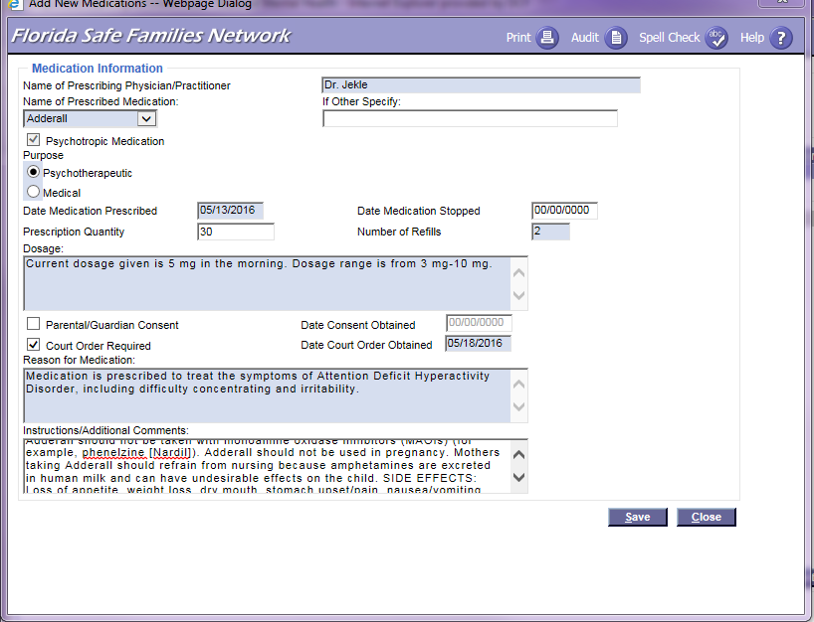
Medication Screen
Pre-Service CM Specialty Module 5.2.13

Slide 44
Activity E: Understanding the Medical Report
Instructions:
Review the Medical Report and make a list of what is “incorrectly” completed.
Be prepared to discuss.
Pre-Service CM Specialty Module 5.2.14

Slide 45
Potential Educational Issues for Children in Out-of-Home Care
Change schools more often
Miss more school days
More frequent suspension/expulsion
Lower academic test scores
Higher levels of grade retention
Higher rates of dropping out
Frequently have special education needs
More likely to obtain GED than diploma

Slide 46
Laws Affecting Educational Needs
Fostering Connections and Increasing Adoptions Act
- requires plan for educational stability
- placement takes into account current educational setting
- assurance that child will remain in educational setting or immediately be enrolled in a new school and that school be provided all education records
Individuals With Disabilities Education Act (IDEA)
- children with a disability are evaluated and provided individualized education services
- identifies who can act as a “parent” for purposes of education for a child
Chapter 39.0016
- children should remain in their current school if possible
- determine if transportation is available by the school board to keep the child in school
- outlines appointment of surrogate parent
Pre-Service CM Specialty Module 5.2.16

Slide 47
Case Manager’s Responsibilities
Obtaining records, filing with court/CRR
Communication with school
Communication with parents, GAL, caregiver
Attending meetings
Ensuring child is receiving appropriate services
Advocating for child
Pre-Service CM Specialty Module 5.2.17
Notes:
3.4.78

Slide 48
What is an Individualized Educational Plan?
Developed by the student, their teachers, parents, caregivers, and others as appropriate
Indicates present levels of academic achievement and functional performance
Contains measurable annual goals
May contain benchmarks or short-term objectives
Pre-Service CM Specialty Module 5.2.18

Slide 49
What is a Surrogate Parent?
“Surrogate parent” means an individual appointed to act in the place of a parent in educational decision making and in safeguarding a child’s rights under the Individuals with Disabilities Education Act F.S. 39.0016(1)(c).
Pre-Service CM Specialty Module 5.2.19
Notes:
9.1.13

Slide 50
The Child Resource Record
Notes:
3.4.69

Slide 51
Confidentiality of the Child Resource Record
Pre-Service CM Specialty Module 5.2.21
Notes:
3.4.70

Slide 52
Child Resource Record
Has all pertinent information gathered (medical, educational, mental health, etc.)
Must go with child on all health care visits and any subsequent placement
Must be kept current at each visit
Moves with the child
Stays in possession of the substitute care provider
Pre-Service CM Specialty Module 5.2.22

Slide 53
Child Resource Record Responsibilities
Child Resource Record
Case Manager
Foster Parent
Licensing Specialist
CPI
Pre-Service CM Specialty Module 5.2.23
Notes:
3.4.71

Slide 54
Missing Children
Pre-Service CM Specialty Module 5.2.24
Notes:
14.2.9

Slide 55
Reporting a Child Missing
Law enforcement contacted
Parents/custodian notified
Notification of GAL/CLS/Court
Documentation must be in FSFN within 1 business day
Pre-Service CM Specialty Module 5.2.25

Slide 56
When a Child is Recovered
Law enforcement contacted
Parents/custodian notified
Notification of GAL/CLS/Court
Child debriefed within 24 hours
Documentation must be in FSFN within 1 business day
Pre-Service CM Specialty Module 5.2.26

Slide 57
Unit 5.3
Family Visitation and
Maintaining Connections
Notes:
3.1.4

Slide 58
Learning Objectives
Explain what Family Time is.
Demonstrate ability to evaluate frequency and quality of family time.
Explain how the Keeping Families Safe Act affects visitation.
Identify why sibling visitation is important.
Explain the Case Manager’s role in helping a child maintain family and important connections.
Pre-Service CM Specialty Module 5.3.2

Slide 59
Family Time
Family time is meaningful and regular contact intended to allow the parents the opportunity to gain confidence and practice the behaviors they are learning/gaining from service providers.
Chapter 39:
Family time between the parent and child;
Family time among siblings who are separated in various placements; and
Grandparent visitation.
Pre-Service CM Specialty Module 5.3.3

Slide 60
Laws Governing Family Time
65C-30.007(6)(f)2.
65C-30.008(2)
39.402(9)
39.4085(16)
39.6012(3)(b)
65C-28.002
Pre-Service CM Specialty Module 5.3.4

Slide 61
Family Time/Visitation Evaluation
Frequency
Consistent
Routine
Quality
Excellent
Adverse
Sporadic
Rarely or Never
Adequate
Not Adequate
Pre-Service CM Specialty Module 5.3.5

Slide 62
Activity F: Family Time
Instructions:
Each group has been assigned a rating for Quality.
Using your Quality Rating Category, write down 3 action/behavioral indicators of how parents would demonstrate the quality rating.
Write your response on flip chart paper and be prepared to share.
Pre-Service CM Specialty Module 5.3.6

Slide 63
39.0139 “Keeping Children Safe Act”
“Presumption of Detriment”
Sexual battery
Removing minors from the state or concealing minors contrary to court order
Lewd & lascivious behavior
Lewdness & indecent exposure
Incest
Has been found by the court to be a sexual predator
When a parent or caregiver has been the subject of an intake alleging sexual abuse of any child; or has been found guilty of, or has plead guilty (or no contest) to:
Persons meeting any of the criteria may visit or have other contact with a child ONLY after a hearing & an order by the court allowing the visitation/contact.
Pre-Service CM Specialty Module 5.3.7

Slide 64
39.0139 “Keeping Children Safe Act”
The court must appoint an Attorney ad Litem or Guardian ad Litem, who has special training in the dynamics of child sexual abuse.
Any visitation or other contact ordered by the court in this situation will be supervised by:
A person specially trained in the dynamics of child sexual abuse or
Conducted in a supervised visitation program.
If the program has an agreement with the court, & has agreed to comply with the minimum standard guidelines specifically related to referrals of cases involving child sexual abuse.
Pre-Service CM Specialty Module 5.3.8

Slide 65
Sibling Visitation
Fostering Connections and Increasing Adoptions Act
39.4085(16)
39.6012 (3)(b)
Reasonable efforts to provide visitation and interaction outside of parent visitation
Sibling visitation should occur once per week unless court orders otherwise
Case plan must outline plan for sibling visitation
Pre-Service CM Specialty Module 5.3.9

Slide 66
Activity G: Sibling Separation and its Effects
Instructions:
Watch the video about siblings being placed apart.
Record your answer to the following question:
How do you think not seeing their siblings affected the children?
3. Be prepared to discuss.
Pre-Service CM Specialty Module 5.3.10

Slide 67
Lifebooks

Slide 68
Unit 5.4
Transitions and
Achieving Permanency
Notes:
3.4.67

Slide 69
Learning Objectives
Name the different transitions for children in out of home care.
Describe how transitions affect the child and caregiver and what a Case Manager’s role is in helping them through transitions.
Explain what an exit interview is and how it is utilized.
Identify Case Management’s responsibilities when a child is reunified.
Explain what a transition plan is.
Identify what life skills are and how Case Manager’s ensure life skills are being provided.
List the services available after a child turns 18 and the requirements to qualify.
Pre-Service CM Specialty Module 5.4.2

Slide 70
Activity H: The Process of Transitioning
Instructions:
Think of a transition you experience in childhood.
Draw the feelings you remember and the memories you have in terms of senses, smell, sounds, sight, etc.
Answer these questions:
Who can summarize this activity?
How comfortable were you in this activity? Why?
What stands out to you about this activity?
What part of the training helped you most in completing this activity?
How did others around you in your memory handle the situation and what would you do the same or differently as an adult?
Pre-Service CM Specialty Module 5.4.3

Slide 71
Types of Transitions
Child in out of home care
Another foster home
Reunification
Adoption
PESS/Extended Foster Care
Relative/non-relative placement/Permanent Guardianship
Pre-Service CM Specialty Module 5.4.4

Slide 72
The Stages Grief
Stage 1 Shock and Denial
Stage 2 Anger
Stage 3 Bargaining
Stage 4 Despair/ Depression
Stage 5 Understanding
Pre-Service CM Specialty Module 5.4.5
Notes:
3.4.74

Slide 73
Creating a Good Transition
Talk with children about the changes that occur with transition.
Help children understand their own history.
Help children adjust to losses.
Notes:
3.4.77

Slide 74
Talking with Children About the Changes
Address questions.
Tell the truth.
Repeat conversations.
Talk during activities.
Plan the discussion.
Make it safe to talk.
Provide analogies.
Pre-Service CM Specialty Module 5.4.7
Notes:
3.4.78

Slide 75
Activity I: Transitions
Instructions:
You have been assigned one of the individuals in the video.
Watch the video and takes notes on your assigned role.
Write down what you think could have been done differently.
Be prepared to discuss with the class.
Pre-Service CM Specialty Module 5.4.8

Slide 76
Helping the Foster Family Through Loss
Notes:
3.4.81

Slide 77
The Exit Interview FAC 65C-28.017
Children 5-18.
30 days or more.
Within 5 days.
Interview tool.
Follow-up.
Pre-Service CM Specialty Module 5.4.10
Notes:
6.1.12

Slide 78
Exit Interview Follow-Up Tasks
Report to Hotline, if needed
Corrective Action Plan, if needed
Documentation
Meet with Foster Parents
Re-Licensing Summary
Pre-Service CM Specialty Module 5.4.11
Notes:
6.1.14

Slide 79
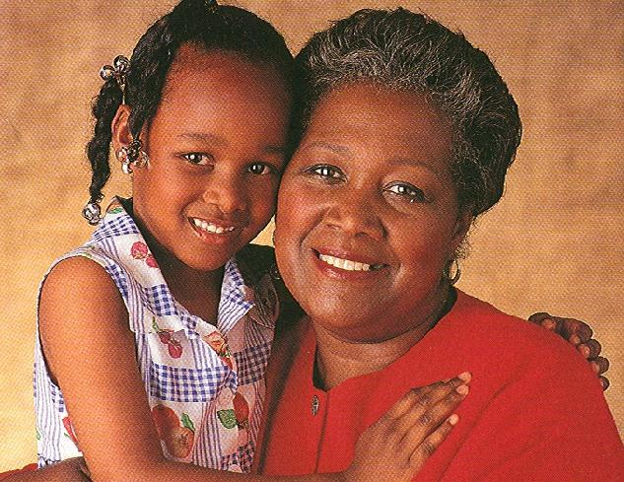
What is Permanency?
Pre-Service CM Specialty Module 5.4.12
Notes:
11.4.33

Slide 80
Chapter 39 ~ Permanency
Reunification
Adoption
Permanent guardianship of a dependent child under
Permanent placement with a fit and willing relative under
Placement in another planned permanent living arrangement
Pre-Service CM Specialty Module 5.4.13
Notes:
11.4.34

Slide 81
Reunification
65C-30.014 and CFOP 170-7
Weekly or bi-weekly visitation
Post Placement case plan
Monitoring of the safety plan
Assessing child well being
Pre-Service CM Specialty Module 5.4.14

Slide 82
Transitioning to an Adoptive Family
Talk with the youth about changes that occur with an adoption
Validate the child’s memories, experiences, and feelings
Tell the truth to the child when they ask a question
Help children grieve their past so they can move on to a feeling of permanency
Inform adoptive parents of the issues the Case Manager and child are discussing so they can be engaged in supporting the child
Pre-Service CM Specialty Module 5.4.15

Slide 83
Help the child…
talk about their feelings in their own words.
understand legal differences by explaining the adoption court hearing and what will happen.
understand parenting differences.
adjust to losses by creating a life book, eco-map, etc. so the child can see and know their history.
by being mindful of the child’s needs in the context of age, mental and physical health, personality and ethnic or racial experiences.
Pre-Service CM Specialty Module 5.4.16

Slide 84
Independent Living
Transitioning before turning 18
Extended Foster Care (EFC)
Postsecondary Educational Services and Supports (PESS)
Aftercare services
Pre-Service CM Specialty Module 5.4.17
Notes:
3.4.77

Slide 85
What are “Life Skills”?
Life skills are skills that are necessary or desirable for full participation in everyday life.
Washing clothes
Cleaning a house
Using public transportation
Grocery shopping
Budgeting
Managing a bank account
Renting a home
Scheduling doctor’s appointments
Applying for jobs
Resume writing
Pre-Service CM Specialty Module 5.4.18

Slide 86
Transition Planning
F.S. 39.6035 and F.A.C. 65C-41.004
Must be completed within 90 days of 18th birthday
Must include
- participation in qualifying activity
- approved living arrangement
- allowance
- parenting goals and needs if a parent
- short term/long term goals
- young adult and caregiver obligations and responsibilities
Pre-Service CM Specialty Module 5.4.19

Slide 87
Extended Foster Care Requirements
Licensed Foster Care when turning 18
Must be enrolled in qualifying program
Requires face to face contact with Case Manager
Resides in approved supervised living arrangement
Can reapply until age of 21 if terminated from program
Eligibility ends when young adult turns 21 (22 if documented disability)
Pre-Service CM Specialty Module 5.4.20

Slide 88
Postsecondary Educational Services and Support (PESS)
Must be in foster care at age 18 or adopted 16 or older (for at least 6 months)
18 years old but not yet 23 (can apply anytime between)
Must have high school diploma or equivalent
Must be enrolled in a Postsecondary education program
Provide ongoing documentation of satisfactory academic progress
Pre-Service CM Specialty Module 5.4.21
Notes:
3.4.76

