Slide 1

Module 1
Introduction to Case Management

Slide 2

Agenda
1.1 Review of CORE
1.2 Overview of the Case Management Process
1.3 Purposeful Contacts
1.4 Laws, Rules and Policies
1.5 Understanding Quality Assurance Case Reviews and Family-Centered Practice
Pre-Service CM Specialty Module 1.0.2

Slide 3
Unit 1.1
Review of CORE
Pre-Service CM Specialty Module 1.1.1

Slide 4

Learning Objectives
Identify key concepts and terminology from CORE.
Review the steps in the Florida Child Welfare Practice Model.
Pre-Service CM Specialty Module 1.1.2

Slide 5

Activity A: CORE Terminology Recall Game
Instructions:
Define the term.
Explain why the term is important to Child Welfare Practice.
Pre-Service CM Specialty Module 1.1.3

Slide 6
Activity B:
Safety Intervention Across the Florida Child Welfare Practice
Instructions:
Identify the significant steps in each process.
Pre-Service CM Specialty Module 1.1.4

Slide 7
Intervention Across the Florida Child Welfare Practice Model
Hotline Assessment: Identify and Screen In Primary Service Population
CPI Family Functioning Assessment: Problem Identification
Ongoing Family Functioning Assessment: Determine What Must Change
Safety Plan and Case Plan Evaluation: Measuring Progress for Change
Anticipated Intervention Outcomes: Case Closure – Child Safety, Permanency and Well-being
Hotline Assessment seeks to screen in cases and determine response times where reported information indicates that maltreatment may have occurred and/or there are indications that children may be unsafe due to Present or Impending Danger.
Collect information related to Maltreatment, the surrounding circumstances, child functioning, adult functioning, parenting general and parenting discipline.
Determine Impending Danger and Diminished Caregiver Protective Capacities.
Establish sufficient Safety Plans.
Engage caregivers to facilitate change.
Discuss reason for case opening and develop “Danger Statement”.
Promote family self-determination: raise self-awareness regarding danger and caregiver protective capacities.
Co-construct case plan with family to establish:
  Family Goal
Outcomes to achieve/ change/enhance/ caregiver protective capacities
Address child well-being needs.
Revise/manage Safety Plans.
Continue to engage caregivers, promote personal choice; raise self-awareness and facilitate change.
Focus on progress related to goals and outcomes for change: Enhancing Diminished Caregiver Protective Capacities.
Assess effectiveness of change strategies.
Safety Management:
Status of Impending Danger
Safety Planning Analysis
Least Intrusive Safety Plan.
In the absence of impending danger and demonstrated Enhanced Caregiver Protective Capacities, close the case.
If reasonable efforts to improve diminished protective capacities have been provided but cannot be achieved in the required time frames, alternative permanency for child is arranged.

Slide 8
Unit 1.2
Overview of the
Case Management Process
Pre-Service CM Specialty Module 1.2.1

Slide 9
Learning Objectives
Identify and describe the four family engagement standards used for information gathering.
Recognize the importance of information collection during the case management process.
Pre-Service CM Specialty Module 1.2.2

Slide 10
Case Management
You will be responsible for:
  assessing how the family is functioning,
  correctly identifying what in the family system needs to change,
  determining when behavior change has occurred, and
  recognizing immediate and ongoing safety needs.
Pre-Service CM Specialty Module 1.2.3

Slide 11
Case Management Flowchart
Safety Management and Enhancing Caregivers Protective Capacities
Preparation
Introduction
Exploration
Case Planning
Develop Strategies for Change Case Plan Outcomes
Determine What Must Change Through Information Collection
Engagement
Developing Strategy for Engagement
Complete FFA-Ongoing
Child Needs
Danger Statement
Family Goal
Motivation for Change
Case Plan
Caregiver Protective Capacity Assessment
Pre-Service CM Specialty Module 1.2.4

Slide 12
Progress
Update
Safety Management and Enhancing Caregiver Protective Capacity
Family Progress
Evaluate progress family has made since last assessment
Develop modification based on Progress Update
Modify
Case Plan
Modify
Safety Plan
Modify
Family Time
Modifications
Case Plan Outcome
Evaluation
Information Gathering
Assess and analyze information gathered
Monthly Contacts
Collaterals
Family Time
Observation
Complete Progress
Update
Caregiver Protective Capacity
Child Strengths and
Needs
Danger Statement
Family Change Strategy
Stages of Change
Safety Analysis/Conditions for Return
Quality and Frequency of Family Time
No Change Needed
Pre-Service CM Specialty Module 1.2.5

Slide 13
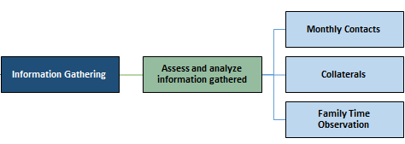
Progress Update
Pre-Service CM Specialty Module 1.2.6

Slide 14
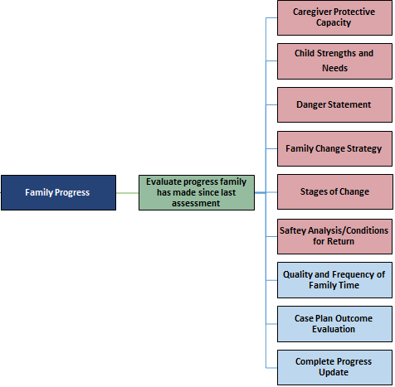
Progress Update
For the first Progress Update, the information in the pink boxes is pulled from the FFA-Ongoing.
Pre-Service CM Specialty Module 1.2.7

Slide 15
Progress Update
Develop modification based on Progress Update
Modify
Case Plan
Modify
Safety Plan
Modify
Family Time
Modifications
No Change Needed
Pre-Service CM Specialty Module 1.2.8

Slide 16
Information Collection
KNOW THE FAMILY
Extent of Maltreatment
Adult Functioning
General Parenting Practices
Disciplinary Practices/
Behavior Management
Surrounding Circumstances
Child Functioning
Pre-Service CM Specialty Module 1.2.9

Slide 17
Unit 1.3
Purposeful Contacts
Pre-Service CM Specialty Module 1.3.1

Slide 18
Learning Objectives
Describe the importance of Case Manager’s working relationships with parents, children and caregivers.
Identify the policy requirements for contacts.
Identify the tenets of purposeful contacts with families.
Pre-Service CM Specialty Module 1.3.2

Slide 19
Purposeful Contacts – the Evidence
Engagement research suggests that the following caseworker behaviors are important to mitigating family fears and building the rapport necessary for effective helping:
Establishing open, honest communication with parents (Yatchmenoff, 2005)
Requesting family participation and feedback in the planning process (Regional Research Institute for Human Services, 1998; Rooney, 1992)
Providing instruction and reinforcement in the performance and completion of mutually agreed-upon activities (Rooney, 1992)
Family Reunification: What the Evidence Shows, U.S. Department of Health and Human Services, 2011
Pre-Service CM Specialty Module 1.3.3

Slide 20
Purposeful Contacts-- the Evidence
“Foster parents facilitate family reunification through both the mentoring of the birth parents and the support of child visitation.”
“The development of a positive relationship between the foster and birth parents may allow children to avoid the stress of divided loyalties and position foster parents to play a supportive role after reunification.”
(Lewis & Callaghan, 1993; Sanchirico & Jablonka, 2000).
Pre-Service CM Specialty Module 1.3.4

Slide 21
Contact Frequency--Children
Provide initial face-to-face contact within two working days of case transfer or the date of court supervision, whichever is earlier
Face-to-face contacts with the child and caregiver will occur at least once every seven (7) days as follows:
  For all in-home safety plans, for the first 30 days from the time the safety plan was established.
  For all out-of-home plans, as long as the child in an out-of-home plan remains in shelter status.
F.A.C. 65C-30.007
Pre-Service CM Specialty Module 1.3.5

Slide 22
Contact Frequency—Children, continued
Provide face-to-face contact with every child under supervision and living in Florida no less frequently than every 30 days in the child’s residence.
If the child lives in a county other than the county of jurisdiction, visits are provided by a secondary worker assigned.
Make an unannounced visit to the child’s current place of residence at least every 90 days or more frequently if warranted based on the safety plan.
F.A.C. 65C-30.007
Pre-Service CM Specialty Module 1.3.6

Slide 23
Contact Frequency—Parent(s)
Contact requirements apply to both the parent responsible for the maltreatment and when children have been removed, contacts with the non-maltreating parent.
Maintain regular face-to-face contact a minimum of every 30 days unless parental rights have been terminated or the court rules otherwise.
If the parent lives in a county other than the county of jurisdiction a secondary worker is responsible for contacts.
F.A.C. 65C-30.007
Pre-Service CM Specialty Module 1.3.7

Slide 24
Contact Frequency--Caregivers
Same requirements as for child contacts, caregivers will be seen at the time of child visits.
Separate discussions with caregivers should occur during child visits.
Pre-Service CM Specialty Module 1.3.8

Slide 25
Other Purposeful Contacts
Family members who know the child and parent.
Other persons who know the child (child care staff, teachers, school counselor, coach).
Treatment providers (substance abuse professionals, Batterer’s Intervention group leader, therapist).
Pre-Service CM Specialty Module 1.3.9

Slide 26
Purposeful Contacts: Questions to Think About
Are the child’s needs being met?
Is the Safety Plan sufficient in managing the danger threats?
Do the parents understand their rights and responsibilities?
Does everyone know the goal of the case and how it is being achieved?
Pre-Service CM Specialty Module 1.3.10

Slide 27
Tenets of
Ongoing Assessment
Treat families as unique individuals and family systems.
Promote mutual respect.
Identify and build on family strengths.
Encourage purposeful family expression.
Pre-Service CM Specialty Module 1.3.11

Slide 28
Tenets of Ongoing Assessment, continued
Respect self-determination.
Control your emotional involvement.
Seek to be less-intrusive.
Promote accountability.
Pre-Service CM Specialty Module 1.3.12

Slide 29
Activity C:
Putting the Tenets to Work in Purposeful Contacts
Instructions:
In small groups, using your assigned core tenets, identify what actions would demonstrate accomplishing the perspective of each of the 8 core tenets.
Be prepared to share with the whole class.
Pre-Service CM Specialty Module 1.3.13

Slide 30
Unit 1.4
Laws, Rules and Policies
Pre-Service CM Specialty Module 1.4.1

Slide 31
Learning Objectives
Identify and review the laws, rules and policies governing child welfare and case management.
Pre-Service CM Specialty Module 1.4.2

Slide 32
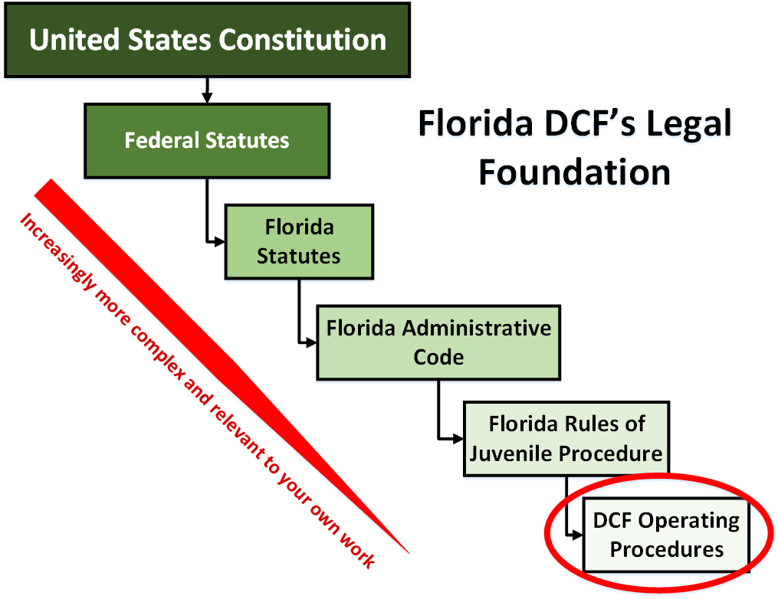

Slide 33
Activity D: Laws/
Policies and Procedures for the Case Manager
Instructions:
In small groups, research your topic(s). On flip chart paper, list what you feel are the highlights or what is important for a Case Manager to know about your topic(s).
Class review: Have a spokesperson for the group share with the class.
Pre-Service CM Specialty Module 1.4.4

Slide 34
Finding Topics in
Statutes, Administrative Code, Operating Procedures and Practice Guidelines
Florida Statutes: http://centerforchildwelfare.fmhi.usf.edu/flstat/FloridaStatues.shtml
Florida Administrative Code:
  http://centerforchildwelfare.fmhi.usf.edu/HorizontalTab/FloridaAdminCode.shtml#
Operating Procedures/Practice Guidelines:
  http://centerforchildwelfare.fmhi.usf.edu/HorizontalTab/DeptOperatingProcedures.shtml
Pre-Service CM Specialty Module 1.4.5

Slide 35
Unit 1.5
Understanding Quality Assurance Case Reviews and Family-Centered Practice
Pre-Service CM Specialty Module 1.5.1

Slide 36
Learning Objectives
Define child well-being, permanency and safety.
Explain the application of Family-Centered Practice during the work of the Case Manager.
Identify the different types of quality assurance reviews used in child welfare.
Pre-Service CM Specialty Module 1.5.2

Slide 37

Quality Assurance
Case Reviews
Rapid Safety Feedback
Florida Child Welfare Service Reviews
Federal Child and Family Services Reviews
Pre-Service CM Specialty Module 1.5.3

Slide 38




Safety, Permanency and
Well-Being
Pre-Service CM Specialty Module 1.5.4

Slide 39

Safety Outcomes
Children are first and foremost, protected from abuse and neglect.
Children are safely maintained in their own homes whenever possible and appropriate.
Pre-Service CM Specialty Module 1.5.5

Slide 40
Permanency Outcomes
Children have permanency and stability in their living situations.
The continuity of family relationships and connections is preserved for children.
Pre-Service CM Specialty Module 1.5.6

Slide 41

Well-Being means…
that a child’s basic needs are met and the child has the opportunity to grow and develop in an environment which provides consistent nurture, support and stimulation.
Pre-Service CPI Specialty Module 1.5.7

Slide 42
Activity E: Safety, Permanency or Well-Being
Instructions:
Read the scenarios.
Determine what the scenario is describing. In the box place an “S” for Safety, “P” for Permanency or “WB” for Well-Being.
Pre-Service CM Specialty Module 1.5.8

Slide 43
Family-Centered
Practice
  Enhances capacity.
  Focuses on family as a whole.
  Establishes partners in the change process.
  Approaches family in a developmentally sensitive way.
Pre-Service CM Specialty Module 1.5.9

Slide 44
Foundations for
Child Welfare Practice Model
Demonstrate:
Respect
Courtesy
Empathy
Encouragement
Professionalism
Respond:
Promptly
By following through with commitments
By continually seeking to engage
Enable:
Participation and involvement
Family expertise
Feedback (Ask what is needed)
Family Education/ Knowledge (Provide necessary information)
Pre-Service CM Specialty Module 1.5.10

Slide 45
Activity F: Using
Family-Centered Practice
Instructions:
Read the scenario.
Identify what Family-Centered Practice skills you could use to engage the family.
List any barriers, fears, or apprehensions you may have when using Family-Centered Practice with this family.
Pre-Service CM Specialty Module 1.5.11

Slide 46
Family Teams and
Family Meetings
Focus on family needs, not symptoms.
People are capable of change.
All people and families have strengths.
A solution generated by a family responds to its uniqueness.
Family and friends provide love and care, which helps a family to take supported risks.
Caring people in the same room create energy for change.
Pre-Service CM Specialty Module 1.5.12

Slide 47
Sense of self
Mental and physical health
Connection with biological family
Connection with the community
Permanency
Educational achievement
Successful peer relationships
STABILITY:
Just as the trunk and roots of a tree are essential items for a tree to grow and bloom, stability is the foundation to a child’s well-being.
Pre-Service CM Specialty Module 1.5.13

