Slide 1











FSFN Independent Living (IL) Enhancements
Topic 4: Young Adult Judicial Review Worksheet
December 2013

Slide 2
Introduction
Topic 4: Young Adult Judicial Review Worksheet
  These changes support:
    Nancy C. Detert Common Sense and Compassion Independent Living Act; SB 1036
    The FSFN Young Adult Judicial Review Worksheet
Notes:
is new functionality and is comprised of two components: the Young Adult Case Planning Worksheet and the Young Adult Judicial Review Worksheet. These components are located within the Independent Living module and consist of numerous tabs to support documentation of the young adult case

Slide 3
Overview of YA Case Judicial Review Process
Independent Living Page as Access Point
Created and launched from the Actions List Box on the IL page via the hyperlink
  Hyperlink only displays after the CP Worksheet is saved initially
  Hyperlink launches a new Legal Documentation page for the Young Adult Judicial Review Template

Slide 4
Overview of YA Case Judicial Review Process (cont.)
YA Case Plan Worksheet used to create YA Judicial Review Worksheet
The FSFN Young Adult Case Planning tool is new functionality and is comprised of two components:
  The Young Adult Case Planning Worksheet
  The Young Adult Judicial Review Worksheet
    These components are located within the Independent Living module and consist of numerous tabs to support documentation of the young adult case
YA Judicial Review Worksheet used for YA Judicial Review Social Study Report for EFC
New templates to produce legal documents for the Case Plan and Judicial Review Social Study Report

Slide 5
YA Judicial Review Worksheet
Overview of Header
Case Information group box label
  Header group box contains basic case and case plan information for the JR Worksheet
Overview of Actions Box
  Create New YA Court Involved Case Plan (Legal Doc)
  View Existing Legal Documents

Slide 6
YA Judicial Review Worksheet (cont.)
Overview of Text List Box
Hyperlink launches the appropriate template
Supervised Living Arrangement Tab
Contains information regarding the supervised living arrangement for the young adult associated to the CP Worksheet
  Updating questions from CP Worksheet

Slide 7
YA Judicial Review Worksheet (cont.)
Resources/Participation Tab
Contains information regarding resources available in the Living Arrangement and the young adult’s participation in the court hearing
Outcome Evaluation Tab
Contains information on the desired outcomes and associated actions and tasks, including a progress evaluation
  Evaluation of Individual outcomes
  Case Plan Goals

Slide 8
YA Judicial Review Worksheet (cont.)
Review Summary Tab
Contains a review summary of the young adult’s progress on the Case Plan
Attachments Tab
  Contains a checklist of documentation that needs to be attached to the Young Adult Judicial Review legal document
Create YA Judicial Review Social Study Report Legal Document
  Hyperlink launches a new Legal Documentation page for the Young Adult Judicial Review Template

Slide 9
YA Judicial Review Worksheet (cont.)
Assessing Existing Legal Document
The Legal Documentation page is currently in FSFN
  Create New Young Adult Judicial Review (Legal Doc) hyperlink on the Young Adult Judicial Review Worksheet page

Slide 10
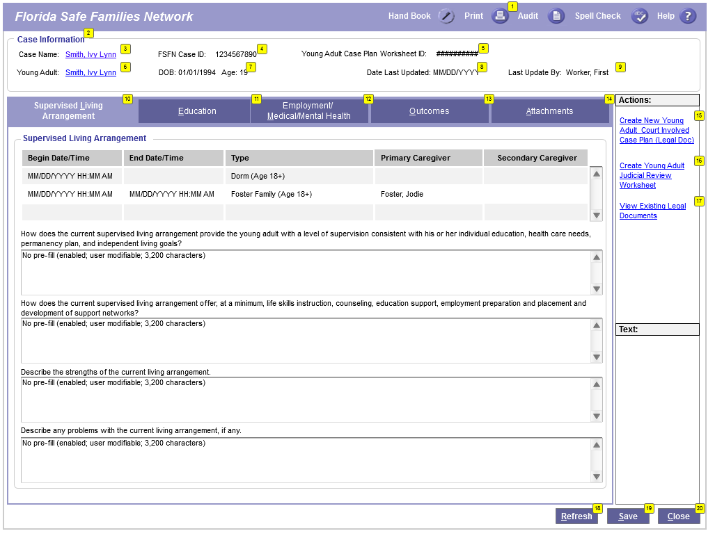
Young Adult Judicial Review Worksheet Page

Slide 11

Young Adult Judicial Review Worksheet Page FSFN System Demo

Slide 12
Reference Information
User Guides, How Do I Guides, and Topic Papers
  Maintain Case
  Education
  Medical/Mental Health
  Meetings
  Independent Living
  Young Adult Case Planning Worksheet
Visit the DCF FSFN Website:
http://fsfn.dcf.state.fl.us

Slide 13

Please go to …
  www.centerforchildwelfare.org

