Slide 1
FSFN Independent Living (IL) Enhancements Topic 3: Young Adult (YA) Case Plan Worksheet
December 2013

Slide 2
Introduction
Topic 3: Young Adult Case Plan Worksheet
These changes support:
Nancy C. Detert Common Sense and Compassion Independent Living Act; SB 1036
The FSFN Young Adult Case Planning tool
Notes:
is new functionality and is comprised of two components: the Young Adult Case Planning Worksheet and the Young Adult Judicial Review Worksheet. These components are located within the Independent Living module and consist of numerous tabs to support documentation of the young adult case

Slide 3
Overview of YA Case Planning Process
Independent Living Page as Access Point
Created and launched from the Actions and Text List Box on the IL page via the hyperlink
Hyperlink will not appear on IL page until it has been initially saved and participant is 18 or older
Only one YA Case Planning Worksheet page within the IL module
Since the IL page is associated to a FSFN Case and one case participant, it is possible for a person to be associated to more than one YA Case Planning Worksheet page
YA Case Planning Worksheet page launched in edit mode if you have:
appropriate security profile
open assignment to the open FSFN Case
page was not accessed via the Search Utility page
From the Young Adult Case Planning Worksheet page, the user can create a new Young Adult Court Involved Case Plan legal document

Slide 4
YA Case Plan Worksheet used to create YA Judicial Review Worksheet
Hyperlink only displays after the CP Worksheet is saved initially
Upon clicking the hyperlink, the Young Adult Judicial Review Worksheet launches and is pre-filled with the appropriate data from the CP Worksheet
Only one JR Worksheet can be created from the CP Worksheet
After the JR Worksheet is saved initially, the hyperlink does not display on the CP Worksheet
The JR Worksheet is only accessed from the IL page

Slide 5
YA Case Plan Worksheet
Overview of Header
Case Information group box label
Header group box contains basic case and case plan information.
Overview of Actions Box
Create New Young Adult Court Involved Case Plan (Legal Doc)
Create New Young Adult Judicial Review Worksheet
View Existing Legal Documents

Slide 6
YA Case Plan Worksheet (cont.)
Overview of Text List Box
Hyperlink launches the appropriate template
Supervised Living Arrangement Tab
Captures information on the supervised living arrangement and current situation
Education Tab
Displays and captures information regarding the young adult’s education

Slide 7
YA Case Plan Worksheet (cont.)
Employment/Medical/Mental Health Tab
Contains information regarding the young adult’s employment and medical/mental health
Outcomes Tab
Contains information regarding the outcomes identified for the young adult
Attachments Tab
Provides a checklist of documentation that needs to be attached

Slide 8
YA Case Plan Worksheet (cont.)
Create YA Court Case Plan for EFC Legal Document
From the Legal Documentation page you launch the YA Court Involved Case Plan template
Assessing Existing Legal Documents
The Legal Documentation page is currently in FSFN
Create New Young Adult Court Involved Case Plan (Legal Doc) hyperlink on the Young Adult Case Planning Worksheet page

Slide 9
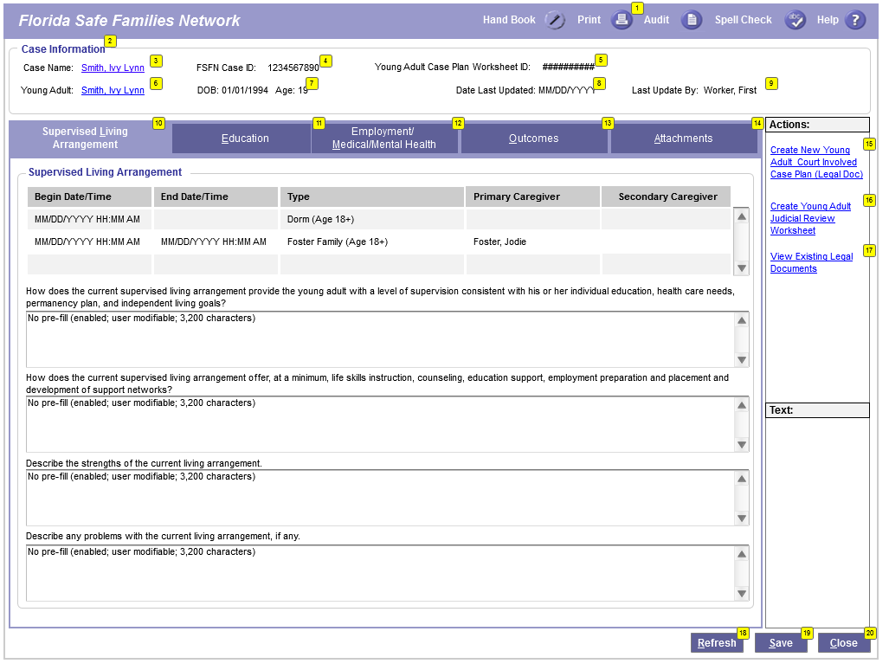
Young Adult Case Planning Worksheet Page

Slide 10
Young Adult Case Planning Worksheet Page FSFN System Demo

Slide 11
Reference Information
User Guides, How Do I Guides, and Topic Papers
Maintain Case
Education
Medical/Mental Health
Meetings
Independent Living
Young Adult Case Planning Worksheet
Visit the DCF FSFN Website:
http://fsfn.dcf.state.fl.us

Slide 12
Please go to …
www.centerforchildwelfare.org

