Slide 1
FSFN Independent Living (IL) Enhancements Topic 1: Overview and General Changes
December 2013

Slide 2
Agenda
This training module is divided into the following topics:
Topic 1: Overview and General Changes
Topic 2: Extended Foster Care (EFC) and Postsecondary Education Services and Support (PESS) Program Eligibility
Topic 3: Young Adult Case Plan Worksheet
Topic 4: Young Adult Judicial Review Worksheet

Slide 3
Introduction
Topic 1: Overview and General Changes
These changes support:
Nancy C. Detert Common Sense and Compassion Independent Living Act; SB 1036- Enhancements to the Road to Independence (RTI) and Transitional Services programs
New program eligibility determination for young adults exiting the foster care system into Extended Foster Care (EFC) and/or Postsecondary Education Services and Support (PESS)
New Young Adult Case Plan and Judicial Review Worksheets to document case planning actions and tasks to support the young adult’s transition from care into independent living

Slide 4
Changes to Supporting Pages
Maintain Case
An additional role of “Legal Guardian of Young Adult” has been added
This information feeds the participants section of the Young Adult Case plan and Judicial Review Worksheets

Slide 5
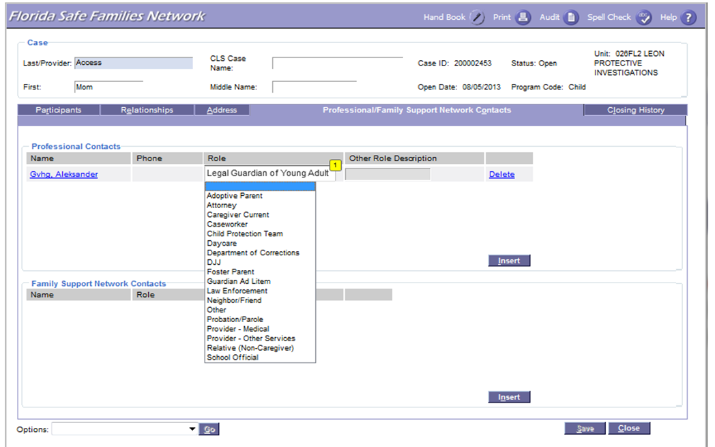
Maintain Case Worksheet Page

Slide 6
Maintain Case FSFN System Demo

Slide 7
Changes to Supporting Pages (cont.)
Education Information Tab
The modification to the Education Information tab is the addition of a question to determine if the young adult has a Transitional Individualized Education Plan (TIEP)

Slide 8
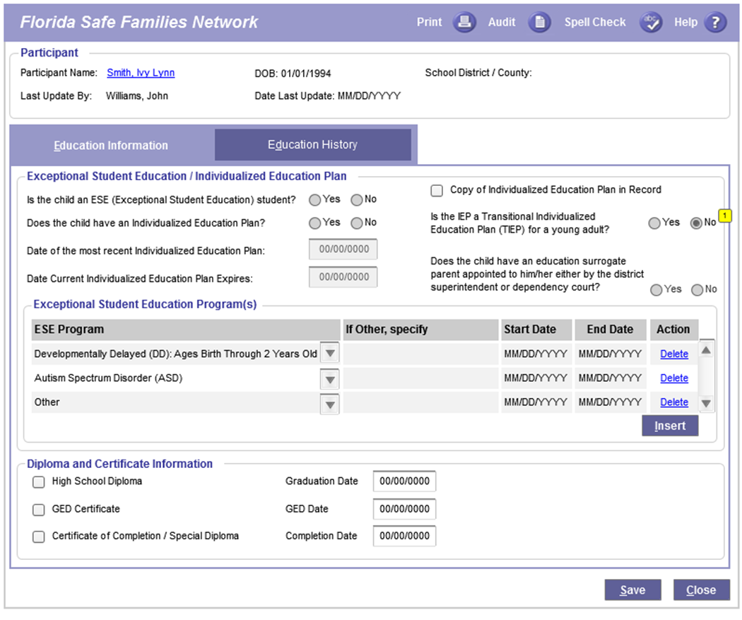
Education Information Tab

Slide 9
Changes to Supporting Pages (cont.)
Education History Tab
The addition of the “Number of Hours Currently Enrolled and Total Credits Earned to Date” is displayed on this page. This information is populated from the Maintain School History pop-up page.
The Number of Hours Currently Enrolled and Total Credits Earned To Date now display in the Education History Group box

Slide 10
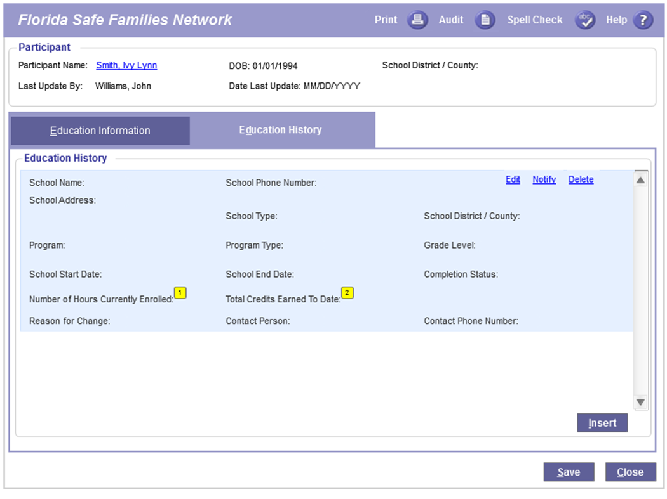
Education History Tab

Slide 11
Changes to Supporting Pages (cont.)
Maintain Education History Pop-Up
Additional reference values to School Type
2 year College
4 year College or University
New grade level reference value
Associate Degree
Two added fields
Number of Hours Currently Enrolled
Total Credits Earned To Date
New Reason for Change reference values
18+: Young Adult Graduated
18+: Young Adult No Longer Attending/Did Not Graduate

Slide 12
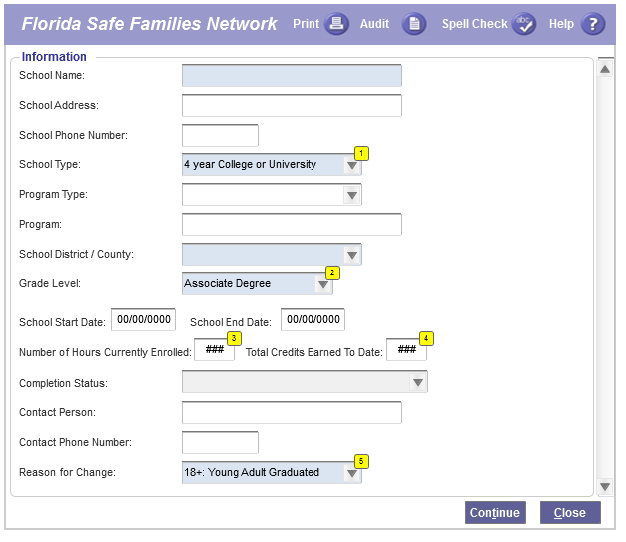
Maintain Education History Pop-Up

Slide 13
Education FSFN System Demo

Slide 14
Changes to Supporting Pages (cont.)
Medical Mental Health (MMH)
Within the MMH Conditions group box the reference value of “18+ Other” has been added as a new category
This value can only be selected for a participant age 18 or older
If the value of “18+ Other” is chosen, the Diagnosed Condition Type text box is required
If the user does not have the appropriate security for MMH records, the entire MMH group box does not display

Slide 15
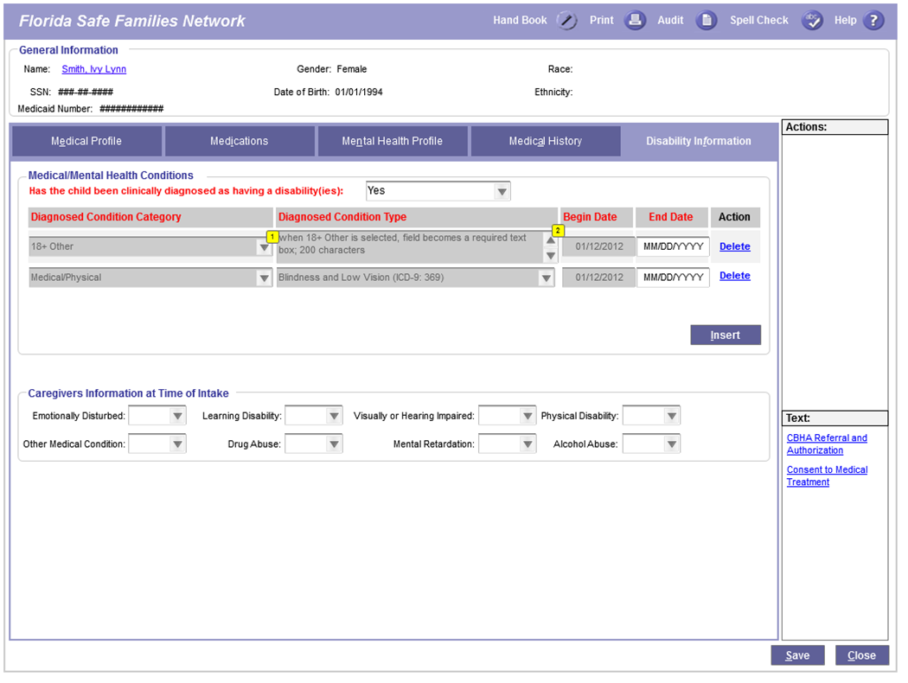
Medical Mental Health – Disability Information Tab

Slide 16
Medical Mental Health FSFN System Demo

Slide 17
Changes to Supporting Pages (cont.)
Meetings
The Meetings page provides users with the ability to document the details of various meetings that take place throughout the life of a FSFN case. The following transition planning meeting types have been added:
Transition Planning-Initial
Transition Planning-Ongoing
Transition Planning-Closure

Slide 18
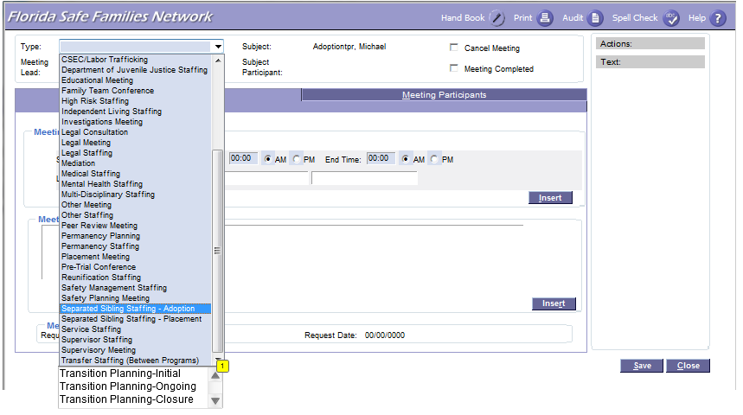
Meetings Page

Slide 19
Meetings FSFN System Demo

Slide 20
General Changes to IL Page
Hyperlinks
Person Management – participant name hyperlink takes user to person management page
Maintain Case – case name hyperlink takes user to maintain case page
Upload Images
Hyperlink only displays after the IL page is saved initially
Hyperlink launches a new Imaging page to allow user to upload an image or a document; defaults Image Category to IL and participant is the young adult
View Attached Images
Hyperlink displays only once when at least one Imaging page is associated with the IL page
Hyperlink launches the Image History page
If added directly to the file cabinet, it will not display for IL page

Slide 21
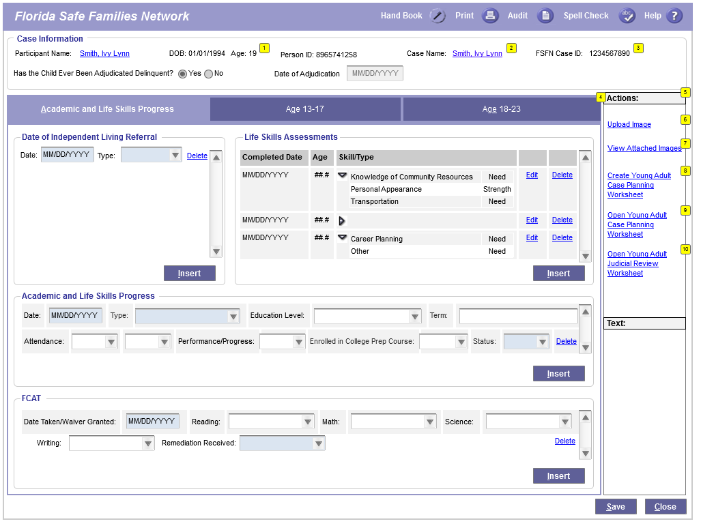
Independent Living Page

Slide 22
General Changes to IL Page (cont.)
Living Skills Assessment
The Age Assessment drop down field has been updated to include additional age values – 18, 18.5, 19, 19.5, 20, 20.5, 21, 21.5
Only available if case participant is of age 18 or older

Slide 23
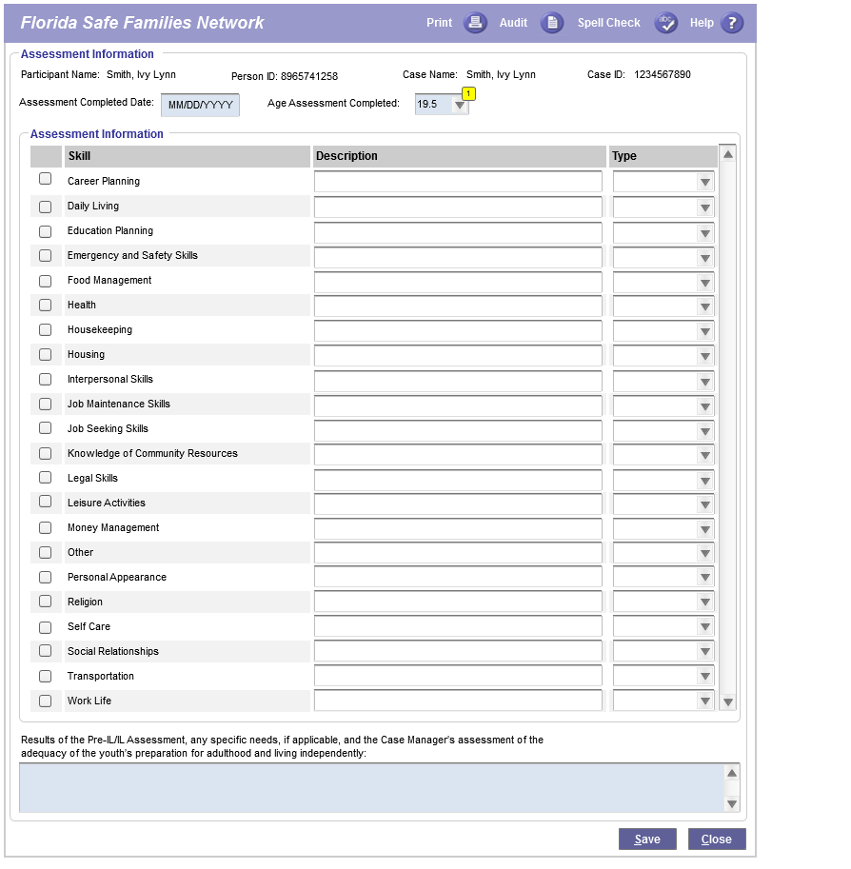
Living Skills Assessment Page

Slide 24
General Changes to IL Page (cont.)
Age 18-23 Tab
Contains two new group boxes:
Extended Foster Care (EFC) Program Eligibility Information
Postsecondary Education Services and Support (PESS) Program Eligibility Information
Both display a current “snapshot” and a historical overview of the eligibility and provision of EFC and/or PESS for young adults, including eligibility type and termination dates
EFC and PESS are covered in more detail in module 2

Slide 25
General Changes to IL Page (cont.)
Age 18-23 Tab (cont.)
Aftercare Support
No changes to the functionality
The group box was moved up on page
Appeal
The Appeals group box allows for the documentation of a second appeal to the district court and why

Slide 26
General Changes to IL Page (cont.)
Age 18-23 Tab (cont.)
RTI/TSS
Existing Road-To-Independence/Transitional Support Services group box allows for the tracking for old RTI/TSS program requirements as they are ‘grandfathered out’
Initial RTI cannot be entered after January 15, 2014. For the young adults receiving RTI as of December 31, 2013 RTI “renewals” or “change in subsidy” are permitted until September 30, 2018. After September 30, 2018, no inserts or edits are permitted.
Initial TSS cannot be entered after January 15, 2014. For the young adults receiving TSS as of December 31, 2013 TSS “change in subsidy” are permitted until April 1, 2014. After March 31, 2014, no inserts or edits are permitted.
As of January 15, 2014, status on existing RTI/TSS cannot be changed, the row can be terminated.

Slide 27
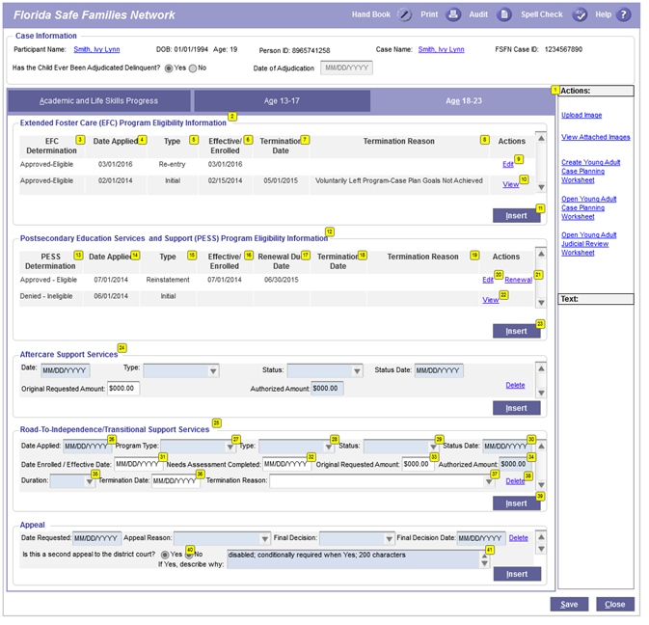
Independent Living Age 18-23 Tab

Slide 28
Independent Living FSFN System Demo

Slide 29
Points to Remember
Maintain Case
New role of “Legal Guardian of Young Adult”
Education
Added Transitional Individualized Education Plan (TIEP)
New fields: Number of Hours Currently Enrolled and Total Credits Earned To Date
New School Types: 2 year College and 4 year College or University
New Grade Level: Associate Degree
New Reason for Changes:18+: Young Adult Graduated and 18+: Young Adult No Longer Attending/Did Not Graduate

Slide 30
Points to Remember (cont.)
Meetings Types
Transition Planning-Initial
Transition Planning-Ongoing
Transition Planning-Closure
Medical/Mental Health
Added Diagnosed Condition Category: 18+ Other
Life Skill Assessment
additional ages:18, 18.5, 19, 19.5, 20, 20.5, 21, 21.5
Upload Image and View Attached Images hyperlinks on Independent Living Page

Slide 31
Points to Remember (cont.)
Appeals
Document second appeal to the district court and why
Grandfathering Road-To-Independence/ Transitional Support Services (January 1, 2014)
RTI “renewals” or “change in subsidy” are permitted until September 30, 2018.
TSS “change in subsidy” are permitted until April 1, 2014.

Slide 32
Reference Information
User Guides, How Do I Guides, and Topic Papers
Maintain Case
Education
Medical/Mental Health
Meetings
Independent Living
Young Adult Case Planning Worksheet
Visit the DCF FSFN Website:
http://fsfn.dcf.state.fl.us

Slide 33
Please go to …
www.centerforchildwelfare.org

