Slide 1











FSFN Independent Living (IL) Enhancements
Topic 2: Extended Foster Care (EFC) Program Eligibility and Postsecondary Education Services and Support (PESS) Program Eligibility
December 2013

Slide 2
Introduction
Topic 2: Extended Foster Care (EFC) Program Eligibility and Postsecondary Education Services and Support (PESS) Program Eligibility
  These changes support:
    Nancy C. Detert Common Sense and Compassion Independent Living Act; SB 1036- Enhancements to the Road to Independence (RTI) and Transitional Services programs
    New program eligibility determination for young adults exiting the foster care system into Extended Foster Care (EFC) and/or Postsecondary Education Services and Support (PESS) is now system determined

Slide 3
Extended Foster Care (EFC)
Program Eligibility
Age 18-23 tab contains a new group box for EFC
The group box display a current “snapshot” and a historical overview of the eligibility and provision of EFC for the young adult, including eligibility type and termination dates
Types:
  Initial (first time young adult applies)
  Redetermination (if previously denied ineligible)
  Re-entry (If previously terminated and re-entering the program)
  First created row can only be Initial type and there can only be one row with Initial type

Slide 4
Extended Foster Care (EFC)
Program Eligibility
EFC Determination:
  Pending (no determination, default)
  Pending – Eligible (eligible, not finalized)
  Pending – Ineligible (ineligible, not finalized)
  Approved – Eligible (eligible, finalized)
  Denied – Ineligible (ineligible, finalized)
  Approved (Override) – Eligible (denied – ineligible was overridden with supervisory override)
  On Appeal – (denied – ineligible is under appeal)

Slide 5
Extended Foster Care (EFC)
Program Eligibility
EFC Determination Eligibility:
  FSFN runs the EFC Eligibility Determination process and determination eligibility based on Effective/Enrolled Date and answers to questions
  Only enabled after questions are answered
Check to Finalized EFC Eligibility Determination
  When checked and page is saved, finalizes determination and freezes data.
  Enabled on or after Effective/Enrollment date.

Slide 6
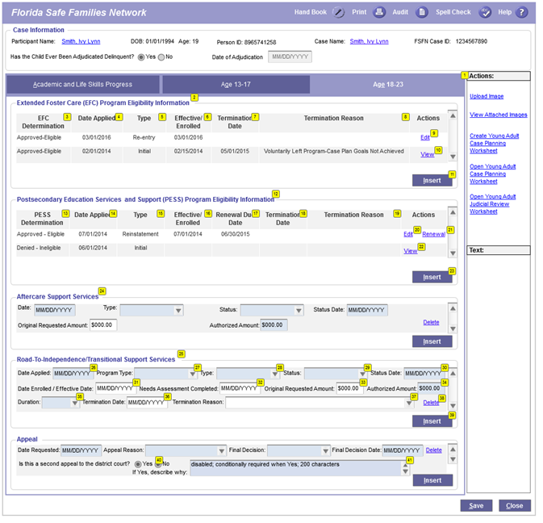
IL Page – Age 18-23 tab

Slide 7
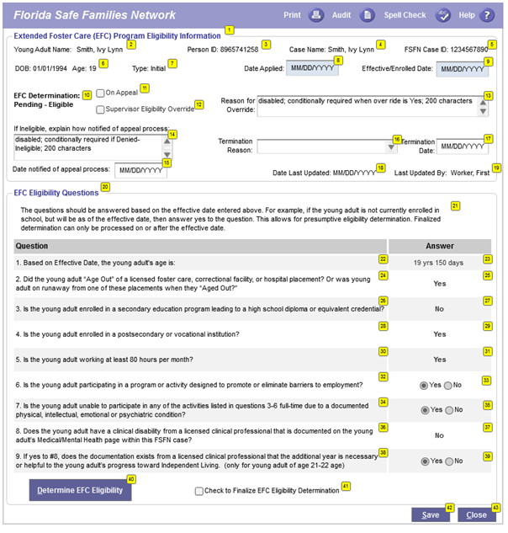
EFC Program Eligibility Pop Up Page

Slide 8

EFC FSFN System Demo

Slide 9
Extended Foster Care Program Eligibility (cont.)
On Appeal checkbox enabled if Denied-Ineligible
If ineligible, explain how notified of appeal process, allows you to explain how the young adult was notified of the appeal process
Date Notified of appeal process

Slide 10
Extended Foster Care Program Eligibility (cont.)
Supervisory Eligibility Override checkbox enabled if Denied-Ineligible; only supervisors security
Reason for Override; Narrative for reason why system-generated final determination of Denied – Ineligible was overridden by a supervisor

Slide 11
Postsecondary Education Services and Support (PESS) Program Eligibility
Age 18-23 tab contains a new group box for PESS
The group box display a current “snapshot” and a historical overview of the eligibility and provision of PESS for the young adult, including eligibility type and termination dates
Types:
  Initial (first time young adult applies)
  Redetermination (if previously denied ineligible)
  Re-entry (if previously terminated and re-entering the program)
  Renewal (redetermination of eligibility to continue program)
  First created row can only be Initial type and there can only be one row with Initial type

Slide 12
Postsecondary Education Services and Support (PESS) Program Eligibility (cont.)
PESS Determination:
  Pending (no determination, default)
  Pending – Eligible (eligible, not finalized)
  Pending – Ineligible (ineligible, not finalized)
  Approved – Eligible (eligible, finalized)
  Denied – Ineligible (ineligible, finalized)
  Approved (Override) – Eligible (denied – ineligible was overridden with supervisory override)
  On Appeal – (denied – ineligible is under appeal)

Slide 13
IL Page – Age 18-23 tab

Slide 14
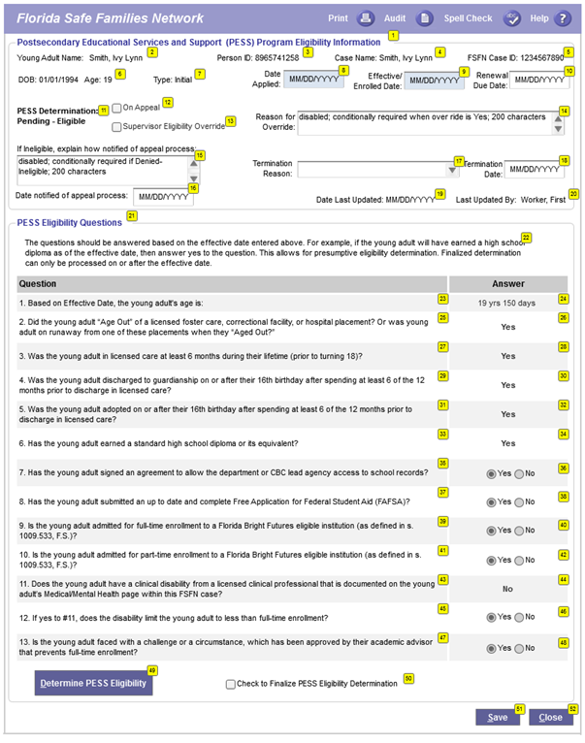
PESS Program Eligibility Pop Up Page

Slide 15
PESS FSFN System Demo

Slide 16
Postsecondary Education Services and Support (PESS) Program Eligibility (cont.)
PESS Renewal:
  From the PESS group box on the Age 18-23 tab, the Renewal hyperlink launches the PESS pop-up page with the termination reason defaulted to ‘Renewal’
  After saving the PESS pop-up page, a new PESS page launches with type of Renewal and Effective/Enrollment date is defaulted to the previous termination date plus one.
  For renewal, the system will not allow for a gap in service.

Slide 17
Points to Remember
Check to Finalize check box is enabled on or after Effective/Enrollment date.
PESS Renewal hyperlink opens the existing PESS page with renewal as the termination reason. When page is saved, the next renewal page is open without a gap in service.
Only supervisors can override a Denied-Ineligibile determination.

Slide 18
Reference Information
User Guides, How Do I Guides, and Topic Papers
  Maintain Case
  Education
  Medical/Mental Health
  Meetings
  Independent Living
  Young Adult Case Planning Worksheet
Visit the DCF FSFN Website:
http://fsfn.dcf.state.fl.us

Slide 19

Please go to …
  www.centerforchildwelfare.org

