Slide 1

Changes to FSFN to Support Extended Foster Care
and
Post-secondary Education Services and Support
October 16, 2013

Slide 2
Overview
Changes to the Independent Living Main Page
Determining Eligibility for Extended Foster Care
Determining Eligibility for Post-secondary Education Services and Support
Extended Foster Care Case Plan Worksheet
Extended Foster Care Judicial Review Worksheet
If we have time
Changes to FSFN Support Pages (Education, Medical Mental Health
Review of Extended Foster Care Case Plan Template
Review of Extended Foster Care Judicial Review Template

Slide 3
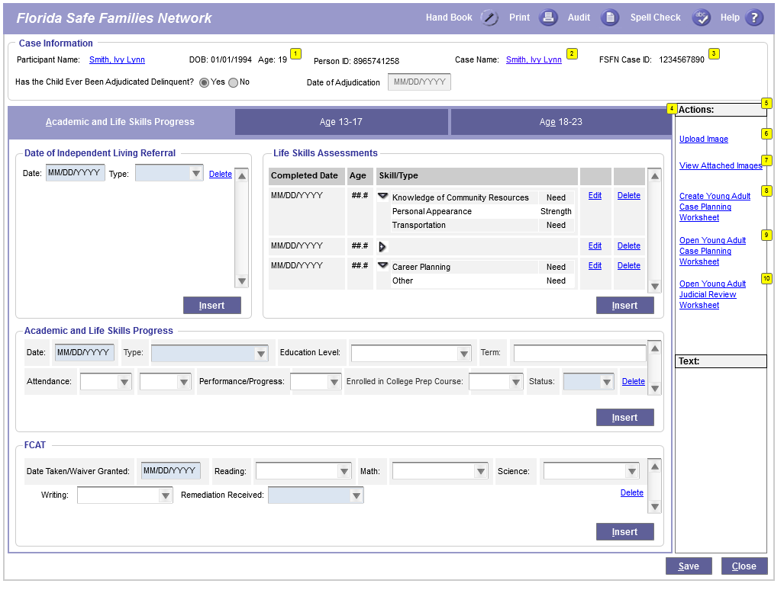
Independent Living Page- General Changes

Slide 4
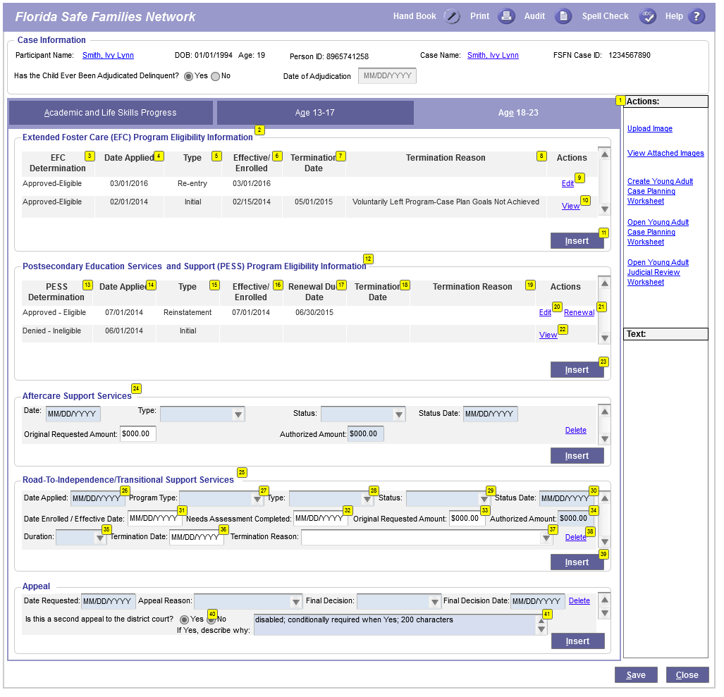
Eligibility Information Page
18 – 23 Tab

Slide 5
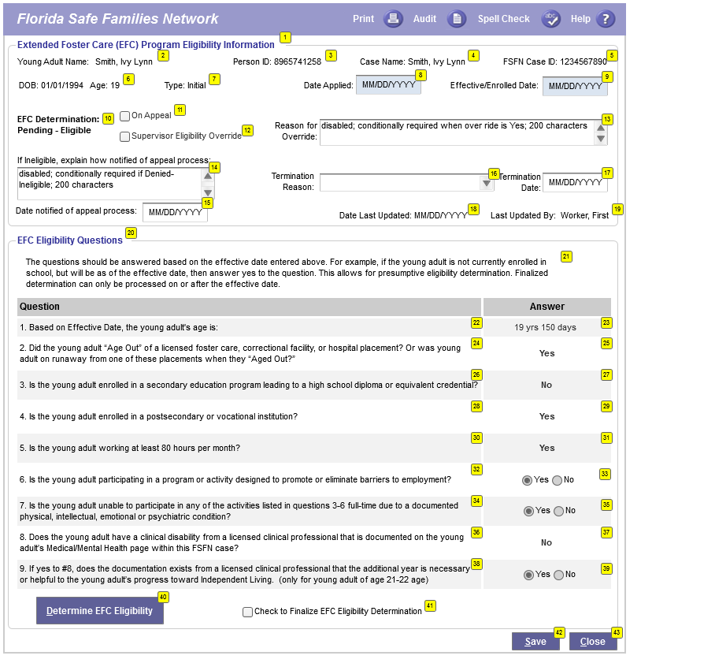
Extended Foster Care Eligibility Pop-Up
System Generated Responses

Slide 6
Extended Foster Care Eligibility Logic

Slide 7
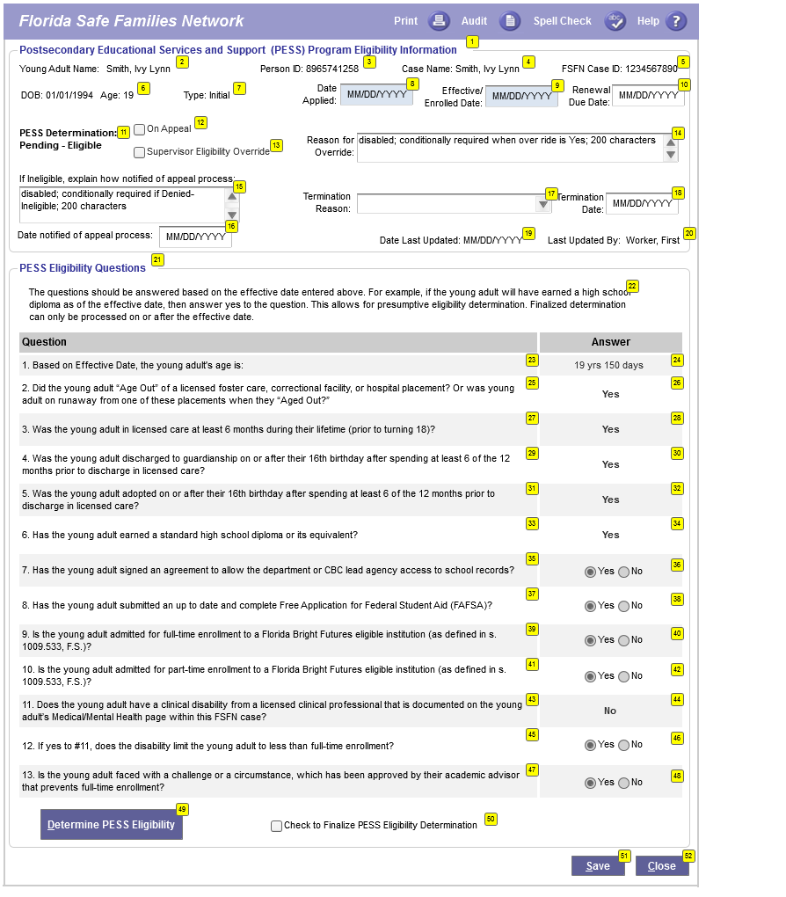
Post-secondary Education Services and Support
Eligibility Pop-Up
System Generated Responses

Slide 8
Post-secondary Education Services and Support
Eligibility Logic

Slide 9
Extended Foster Care
Case Plan Worksheet Page
Access from the “Actions and Text” box on the IL page
Allows for the Creation of a Case Plan for a Young Adult
Many fields pre-fill from other areas of FSFN
Allows for the Creation of a Judicial Review Worksheet

Slide 10
Accessing the EFC Case Plan Worksheet Page
Click Here on the IL Page

Slide 11
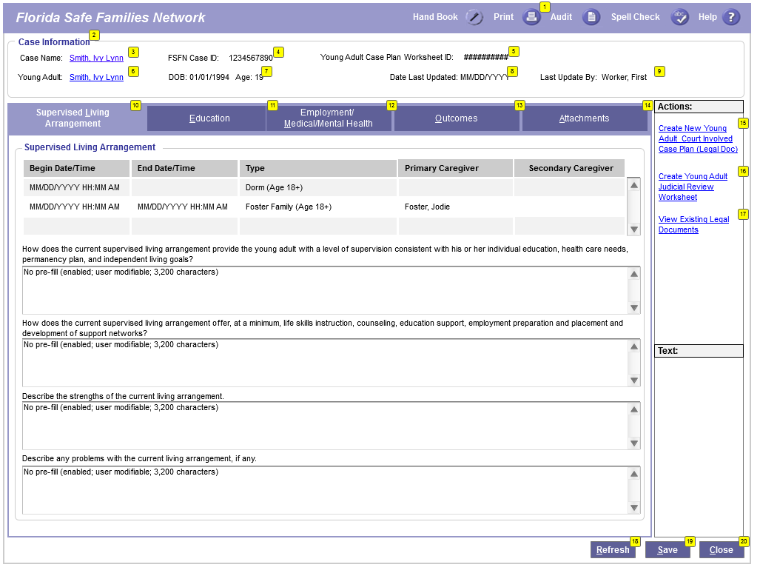
EFC Case Planning Worksheet Page

Slide 12
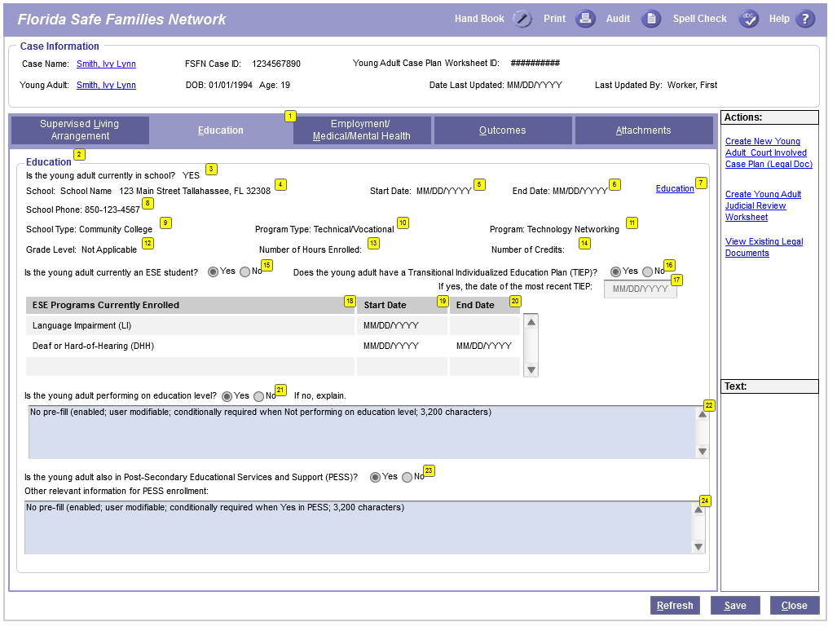
EFC Case Planning Worksheet Page (cont’d)

Slide 13
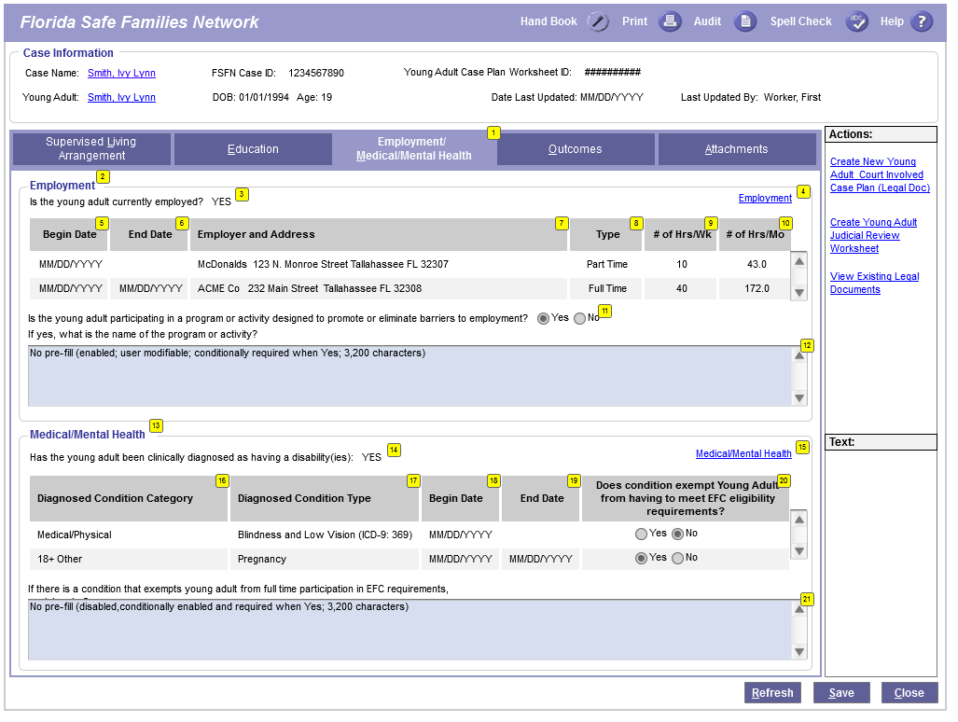
EFC Case Planning Worksheet Page (cont’d)

Slide 14
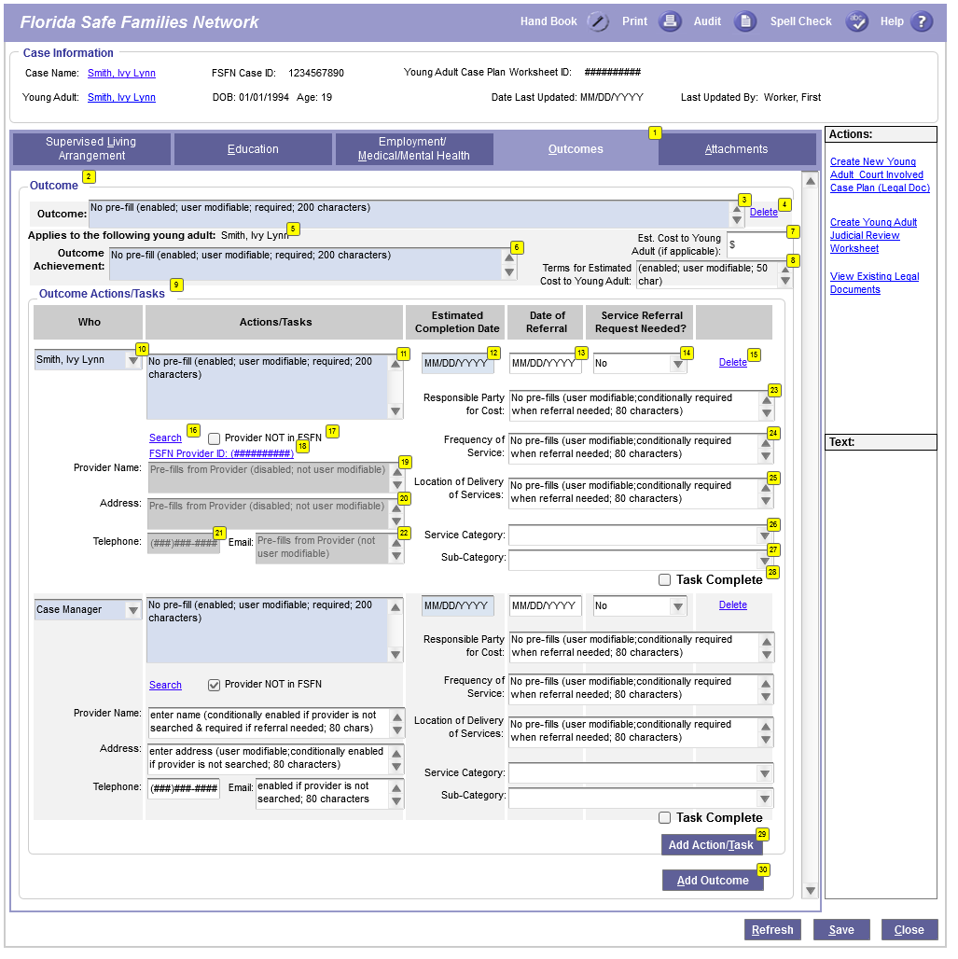
EFC Case Planning Worksheet Page (cont’d)

Slide 15
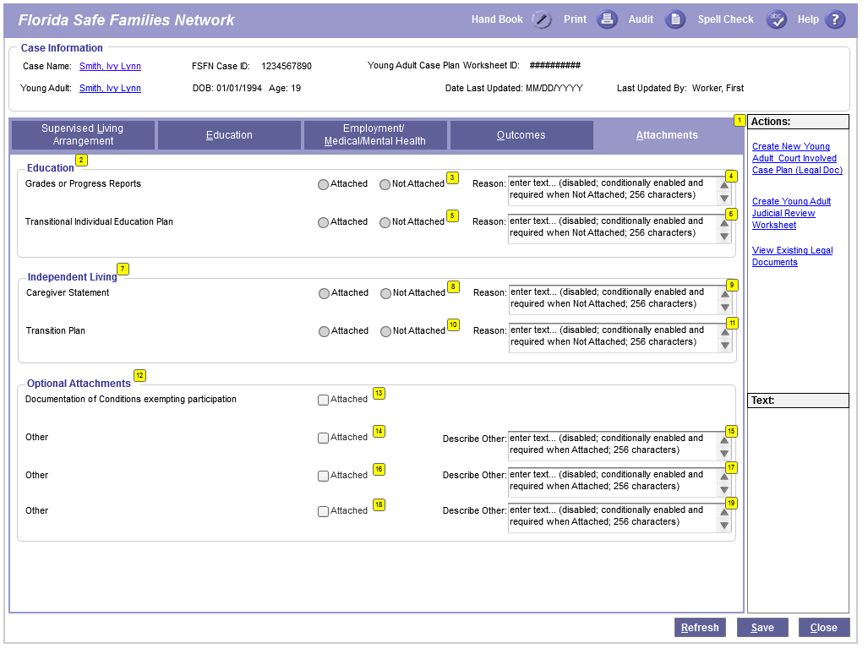
EFC Case Planning Worksheet Page (cont’d)

Slide 16
EFC Judicial Review Worksheet Page
Access from the Case Plan Worksheet Page
Allows for the creation of a Judicial Review for a Young Adult
Most of the fields pre-fill from FSFN or the Case Plan Worksheet

Slide 17
Accessing the EFC Judicial Review Worksheet Page
Click Here on the Case Plan Worksheet

Slide 18
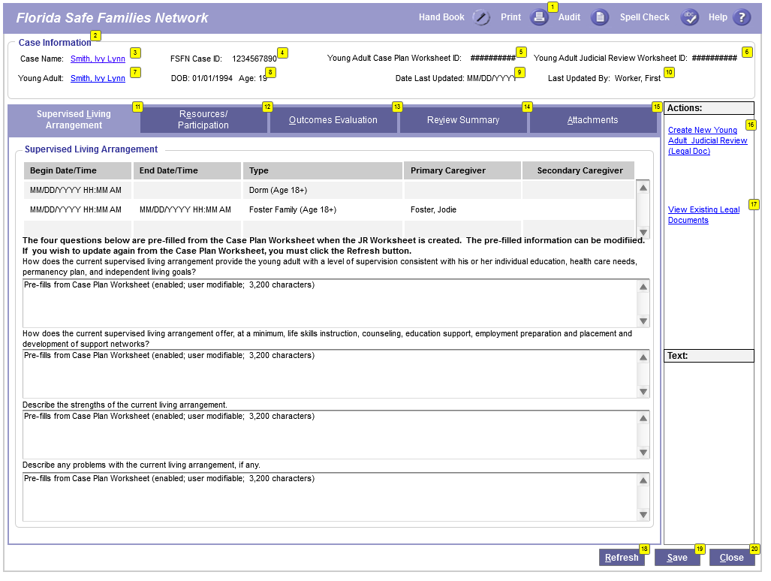
EFC Judicial Review Worksheet Page

Slide 19
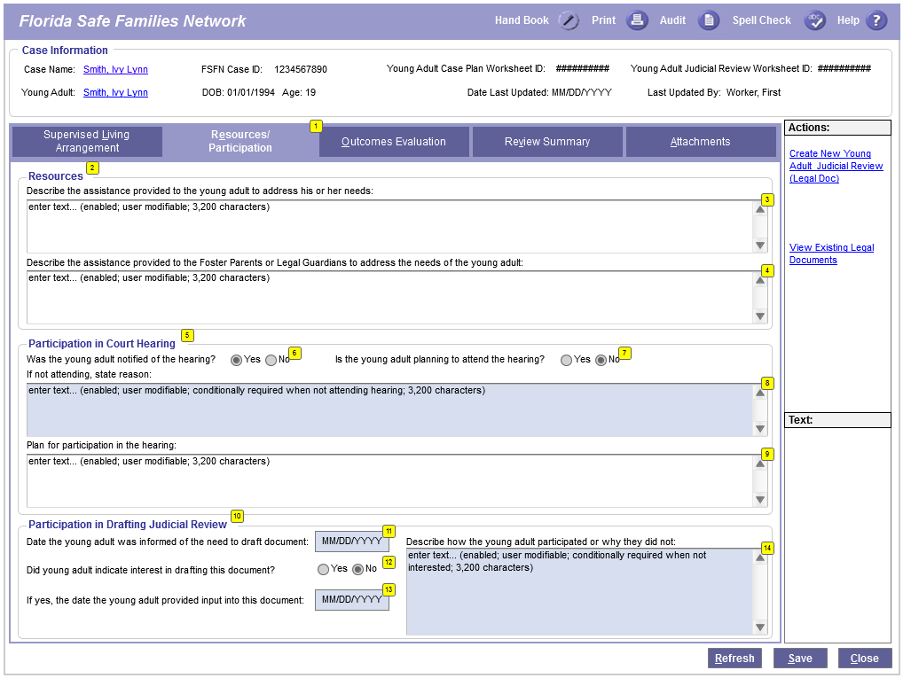
EFC Judicial Review Worksheet Page (cont’d)

Slide 20
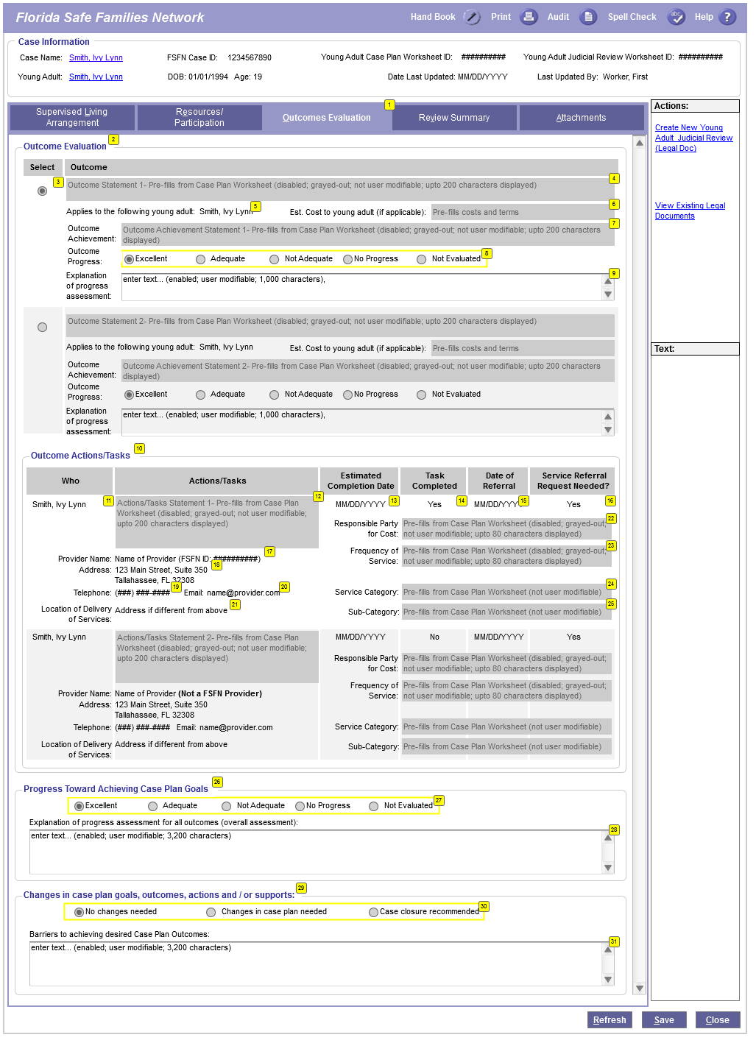
EFC Judicial Review Worksheet Page (cont’d)

Slide 21
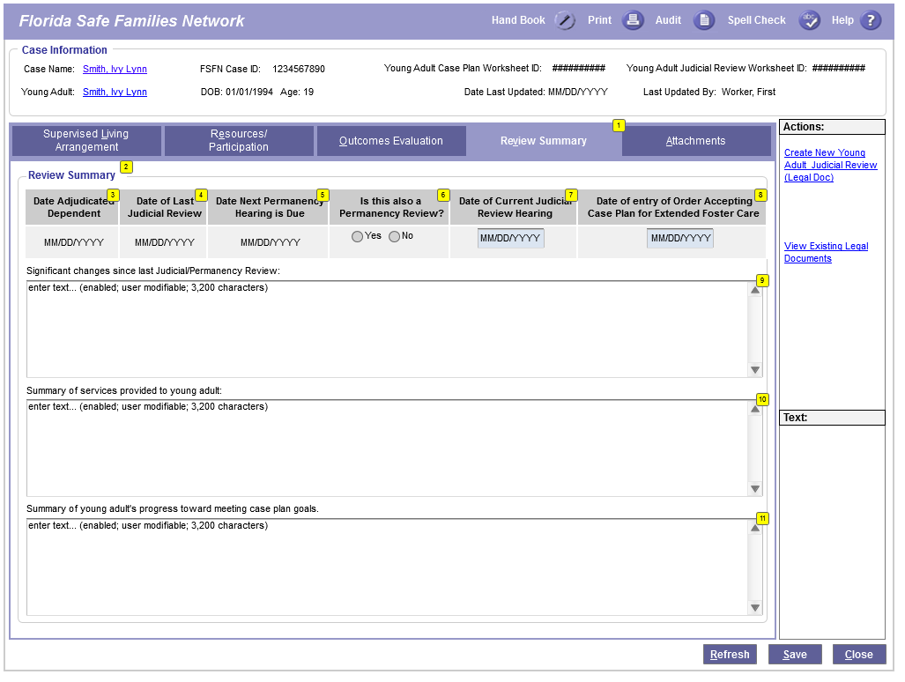
EFC Judicial Review Worksheet Page (cont’d)

Slide 22
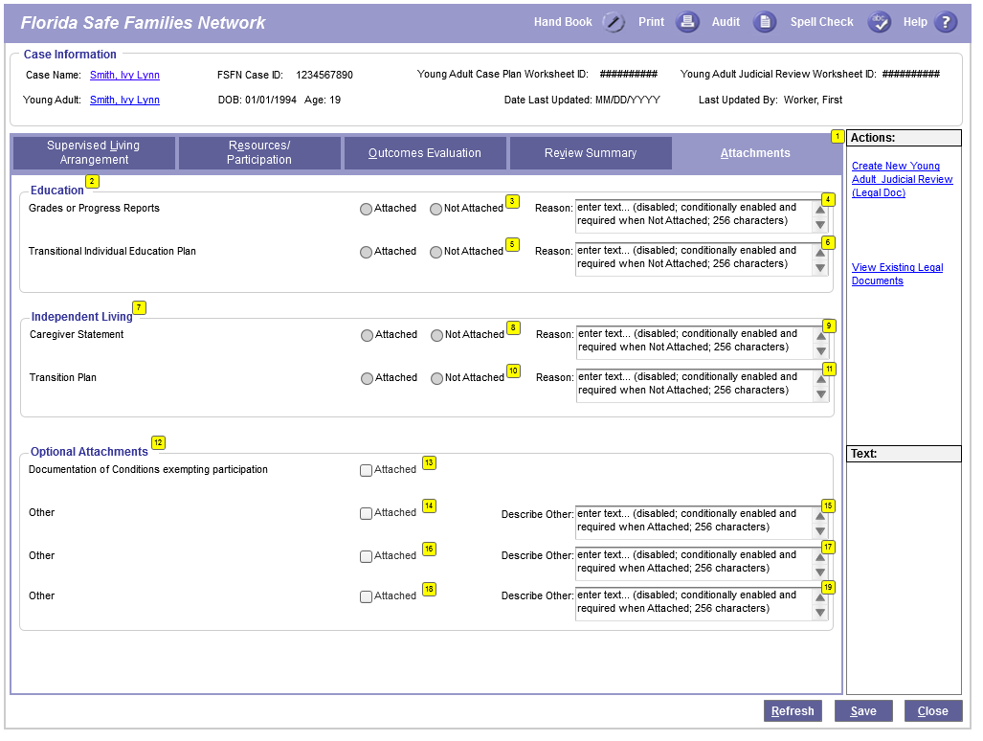
EFC Judicial Review Worksheet Page (cont’d)

Slide 23
Changes to Supporting Pages

Slide 24
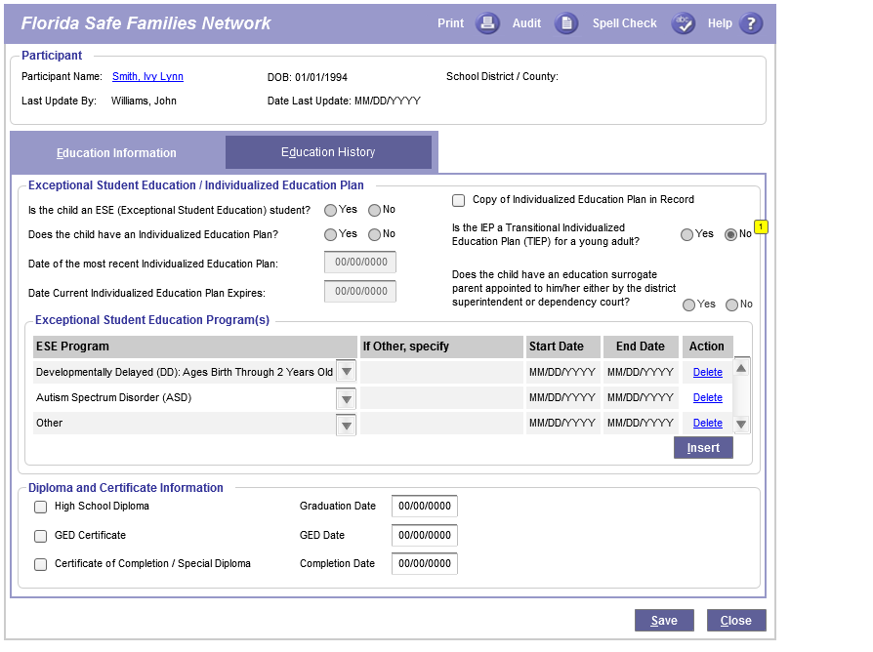
EFC/PESS FSFN Supporting Page Changes
Education

Slide 25
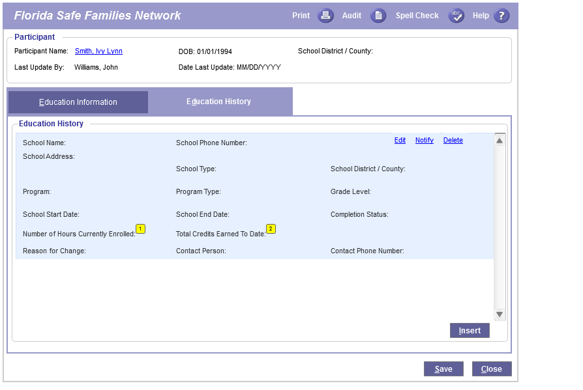
EFC/PESS FSFN Supporting Page Changes
Education (cont’d)

Slide 26
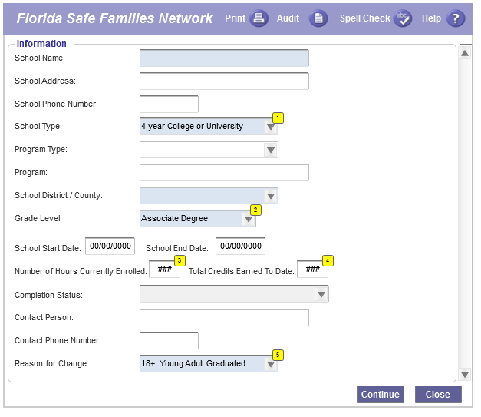
EFC/PESS FSFN Supporting Page Changes
Education (cont’d)

Slide 27
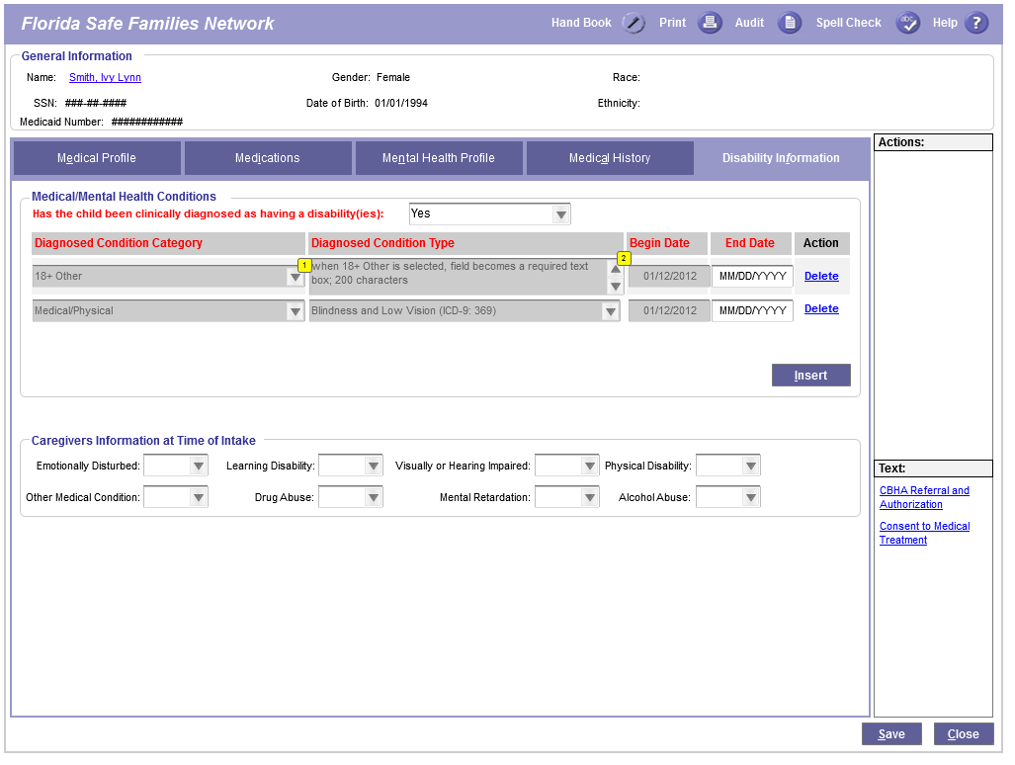
EFC/PESS FSFN Supporting Page Changes
Medical/Mental Health

